Slide 1
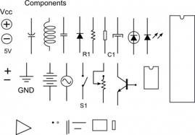
Electronic Components
The parts that make the things work
Chapter 4.1
ARRL General Class License Manual
Section
G5B
G5C

Slide 2
The Big Four
Resistor
Capacitors
Inductors
Semi-conductors

Slide 3
DC Power
Rules:
Current is the flow of electrons through a conductor.
Electrons flow from negative to positive.
DC current flows in one direction.
Voltage E forces current I to flow through resistance R
Current flowing through R causes power P to be dissipated.

Slide 4
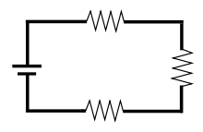
Series resistor circuit

Slide 5
R1 = 12 Ω
12 V
R2 =6 Ω
I
R3 = 6 Ω
Rules, Series resistive circuits
Total resistance = Sum of all resistances R_{T} = R1 + R2 +R3
The current in a series circuit is the same throughout the circuit. I = E / R_{T}
The sum of the voltage drops throughout the circuit = the supplied voltage.

Slide 6
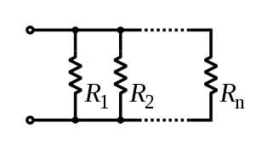
Parallel resistor circuit
I_{R1}
I_{R2}
I_{T}
I R_{n}
Rules for parallel resistive circuit
Total resistance in the circuit (for two resistors) R1 x R2
R1 + R2
Total resistance in the circuit (for multiple resistors) _________1_______________
1/R1 + 1/R2 + 1/R3 …..
The sum of the current of each branch of the circuit = total current
Total resistance in a Parallel circuit is always less than any individual resistor

Slide 7
Parallel resistor circuit
Test Secret…. When a multiple of resistors in a parallel circuit are the same value
Divide the value by the number of resistors for R_{T}
I_{R1}
I_{R2}
I_{T}
200 Ω
I R_{n}
200 Ω
R1 x R2
R1 + R2
R_{T} =
100 Ω
G5B02
_________1_______________
1/R1 + 1/R2 + 1/R3 …..
Total Current equals the sum of the currents through each branch

Slide 8
Example
G5C04
Use the test secret. 100 / 3
100 Ω
100 Ω
R_{T} =
33.3Ω
100 Ω
R1 x R2
R1 + R2
_________1_______________
1/R1 +1/R2 + 1/R3

Slide 9
Example
G5C15
A. 5.9 ohms
B. 0.17 ohms
C. 10000 ohms
D. 80 ohms
Total value of parallel resistors must be less than lowest resistor value.
10 Ω
50 Ω
R_{T} =
5.9 ohms
20 Ω
R1 x R2
R1 + R2
_________1_______________
1/R1 +1/R2 + 1/R3

Slide 10
Example
G5C05
450 / 3
R1 = R2 = R3
R1
R2
R3
? Ω
? Ω
? Ω
And
R1 + R2 + R3 = 450 Ω
What is the value of R1, R2, R3
150 Ω

Slide 11
Example
G5C03
What would I add to the resistor to increase the value?

Slide 12
Picture This
Capacitors in parallel, add the values.
the plate surface area get larger
Capacitance increases
Capacitors in series, value decreases.
The space between plates becomes greater
For the purposes of the math,
They don’t look like resistors
Calculate them opposite of resistors

Slide 13
Picture This
Inductors in parallel decrease inductance
G5C14
Inductors in series, add the values
For the purposes of the math,
They look somewhat like resistors
Calculate them like resistors

Slide 14
Example
G5C11
What is the inductance of a 20 millihenry inductor in series with a 50 millihenry inductor?
= 70 mH
G5C10
What is the inductance of three 10 millihenry inductors connected in parallel?
Use test secret
= 3.3 mH

Slide 15
Example
A. 0.07 microfarads
B. 14.3 microfarads
C. 70 microfarads
D. 1000 microfarads
G5C12
What is the capacitance of a 20 microfarad capacitor in series with a 50 microfarad capacitor?
= 14.29 μF
G5C09
What is the capacitance of three 100 microfarad capacitors connected in series?
Use the test secret
= 33.3 μF

Slide 16
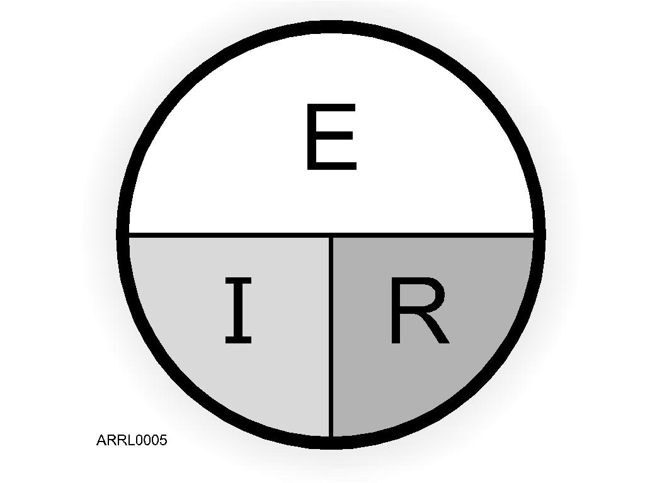
Ohm’s Law
E is voltage
Units - volts
I is current
Units - amperes
R is resistance
Units - ohms
R = E/I
I = E/R
E = I x R
Examples:
Notes:
Go over the simple Ohm’s Law math and provide a few examples of how to solve problems. Give some homework problems that are the same as test questions (without telling them that they are test questions). Have the students solve these problems so they are confident that they can do the math.

Slide 17
Power Formula
Power is defined as the amount of current that is being pushed through a conductor or device to do work. Devices are often reffered to as the load.
P = I x E
E = P/I
I = P/E
P
I
E
Notes:
Go through some simple problems using the power formula. Again use test question examples for homework.

Slide 18
Substitute
P
E
I
IR
E/R
E
I
R
P = I² R
P = E²/R
P = E²/R
Test secret… All power formulas questions use

Slide 19
AC Power
Rules
Current alternately flows in both direction.
The RMS value of AC voltage dissipates the same power in a resistive circuit as the equivalent DC voltage.
RMS value is always used for calculations
G5B07

Slide 20
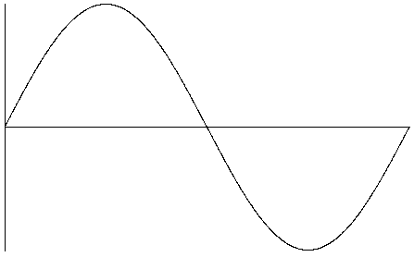
AC Sine Wave
Peak value
RMS Value
= .707 x Peak
Peak value
Peak to Peak value / 2 = peak
1.414 x RMS = Peak

Slide 21
RMS Vs. Peak
Fun with math
√2 = 1.414 1/1.414 = .707
The two numbers to remember when working with AC
Peak X .707 = RMS
RMS X 1.414 = Peak
Gotta be less but not excessive
Always work with RMS
G5B09
What is the RMS voltage of a sine wave with a value of 17 volts peak?
A. 8.5 volts
B. 12 volts
C. 24 volts
D. 34 volts
2 over 1 under rule

Slide 22
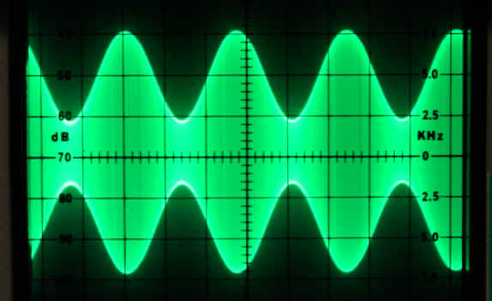
Power and RF wave forms
Average AC power.
Need to know RMS Voltage and Load
Power = E²/R
AC power = E_{RMS}²/R_{Load}
G5B14 (B)
What is the output PEP from a transmitter if an oscilloscope measures 500 volts peak-to-peak across a 50 ohm resistive load connected to the transmitter output?
A. 8.75 watts
B. 625 watts
C. 2500 watts
D. 5000 watts
PEP ( Peak Envelope Power) is the average power of one complete RF cycle measured at the peak of the signals envelope.
Look at G5B14
2 over 1 under rule

Slide 23
Examples
G5B12
Remember
Power = E²/R
What would be the RMS voltage across a 50-ohm dummy load dissipating 1200 watts?
AC power = E_{RMS}²/R_{Load}
1200 W = E_{RMS}²/ 50
1200 x 50 = E_{RMS}²
A. 173 volts
B. 245 volts
C. 346 volts
D. 692 volts
60,000 = E_{RMS}²
2 over 1 under rule
= 244.9 V

Slide 24
G5B06
What is the output PEP from a transmitter if an oscilloscope measures 200 volts peak-to-peak across a 50-ohm dummy load connected to the transmitter output?
200 v p-p
50 0hm load
AC power = E_{RMS}²/R_{Load}
Power = E²/R
PEP ( Peak Envelope Power) is the average power of one complete RF cycle measured at the peak of the signals envelope.
A. 1.4 watts
B. 100 watts
C. 353.5 watts
D. 400 watts
PEP = (.707 x 100) ² /R
Look at G5B13 and G5B11
PEP = 70.7² /50
Just think about your everyday 100 watt transceiver
PEP = 99.6 watts
2 over 1 under rule

Slide 25
G5B14 (B)
What is the output PEP from a transmitter if an oscilloscope measures 500 volts peak-to-peak across a 50 ohm resistive load connected to the transmitter output?
A. 8.75 watts
B. 625 watts
C. 2500 watts
D. 5000 watts
Remember 200 volts P – P was our typical 100 watt transmitter
A. 8.75 watts
B. 625 watts
C. 2500 watts
D. 5000 watts
2 over 1 under rule

Slide 26
What is the peak voltage of our 120 VAC line voltage?
Peak value
RMS Value
= .707 x Peak
169.7 volts
Peak value
What is the peak to peak voltage of our 120 VAC line voltage?
G5B08
339.36 volts

Slide 27
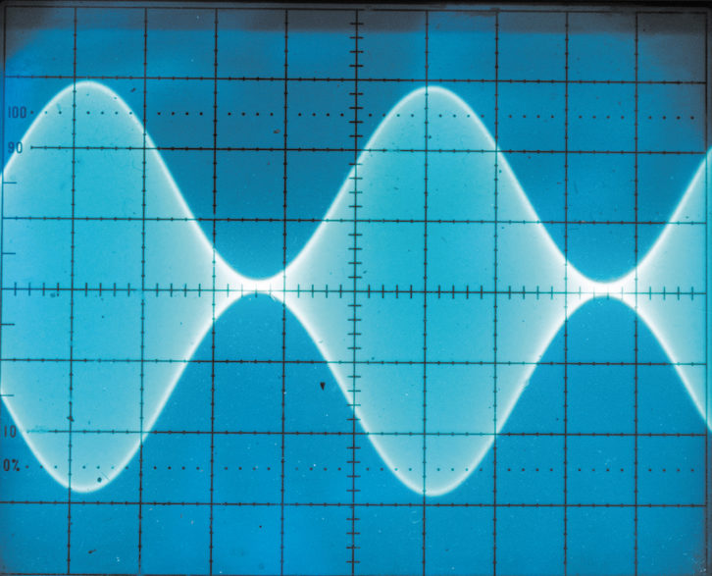
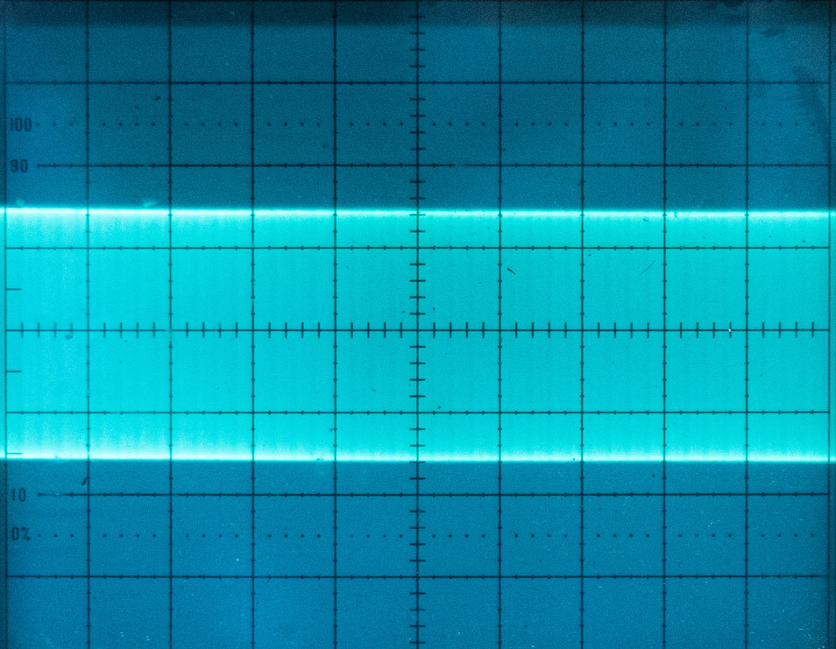
G5B11 (B)
What is the ratio of peak envelope power to average power for an unmodulated carrier?
A. 0.707
B. 1.00
C. 1.414
D. 2.00
Modulated
Un-modulated
G5B13 (B)
What is the output PEP of an unmodulated carrier if an average reading wattmeter connected to the transmitter output indicates 1060 watts?
A. 530 watts
B. 1060 watts
C. 1500 watts
D. 2120 watts

Slide 28
Deci - Bel
G5B10
What percentage of power loss would result from a transmission line loss of 1 dB?
20.6 %
Memorize
What dB change represents a factor of two increase or decrease in power?
G5B01
3 db
Remember any double increase or decrease in power is a 3db change

Slide 29
For Next Week
Study flash cards www.hamexam.org
Radio
Fundamentals
ARRL Ch. 1, 2, 3, 6
Electricity
ARRL Ch. 4
Antennas
ARRL Ch. 7
Equipment
ARRL Ch. 5
Digital
ARRL Ch. 6
Safety
Ch. 9
Resistors
Capacitors
AC Power
Semi-
conductors
Lesson 1
G1A
G1C
G2A
G2B
G2C
G2D
G4A part
G4D part
Lesson 2
G1B
G1D
G2A
G2E
G8C
Lesson 3
G5B
G5C
Lesson 5
G4B
G4E
G6A
G6B
G7A
G7B
Lesson 6
G4E
G9A
G9B
G9C
G9D
Lesson 8/9
G4A
G4B
G4C
G4D
G7B
G7C
G8A
G8B
Lesson 10
G1E
G2E
G8A
G8B
G8C
Lesson 11
G0A
G0B
The Reactive
components
Lesson 4
G5A
G5B
G6A
G6B
Propagation
ARRL Ch. 8
Lesson 7
G3A
G3B
G3C
73
Tom and Jack

