Slide 1
Capacitors and Inductors,
The reactive components
G5A
G5C
G6A
G6B

Slide 2
The Reactance Party
The components that are in opposition to AC
Inductors
Oppose the change of Current
Capacitors
Oppose the change of voltage
Blocks Non-changing DC
This opposition, or reactance is measured in Ohms
Inpedance
The combination of inductance and capacitance and resistance
That opposes the flow of alternating current

Slide 3
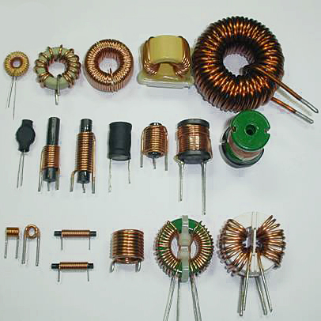
Inductors
The wiry thingies

Slide 4
Resistance
The opposition of flow to electric current
Measured in Ohms Ω

Slide 5
Reactance
G5A02
G5A03
G5A04
G5A05
G5A06
The opposition to flow of AC caused by capacitance or inductance.
Frequency dependant
Symbol X, measured in ohms. G5A09
X_{L} = 2πFL
X_{C} = 1 / (2πFC)
G5A05
G5A06

Slide 6
Impedance
G5A01
G5A07 (D)
What happens when the impedance of an electrical load is equal to the output impedance of a power source, assuming both impedances are resistive?
A. The source delivers minimum power to the load
B. The electrical load is shorted
C. No current can flow through the circuit
D. The source can deliver maximum power to the load
The opposition to the flow of current in an AC circuit
Symbolized by Z Measured in Ohms.
Produced by the combination of all circuit components
G5A08 (B)
What is one reason to use an impedance matching transformer?
A. To minimize transmitter power output
B. To maximize the transfer of power
C. To reduce power supply ripple
D. To minimize radiation resistance
When
Impedance _{in}
=
Impedance _{out}
Max energy transfer
G5A07 G5A08

Slide 7
Inductance
A coil of wire
Can just be a straight piece of wire
Can be wrapped on a core
Stores energy in a magnetic field
Opposes the change in current
As frequency increases, inductive reactance increases
Symbol L
Measured in Henrys H
Rules:
X_{L} = 2πFL

Slide 8
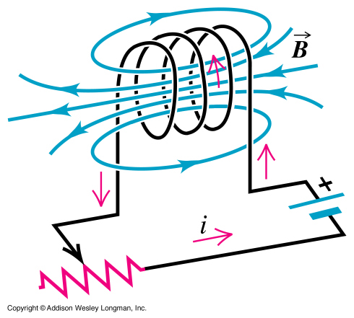
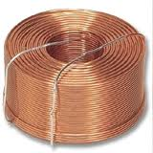

Slide 9
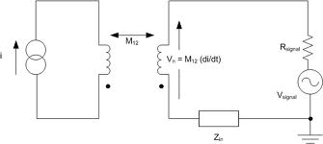
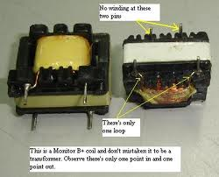
Inductive coupling
G5C01 (C)
What causes a voltage to appear across the secondary winding of a transformer when an AC voltage source is connected across its primary winding?
A. Capacitive coupling
B. Displacement current coupling
C. Mutual inductance
D. Mutual capacitance
Maximum coupling occurs when the cores are parallel or in line
Mutual Inductance: Transfer of energy to another inductor
G5C01
Cores at right angles to each other minimize coupling.

Slide 10
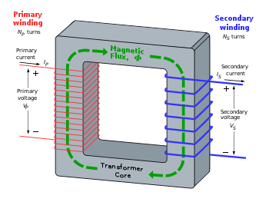
Transformers
Rules:
Two windings on a common core
Transfers AC power from the primary winding to the secondary winding through mutual inductance. G5C01
The voltage ratio between the primary and the secondary windings is the ratio of the number of turns of the windings.

Slide 11
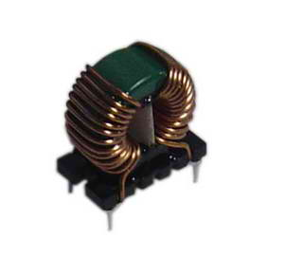
Toroid Core inductors
Advantages
Large values of inductance
The core contains most of the magnetic field
Magnetic materials of the core can be optimized.
G5A08
All of the above
G6B01 (C)
What determines the performance of a ferrite core at different frequencies?
The composition, or “mix,” of materials used

Slide 12
Capacitors
Rules:
Store energy in an electric field.
Oppose the change in voltage
As frequency increases, capacitive reactance decreases
Symbol C
Measured in Farads F
X_{C} = 1 / (2πFC)

Slide 13
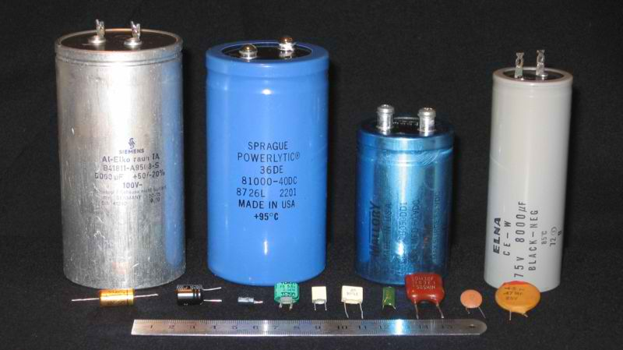
Capacitors
Electrolytic capacitors can be high capacitance in a relative small package G6A04
Use proper polarity on a polarized capacitor
Otherwise: Can short circuit, can destroy dielectric, may overheat and explode. G6A13
Ceramic capacitors are popular because of low cost. G6A14

Slide 14
Resonance
The state in which
Inductive reactance = Capacitive reactance
X_{C} = X_{L}
Both the inductive reactance and the capacitive have an equal effect on the AC
The circuit simulates pure resistance

Slide 15
Impedance Transformation
Impedance
The ratio of Voltage and Current in an AC circuit
In an AC circuit Z = E/I
In a DC circuit R = E/I
Impedance matching,
Maximize the transfer of power from the source to the load G5A07 G5A08

Slide 16
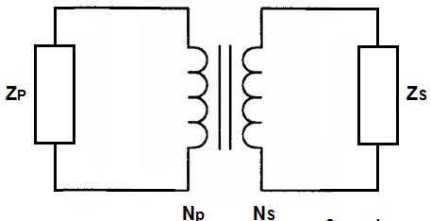
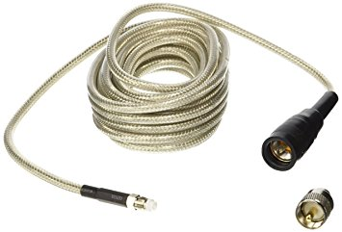
Matching Networks
WHAT ELSE CAN WE USE TO MATCH IMPEDANCE?
PI network
Impedance matching transformer
G5A10, G5A11
Methods for impedance matching between two AC circuits
Insert a LC matching circuit
A matching transformer
A length of transmission line

Slide 17
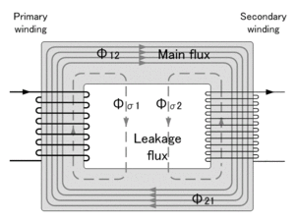
G5C06
What is the RMS voltage across a 500-turn secondary winding in a transformer if the 2250-turn primary is connected to 120 VAC?
A. 2370 volts
B. 540 volts
C. 26.7 volts
D. 5.9 volts
(C)
120 VAC
Output voltage = ?
2200 t
500 t
2250-turn
500-turns
= 4.5 : 1
120 /4.5 = 26.66

Slide 18
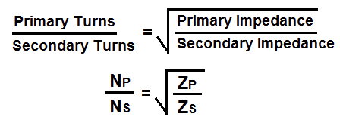
Impedance Ratio
G5C07
G5C07 (A) What is the turns ratio of a transformer used to match an audio amplifier
having 600 ohm output impedance to a speaker having 4 ohm impedance?
12.2 to 1
24.4 to 1
150 to 1
300 to 1
Impedance ratio = 600 / 4
= 150:1
(Turns ratio is the square root of the impedance ratio)
√
150 = 12.24:1

Slide 19
Ohm’s Law challenges

Slide 20
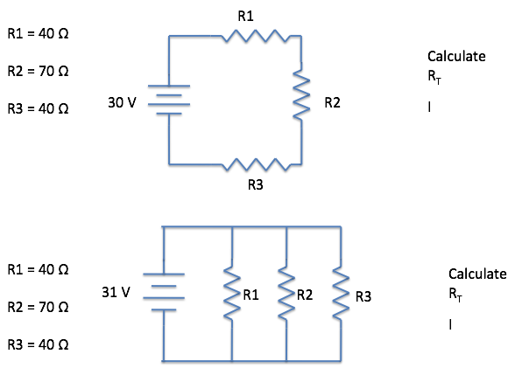

Slide 21
R1
R1 = 40 Ω
R2 = 70 Ω
R3 = 40 Ω
R4 = 70 Ω
Calculate
R_{T}
I
30 V
R2
R4
R3
R3
R1 = 40 Ω
R2 = 70 Ω
R3 = 40 Ω
Calculate
R_{T}
I
31 V
R1
R2
Hint: work parallel first

Slide 22
R1 50 Ω
Supply Voltage
E_{R2} = 50 V
I = 2 A
R3 = 100 Ω
Calculate
Supply Voltage
Calculate R2
E_{R1} = 100v
E_{R3} = 200v
E_{R2} = 50 V
Therefore, E_{sv} = 350 V
R2 = 25Ω
Therefore R_{T} = 175 Ω
And I x R = 350 v

Slide 23
R1 = 10Ω
E = 60 V
R2 = 20Ω
C1 = 100 μF
R3 = 30Ω
Trick question for the day
Calculate current I

Slide 24
For Next Week
Study flash cards www.hamexam.org
Radio
Fundamentals
ARRL Ch. 1, 2, 3, 6
Electricity
ARRL Ch. 4
Antennas
ARRL Ch. 7
Equipment
ARRL Ch. 5
Digital
ARRL Ch. 6
Safety
Ch. 9
Resistors
Capacitors
AC Power
Semi-
conductors
Lesson 1
G1A
G1C
G2A
G2B
G2C
G2D
G4A part
G4D part
Lesson 2
G1B
G1D
G2A
G2E
G8C
Lesson 3
G5B
G5C
Lesson 5
G4B
G4E
G6A
G6B
G7A
G7B
Lesson 6
G4E
G9A
G9B
G9C
G9D
Lesson 8/9
G4A
G4B
G4C
G4D
G7B
G7C
G8A
G8B
Lesson 10
G1E
G2E
G8A
G8B
G8C
Lesson 11
G0A
G0B
The Reactive
components
Lesson 4
G5A
G5B
G6A
G6B
Propagation
ARRL Ch. 8
Lesson 7
G3A
G3B
G3C
73
Tom and Jack

