Slide 1
Week 4
Radio Signals and Equipment
Sections:
G4A
G4B
G4C
G4E
G4D
G7B
G7C
G8A
G8B
ARRL
Chapter 5
Gordon West
Your HF Transmitter
Your Receiver
Oscillators and Components

Slide 2
Modulation Modes
AM
FM
PM

Slide 3
Frequency Shift Keying
FSK. Frequency shift Keying. G8A01
Can be identified as Mark and Space G8C11
AFSK Audio Frequency shift keying
Usually LSB for RTTY. G2E01
If RF is being picked up by an audio cable carrying AFSK data signals between a computer and a transceiver. G4A15
A. The VOX circuit does not un-key the transmitter
B. The transmitter signal is distorted
C. Frequent connection timeouts
AOTA

Slide 4
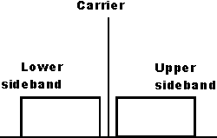
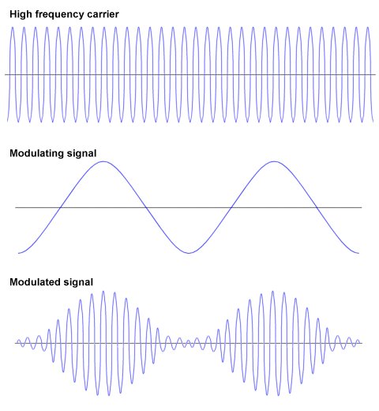
Amplitude Modulation AM
Modulation envelope of an AM signal?
The waveform created by connecting the peak values of the modulated signal
G8A11
G8A05 Varies the instantaneous power level of the RF signal

Slide 5
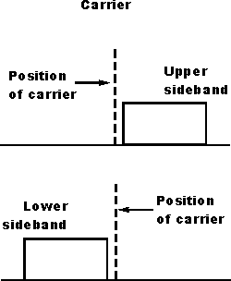
Single Side Band SSB
Most commonly used voice mode on the HF amateur bands. G2A05
SSB is the narrowest phone emissions bandwidth. G8A07
Only one sideband is transmitted; the other sideband and carrier are suppressed G2A07
Advantage; Less bandwidth used and greater power efficiency
G2A06

Slide 6
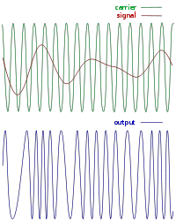
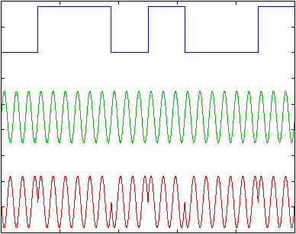
Angle Modulated Modes: FM, PM
G8A03 Frequency Modulation ( FM)
is the process which changes the instantaneous frequency of an RF wave?
G8A02 Phase Modulation (PM) is the process that changes the phase angle of an RF wave to convey information?
PM is produced by a reactance modulator connected to a transmitter RF amplifier stage G8A04

Slide 7
Our Basic Building Blocks
Combines two signals
Heterodyning G8B03
Mixer
Oscillator
Produces a steady signal at a single frequency
Converts modulated RF
directly into data or voice
Detector
Increases frequency by a whole number multiple
G8B04
Multiplier
Product
Detector
Detects CW & SSB
Removes or blocks unwanted signals
Filters
Puts information on the RF signal
Frequency
Discriminator
Removes information from FM signals
Modulator
Amplifier
Demodulator
Removes information from modulated RF
Increases the amplitude of a signal

Slide 8
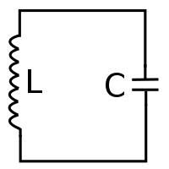
Oscillator
Oscillator
Amplifier
Output
LC Oscillator, The LC value of the tank circuit determines the frequency. G7B09
Feedback circuit
with a filter
G7B07

Slide 9
Mixer
The sum and the difference of the LO and input RF freq. will be found at the output of the mixer. G8B11
Mixer
Mixer
f₁
f₁ + f₂
Mixing also known as heterodyning G8B03
f₂
G8B01 Local oscillator
is varied or tuned to convert signals of different frequencies to an intermediate frequency (IF)?
LO
Oscillator

Slide 10
Multiplier
Multiplier
Input f₁
Output f₂
N = 2, 3, 4, ….
G8B04
A multiplier in a VHF FM transmitter generates a harmonic of a lower frequency signal to reach the desired operating frequency?

Slide 11
Modulators
A reactance modulator produces FM or PM signals
G8A04
Modulator
A balanced modulator produces AM or SSB
G7C02
Carrier input
f₁
Output, f₁
modulated by f₂
Modulating input
f₂

Slide 12
Balanced Modulator To produce SSB
G7C02
Advantage of carrier suppression
Transmitter power can be used more effectively
Balanced modulator
Special type of mixer
carrier removed
Carrier signal F₁
LSB
USB
Filter
A Filter is used to process signals from the balanced modulator
G7C01
Speech amplifier

Slide 13
FM Modulators
Reactance modulator
FM output
AF
AMP
Audio
Input

Slide 14
Phase Modulators
Fixed Frequency
Reactance modulator
RF
AMP
PM output
Phase modulation is produced by a reactance modulator connected to an RF power amplifier? G8A04
AF
AMP
Audio
Input

Slide 15
Transmitter Structure (AM)
G7C02
Which circuit is used to combine signals from the carrier oscillator and speech amplifier and send the result to the filter in a typical single-sideband phone transmitter?
Balanced Modulator
G7C01
Which of the following is used to process signals from the balanced modulator and send them to the mixer in a single-sideband phone transmitter?
Filter

Slide 16
Transmitter Structure (FM)
It is less expensive and more practical to generate FM signals at low frequencies
and multiply them to the desired frequencies.
146.52-MHz
5kHz deviation
Antenna
Also the deviation is multiplied with each harmonic
12.21-MHz
X 12
Reactance
Modulator
Multiplier
Filter
AMP
G8B07
What is the frequency deviation for a 12.21-MHz reactance-modulated oscillator in a 5-kHz deviation, 146.52-MHz FM-phone transmitter?
A. 101.75 Hz
B. 416.7 Hz
C. 5 kHz
D. 60 kHz
AF
AMP
(B)
Audio
Input
146.52 MHz
12.21. MHz
=
12
5 kHz
12
= 416.7 Hz

Slide 17
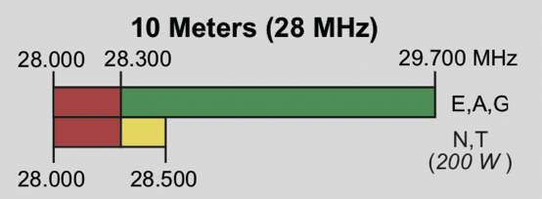
Carson’s Rule
Bandwidth = 2x (peak deviation + highest modulating frequency)
G8B06
What is the total bandwidth of an FM-phone transmission having a 5 kHz
deviation and a 3 kHz modulating frequency?
A. 3 kHz
B. 5 kHz
C. 8 kHz
D. 16 kHz
(D)
FM repeater use only available above 29.5 MHz (upper 10 meter band) G1A15

Slide 18
Distortion on an SSB signal
Over Modulation
Clipping (flat topping)
Both cause distorted sounding audio.
Both can create spurious signals.
Can be controlled by reducing microphone gain
Speak farther away from the microphone
Caused by driving the amplifier past the point of maximum output. G8A10
Reduce the amplifier drive

Slide 19
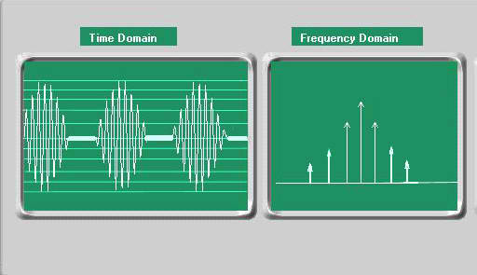
Signal Quality
Over Modulation
ALC, Automatic Level Control
Helps control over modulation
Reduces modulator power output on voice peaks
Adjust ALC to activate on voice peaks.
If a transceiver’s ALC system is not set properly when transmitting AFSK signals with the radio using single sideband mode. G4A14
It can distorts the signal and can cause spurious emissions
The ALC is set by the transmit audio or mic gain control. G2A12

Slide 20
Speech Processing
Increases average power of the speech signal with out distortion. G4D02
Improves intelligibility of the speech signal. G4D01
The processing is accomplished by compression
Upper voice peaks
Voice audio levels
dB
40 dB
30 dB
20 dB
10 dB
Softer voice levels
Compression 10 db

Slide 21
Drawbacks of Speech Processing
Improper Adjustment of Compression levels
Distorted Speech
Splatter
Excessive background pickup
G4D03
AOTA

Slide 22
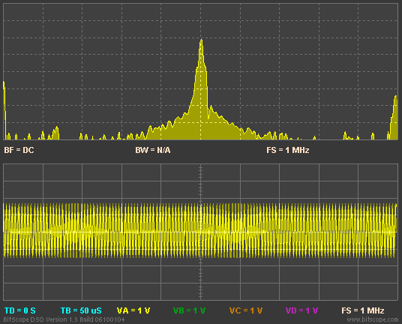
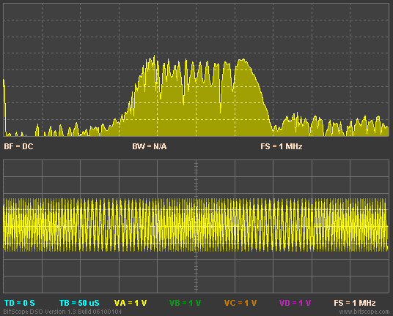
Over Deviation FM & PM
G8A08
Which of the following is an effect of over-modulation?
A. Insufficient audio
B. Insufficient bandwidth
C. Frequency drift
D. Excessive bandwidth
(D)

Slide 23
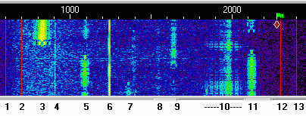
Digital Modes PSK 31
Excessive audio drive
Keep transmit audio low.
Adjust ALC level to not activate ALC meter.

Slide 24
Amplifiers
Linear amplifier
An amplifier in which the output preserves the input waveform G7B10
Class A
Class B
Most linear
Low Distortion
Low Gain
Least efficient
Always on
Linearity good
Efficiency good
Push Pull design
Each half operates for half of the cycle
Class AB
Class C
Operates midway between A and B
Operates more than 180 º of the cycle
Not as linear as class A
More efficient than class A
Used for SSB operation
Highest efficiency G7B02
Poor linearity
Only suitable for FM or CW G7B11
Efficiency = Output Power / DC Input Power
G7B08

Slide 25
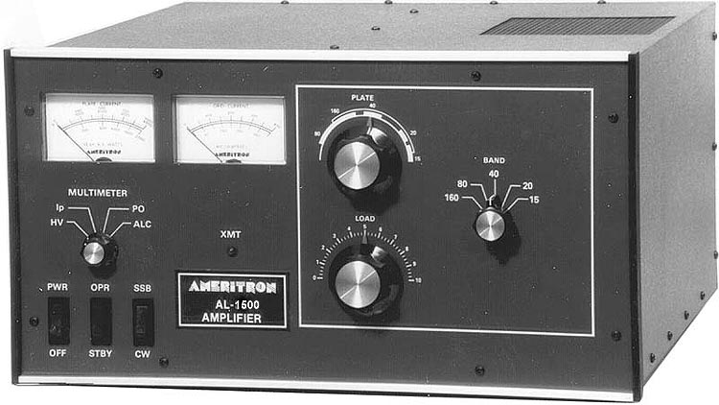
Tuning and Driving an Amplifier

Slide 26
Peak the load
Maximum power output without exceeding maximum allowable plate current
G4A08
Never exceed maximum drive power G4A07
Neutralize, limit self oscillation
G7B01

Slide 27
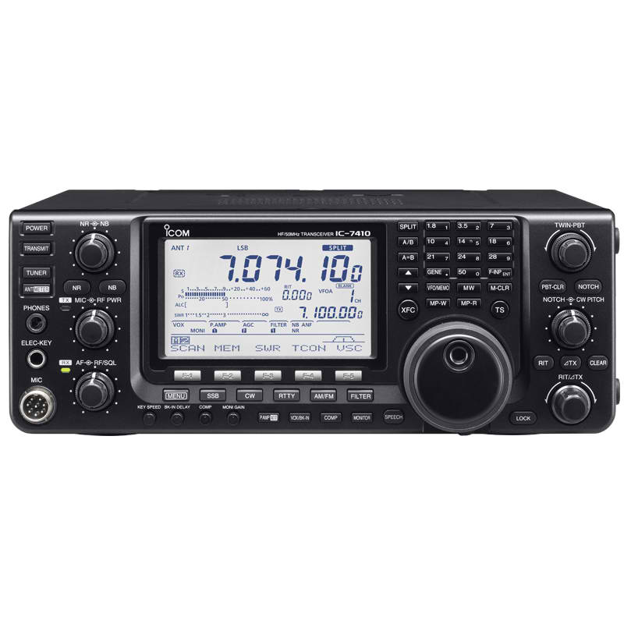
Receiver Structure
“You can’t work ‘em if you can’t hear ‘em.”
G8B09 Match the receive bandwidth to the received signal for better signal to noise ratio

Slide 28
Super Heterodyne Receiver
The Product Detector is used to de-modulate SSB and CW. G7C04
“Front End”
RF
Amp
Mixer
Filter
IF
Amp
Product
Detector
AF
Amp
Beat Frequency
Oscillator BFO
Local Oscillator
Direct digital synthesizer G7C16
Highly stable VFO in a transceiver
Variable frequency with the stability of a crystal oscillator. G7C05
The mixer processes signals from the RF amp and LO and sends to the IF G7C03

Slide 29
Super Heterodyne Receiver
The Discriminator is used to de-modulate FM. G7C08
“Front End”
RF
Amp
Mixer
Filter
IF
Amp
Product
Detector
AF
Amp
Limiter
Discriminator or
Quadrature Detector
Local Oscillator
Beat Frequency
Oscillator BFO

Slide 30
KISS
G7C07
What is the simplest combination of stages that implement a super-heterodyne receiver?
A. RF amplifier, detector, audio amplifier
B. RF amplifier, mixer, IF discriminator
C. HF oscillator, mixer, detector
D. HF oscillator, pre-scaler, audio amplifier
(C)
Mixer
Detector
Audio
HF Oscillator

Slide 31
Image Response
G8B02
14.255MHz
13.345 MHz
The 13.345 MHz signal is called an Image
455 kHz IF
Image rejection accomplished by specific filtering in the receivers front end.
13.800 MHz
14.255 – 13.8 = 455
13.8 – 13.345 = 455

Slide 32
Filters
G7C13. Maximum ability to reject signals outside its passband
Ultimate rejection
G7C14 The bandwidth of a band-pass filter is measured between upper and lower half power point
G7C12 Cutoff frequency is the filter’s output power is less than half the input power
G7C15 Insertion loss is a filter’s attenuation inside its passband
G7C06 impedance of a low-pass filter as compared to the impedance of the transmission line into which it is inserted should be about the same.

Slide 33
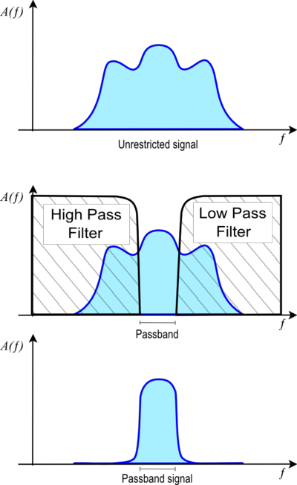
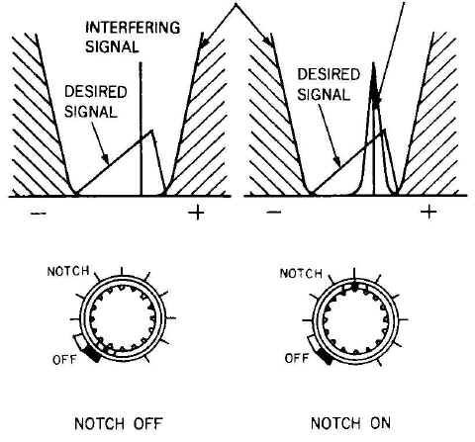
Removing received interference
Passband
Interfering signal
Notch Filter
Used to reduce interference from carriers in the receiver passband G4A01
IF shift filter
Used to avoid interference from stations very close to the receive frequency G4A11

Slide 34
Noise Reduction
Noise blanker: Reduces receiver gain during a noise pulse. G4A16
Too much noise reduction can cause signal distortion. G4A17

Slide 35
Removing received interference
Interfering signal
Reverse Sideband for CW
It may be possible to reduce or eliminate interference from other signals G4A02

Slide 36
Digital Signal Processing DSP
From mixer or
IF amp
ADC
DSP
DAC
AF
Signal filtering,
Wide range
Many choices
Noise reduction
A wide range of filter bandwidths and shapes can be created G4C12
Notch filtering
Can provide automatic notching

Slide 37
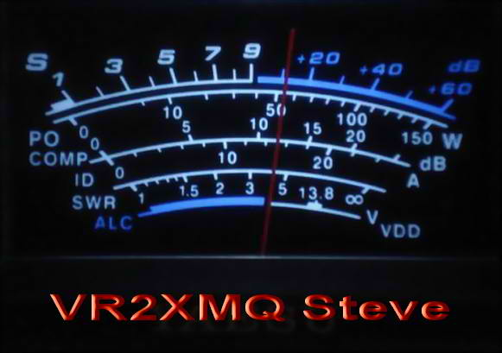
Receiver Gain.
S-Meter
S-Meter reads received signal strength 0 – 9 and + dB over
1 S-unit usually = to 6dB G4D04 G4D07
Manual gain control or
Automatic Gain Control (AGC)
Receiver S-Meter is found on most receivers G4D06
20 dB over = 100 times stronger
than S9 G4D05
A received signal from S8 to S9 is an increase of approx. 4 times. G4D07

Slide 38
Software-Defined radios SDR
A radio in which most major signal processing functions are performed by software G7C11
Q
+
RF out
All types of modulation G7C10
Combiner
+90º
phase shift
network
90º difference between I and Q
Quadrature Modulation
or
I Q Modulation
LO
I

Slide 39
Front End Overload.
Front end of a receiver can be overloaded by a strong signal.
This overloading can cause:
Signal distortion in all signals
Non-linearity of received signal
To correct the problem the operator should use:
The built in attenuator circuit G4A13
RF Gain control
Front end filtering to eliminate the strong signal

Slide 40
Station Installation HF
Mobile Installation:
Use heavy gauge wire connected with a fuse directly to the battery. G4E03
On most vehicles, the aux power socket or light socket is not designed for high current. G4E04
The mobile antenna system is the limiting factor for effectiveness in the 75 meter phone band. G4E05
Mobile interference: G4E07
A. The battery charging system
B. The fuel delivery system
C. The vehicle control computer
AOTA

Slide 41
Station Installation HF
Station Grounding.
To RF, long ground wires act like antennas.
Ground all equipment to a common bus.
Keep all connections, straps, and wires short
Connect ground bus to a ground rod.
Ground wires a a quarter wave multiple to the
operating frequency offer a high impedance to RF.
Can cause high RF voltages on equipment housing. G4C06

Slide 42
Station Installation HF
Station Grounding.
Ground Loops
Caused by a continues grounding system acting like an inductor and picking up stray magnetic energy.
Results in a hum or buzz on the station’s signal. G4C10
Connect all grounding wires to a single point. G4C09

