Slide 1
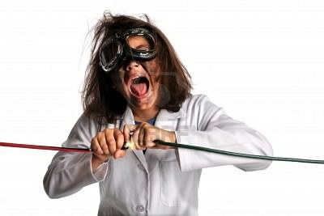
Safety
Week 5
G0A
G0B
Nov 16, 2020

Slide 2
ZAP
G0A01 Current flowing through the body cause a health hazard:
By heating tissue

Slide 3
Station Wiring
A good way to guard against electrical shock at your station:
Use three-wire cords and plugs for all AC powered equipment;
Connect all AC powered station equipment to a common safety ground
Use a circuit protected by a ground-fault interrupter
The National Electric Code regulates safety requirements for electrical wiring. G0B06
Common wire sizes for current capacity
AWG 16 10Amps
AWG 14 15 Amp G0B03
AWG 12 20 Amp. G0B02
AWG 10 30 Amp
In a 240 VAC single phase circuit both wires carrying the voltage should be protected with a circuit breaker. G0B01

Slide 4
GFCI Ground Fault Circuit Interrupter
Current flowing from one or more of the voltage-carrying wires directly to ground will trip a GCFI
G0B05

Slide 5
Back-up Power
Make sure you operate gas powered generators in a well ventilated area.
G0B09. G0B04
Disconnect the incoming utility power feed
G0B13.

Slide 6
Power Supply Interlocks
Interlocks on power supplies and cabinets
Insure that dangerous voltages are removed if the cabinet is opened. G0B12

Slide 7
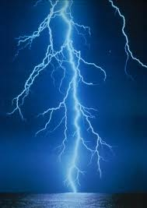
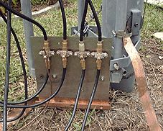
Lightning
Ground all protectors to a common plate. G0B11
Good for nearby lightning strikes
Direct hits, forget it, kiss everything goodbye
Avoid sharp bends in your grounding conductors.

Slide 8
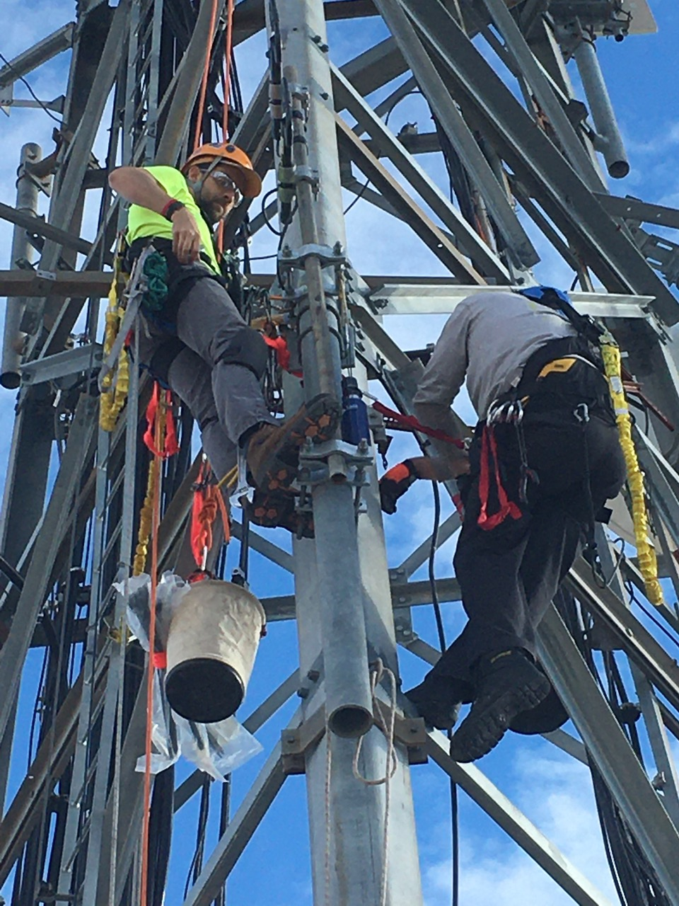
Overhead Tower Work
Members of a tower work team should wear a hard hat and safety glasses at all times when any work is being done on the tower.
On ground or up the tower
Wear hard hat and safety glasses
Putting on a climbing harness and safety
glasses is a good precaution to observe before climbing an antenna tower.
G0B07 Confirm that the belt is rated for the weight of the climber and that it is within its allowable service life
G0B08. Make sure all circuits that supply power to the tower are locked out and tagged
8

Slide 9
Antenna Work
For your safety Turn off the transmitter and disconnect the feed line prior to antenna work. G0B14
Ground mounted antennas should be installed such that it is protected against unauthorized access. G0A06

Slide 10
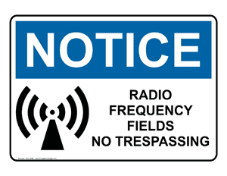
RF Hazards

Slide 11
RF Radiation
RF radiation is non-ionizing radiation
It does not cause genetic tissue damage.

Slide 12
Exposure limits
G0A03 Acceptable methods to determine that your station complies with FCC RF exposure regulations:
By calculation based on FCC OET Bulletin 65
By calculation based on computer modeling
By measurement of field strength using calibrated equipment
Just remember all choices are correct

Slide 13
Table 1 -- Power Thresholds for Routine Evaluation of Amateur Radio Stations
Band (Wavelength) Transmitter Power (W)
160 m 500
75 m 500
80 m 500
40 m 500
30 m 425
20 m 225
17 m 125
15 m 100
12 m 75
10 m 50
6 50
1.23 m 50
70 cm 70
33 cm 150
23 cm 200
13 cm and up 250

Slide 14
Exposure limits
G0A08. Perform a routine RF exposure evaluation to ensure compliance with RF safety regulations when transmitter power exceeds levels specified in FCC Part 97.13
G0A09 A calibrated field strength meter can be used to accurately measure the strength of an RF Field

Slide 15
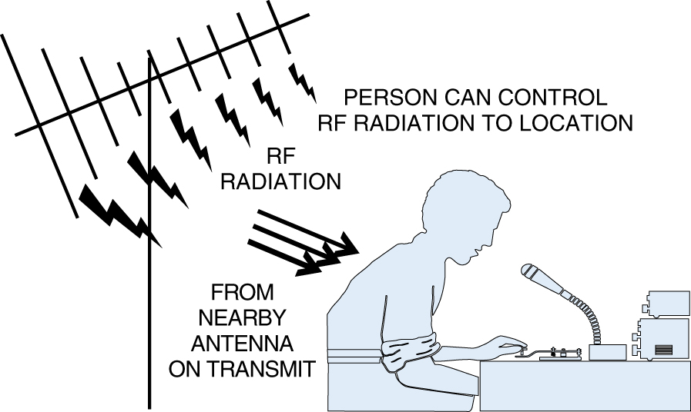
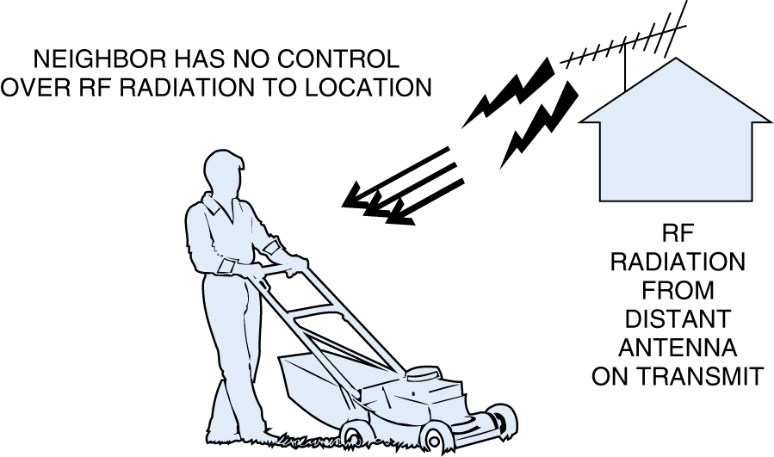
Factors affecting the RF exposure of people near an amateur station antenna:
Frequency and power level of the RF field
Distance from the antenna to a person
Radiation pattern of the antenna
Take precautions to ensure that the antenna cannot be pointed in the direction of neighbors if excess of allowable exposure. G0A10
Controlled
Uncontrolled
15

Slide 16
Exposure Prevention
Indoor antennas: Make sure that MPE limits are not exceeded in occupied areas. G0A11

Slide 17
Duty Cycle
Duty cycle is one of the factors used to determine safe RF radiation exposure levels because it affects the average exposure of people to radiation.
G0A07 A lower transmitter duty cycle permits greater short-term exposure levels
17

Slide 18
Soldering
Danger from lead-tin solder
G0B10
Lead can contaminate food if hands are not washed carefully after handling the solder

