Slide 1
Digital Modes

Slide 2
New Digital Protocol
If you were to establish a new digital protocol, prior to operating on the air, you must:
Publicly document the technical characteristics of the protocol G1C13
The Part 97 limit on the maximum bandwidth occupied by an automatically controlled digital station
Is 500 Hz G1E11
G1E09 (A) [97.115]
Under what circumstances are messages that are sent via digital modes exempt from Part 97 third-party rules that apply to other modes of communication?
A. Under no circumstances
B. When messages are encrypted
C. When messages are not encrypted
D. When under automatic control
Digital modes are never exempt from part 97 rules and regulations. G1E09

Slide 3
Digital Modes
1. Protocol
The directions for the particular mode.
How the information is coded
2. Method of modulation
FM
SSB
AFSK
PSK
Digital modes are restricted to the CW/DATA sub band.

Slide 4
Where do we find digital modes in the bands
CW and Data portions of the bands
On 20 meters digital is found at 14.070 to 14.1 MHz
On 80 meters found at 3570 to 3600 kHz
Look for the “70” in the answers
G2E04, G2E08
G2E07
14.000
14.070
14.112
14.150
14.350
G2E08 (D)
In what segment of the 20-meter band are most PSK31 operations commonly found?
A. At the bottom of the slow-scan TV segment, near 14.230 MHz
B. At the top of the SSB phone segment, near 14.325 MHz
C. In the middle of the CW segment, near 14.100 MHz
D. Below the RTTY segment, near 14.070 MHz
RTTY, Data. And CW
Phone and image
E
G2E07 (A)
What segment of the 80-meter band is most commonly used for digital transmissions?
A. 3570 – 3600 kHz
B. 3500 – 3525 kHz
C. 3700 – 3750 kHz
D. 3775 – 3825 kHz
G2E04 (B)
What segment of the 20-meter band is most often used for digital transmissions (avoiding the DX propagation beacons)?
A. 14.000 - 14.050 MHz
B. 14.070 - 14.112 MHz
C. 14.150 - 14.225 MHz
D. 14.275 - 14.350 MHz
A
14.175
G
14.025
14.225
PSK31
G2E08 PSK31 found below RTTY

Slide 5
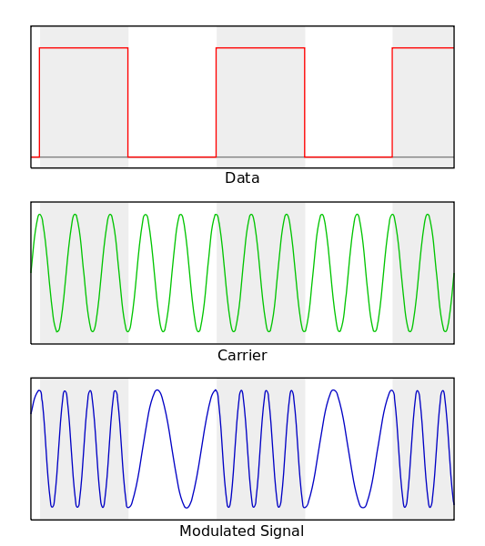
RTTY “Teletype” Narrowband direct printing telegraphy
Popular in all HF bands
Originated in 1930
Protocol
Uses the Baudot Code
Five bits + start and stop
G2E06 Shift between mark and space = 170 Hz
On HF 45 bauds or 60 WPM most common
G8C04
Modulation
AFSK
Via LSB G2E01
Cannot decode an RTTY or other FSK signal even though it is apparently tuned in properly?
A. The mark and space frequencies may be reversed
B. You may have selected the wrong baud rate
C. You may be listening on the wrong sideband
AOTA

Slide 6
PACTOR Packet Teletype Over Radio
Improvement over RTTY with the ability to detect and correct errors.
Three versions: PACTOR I, PACTOR II PACTOR III
Limited between two stations only
Can not join ongoing conversation
G2E09
Limited between two stations only
Can not join ongoing conversation
Operation
Any signals or modes can interfere with PACTOR or WINOR G2E03. AOTA
NAK response from receive station = Requesting re-transmission
G8C05
Re-Tries……Timeouts…….Pauses…….Failure to connect. G2E03
Monitor without connect to check for busy G2E02
Modulation
FSK and PSK used in PACTOR III
Most common on HF for exchanging large amounts of information.
Used in Winlink email. www.winlink.com. G2E13
Bandwidth 2300 Hz. G8B05
Notes:
NAK= Not Acknowledged

Slide 7
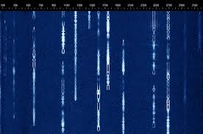
PSK31 Phase Shift Keying 31 baud
Very common on HF
Keyboard to Keyboard
The transmitted symbol rate G3E09
Protocol
Uses a variable length code 5, 7, or 8 bits
Shorter code for common characters
Upper case letters use longer Varicode. G8C08
The code is called Varicode G8C12
Advantage
Uses very narrow bandwidth
Uses computer soundcard
Modulation
Phase Shift Keying
Via SSB

Slide 8
Packet Radio
Protocol
AX.25 protocol standard.
7 bit code + start, stop, and parity bit.
Operation
Transmitted in a group of characters (packets)
Each starts with a header. G8C03
provides information about the routing and handling.
Most common on VHF and VHF
G8C07 ERRORS Receive station responds with ARQ = Send packet again
Modulation
FSK,

Slide 9
FT8
Joe Taylor WSJT-X
JT65, JT9, FT8 use USB
G2E08
Digital mode designed for signals with very low signal to noise ratio. G8A12
8 tone AFSK on USB G2E05 G8A09
Typical exchanges are limited to call signs, grid locators, and signal reports
G2E11
Must use computer timing accurate to 1 second. G2E15

Slide 10
Transmitting data
Increase data rate increase bandwidth G8B10
Maximum Symbol Rate (Baud) per Band
- 12 m 300 bauds
10 m 28 MHz 1200 bauds
6 and 2 m 19,600 bauds
1.25 and .70 m 56,000 bauds
G1C07
G1C07 (D)
What is the maximum symbol rate permitted for RTTY or data emission transmission on the 20-meter band?
A. 56 kilobaud
B. 19.6 kilobaud
C. 1200 baud
D. 300 baud
G1C10 (C)
What is the maximum symbol rate permitted for RTTY or data emission transmissions on the 10-meter band?
A. 56 kilobaud
B. 19.6 kilobaud
C. 1200 baud
D. 300 baud
G1C09 (A)
What is the maximum symbol rate permitted for RTTY or data emission transmitted on the 1.25-meter and 70-centimeter bands?
A. 56 kilobaud
B. 19.6 kilobaud
C. 1200 baud
D. 300 baud
G1C08 (D)
[What is the maximum symbol rate permitted for RTTY or data emission transmitted at frequencies below 28 MHz?
A. 56 kilobaud
B. 19.6 kilobaud
C. 1200 baud
D. 300 baud
G1C08
G1C11 (B)
What is the maximum symbol rate permitted for RTTY or data emission transmissions on the 2-meter band?
A. 56 kilobaud
B. 19.6 kilobaud
C. 1200 baud
D. 300 baud
G1C10
G1C11
G1C09
Notes:
Write on Frequency chart.

Slide 11
Videos
RTTY
https://www.youtube.com/watch?v=gZx8IcHrLwo
PSK 31
https://www.youtube.com/watch?v=ymo91kP1Fpo

Slide 12
Operating CW
G2C01 – G2C11
Break in Keying (QSK)
can receive between code characters G2C01
Straight key, Paddles, and Electronic Keyers used to send a series of dots and dashes G4A10
Answer a CQ at the speed not faster than it was sent G2C05
Zero Beat – Match transmit freq. to received freq. G2C06
Restrictions of Q signals and Pro-signs
They may be used if they do not obscure the meaning of a message
G1B07
Notes:
WX= Weather GG= Going TNX= Thanks K= OK R= Affirmative CL= Clear, closing station RST-C= Key Click QSO= Conversation QRS= Send slower QRQ= Send faster QSY= Change Freq. QSL= Receipt of transmission QRT= Quit QRV= Ready QRL= Is the Freq clear?
DE= This is BT= Pause SK= Silent Key end of contact. KN= Invite specific station AR= End of message

Slide 13
G2C01 – G2C11
Abbreviate
WX, GE, TNX, K, R, CL, [RST C ]
[RST C ] Key Clicks
Q Signals
QSO, QRS, QRQ, QSY, QSL, QRT, QRV QRL
QRS Send Slower
QRL Frequency in use
QSL I acknowledge receipt
QRN I am troubled by static
QRV I am ready to receive messages
Pro Signs
DE, BT, SK, KN, AR
KN Listening only for a specific station or stations
AR End of formal message
Notes:
WX= Weather GG= Going TNX= Thanks K= OK R= Affirmative CL= Clear, closing station RST-C= Key Click QSO= Conversation QRS= Send slower QRQ= Send faster QSY= Change Freq. QSL= Receipt of transmission QRT= Quit QRV= Ready QRL= Is the Freq clear?
DE= This is BT= Pause SK= Silent Key end of contact. KN= Invite specific station AR= End of message

Slide 14
CW USB or LSB?
G4A02 (C)
What is one advantage of selecting the opposite, or “reverse,” sideband when receiving CW signals on a typical HF transceiver?
A. Interference from impulse noise will be eliminated
B. More stations can be accommodated within a given signal passband
C. It may be possible to reduce or eliminate interference from other signals
D. Accidental out-of-band operation can be prevented
G4A02
Carrier Frequency
Reduce or eliminate unwanted signals
Receiver
Bandpass
LSB
CW signals
Receiver
Bandpass
USB
CW signals

Slide 15
Notch Filter
G4A01 (B)
What is the purpose of the “notch filter” found on many HF transceivers?
A. To restrict the transmitter voice bandwidth
B. To reduce interference from carriers in the receiver passband
C. To eliminate receiver interference from impulse noise sources
D. To enhance the reception of a specific frequency on a crowded band
G4A01
Carrier Frequency
To reduce interference from carriers in the receiver passband
Receiver
Bandpass
LSB
CW signals
Receiver
Bandpass
USB
CW signals
Notch filter on

Slide 16
Digital Modes
1. Protocol
The directions for the particular mode.
How the information is coded
2. Method of modulation
FM
SSB
AFSK
PSK
Digital modes are restricted to the CW/DATA sub band.

Slide 17
Digital Modes Station Set UP
The connection between the transceiver and computer
Receive audio, transmit audio, and push-to-talk (PTT)
Soundcard
interface
Transceiver
Microphone of line input
Computer
Computer control
The sound card provides audio to the radio's microphone input and converts received audio to digital form
Most modern transceivers have built in soundcards and usb connections to connect to the computer

Slide 18
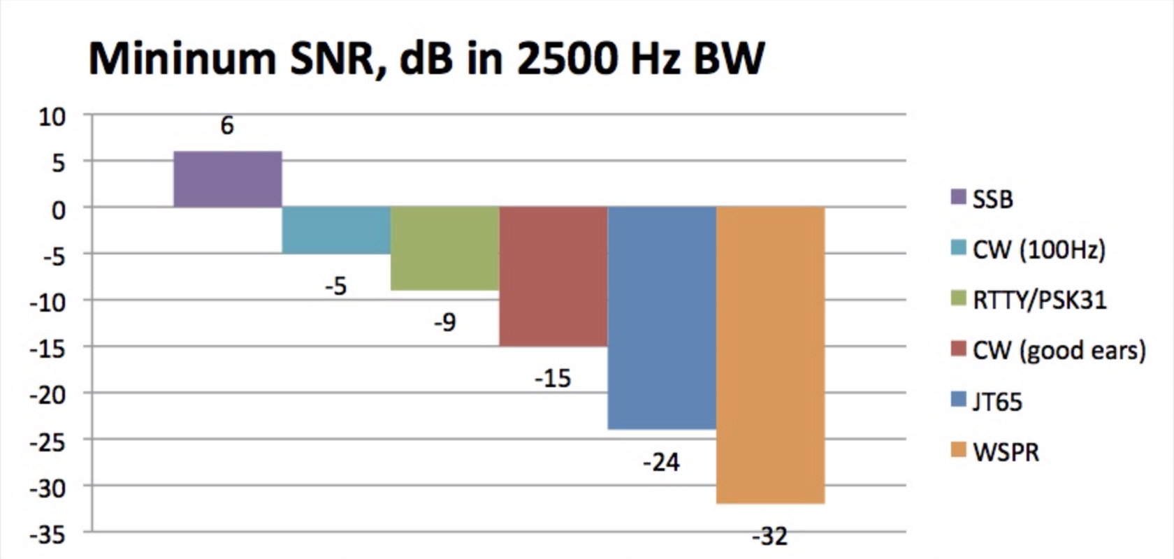
Advantages of digital

Slide 19
RTTY “Teletype” Narrowband direct printing telegraphy
Originated in 1930
Protocol
Uses the Baudot Code
Five bits + start and stop
FIGS and LTRS
Mark bit = 1
Space bit = 0
G2E06 Shift between mark and space = 170 Hz
On HF 45 bauds or 60 WPM most common
G8C04
G2E01 (D)
Which mode is normally used when sending RTTY signals via AFSK with an SSB transmitter?
A. USB
B. DSB
C. CW
D. LSB
Modulation
AFSK
Via LSB G2E01
Popular in all HF bands

Slide 20
PACTOR PACet Teletype Over Radio
Improvement over RTTY with the ability to detect and correct errors.
Three versions: PACTOR I, PACTOR II PACTOR III
Limited between two stations only
Can not join ongoing conversation
G2E09
Limited between two stations only
Can not join ongoing conversation
Operation
Any signals or modes can interfere with PACTOR or WINOR G2E03
NAK response from receive station = Requesting re-transmission
G8C05
Re-Tries……Timeouts…….Pauses…….Failure to connect. G2E03
Monitor without connect to check for busy G2E02
Modulation
FSK and PSK used in PACTOR III
Most common on HF for exchanging large amounts of information.
Used in Winlink email. www.winlink.com
Bandwidth 2300 Hz. G8B05
Notes:
NAK= Not Acknowledged

Slide 21
PSK31 Phase Shift Keying 31 baud
Very common on HF
Keyboard to Keyboard
Protocol
Uses a variable length code 5, 7, or 8 bits
Shorter code for common characters
Upper case letters use longer Varicode. G8C08
Called Varicode G8C12
G8C09
Advantage
Uses very narrow bandwidth
Uses computer soundcard
Modulation
Phase Shift Keying
Via SSB
Primarily USB

Slide 22
PACKET RADIO
Protocol
AX.25 protocol standard.
7 bit code + start, stop, and parity bit.
Operation
Transmitted in a group of characters (packets)
Each starts with a header. G8C03
provides information about the routing and handling.
Most common on VHF and VHF
G8C07 ERRORS Receive station responds with ARQ = Send packet again
Modulation
FSK,

Slide 23
FT8
Digital mode designed for signals with very low signal to noise ratio. G8A12
8 tone AFSK on USB G2E05 G8A09
Typical exchanges are limited to call signs, grid locators, and signal reports
G2E11
Must use computer timing accurate to 1 second. G2E15

Slide 24
Where do we find digital modes in the bands
CW and Data portions of the bands
Found in the respective band plans.
On 20 meters digital is found at 14.070 to 14.1 MHz
On 80 meters found at 3570 to 3600 kHz
G2E04
G2E07
14.000
14.070
14.112
14.150
14.350
RTTY, Data. And CW
Phone and image
E
A
14.175
G
14.025
14.225
PSK31
G2E08 PSK31 found below RTTY

Slide 25
Transmitting data
Increase data rate increase bandwidth G8B10
Maximum Symbol Rate (Baud) per Band
- 12 m 300 bauds
10 m 1200 bauds
6 and 2 m 19,600 bauds
1.25 and .70 m 56,000 bauds
G1C08
G1C10
G1C11
G1C09
Set up transmitter to transmit DATA at low power
Set ALC to Minimum
Notes:
Write on Frequency chart.

Slide 26
For Next Week
Study flash cards www.hamexam.org
Radio
Fundamentals
ARRL Ch. 1, 2, 3, 6
Electricity
ARRL Ch. 4
Equipment
ARRL Ch. 5
Equipment
Cont.
ARRL Ch. 5
Propagation
ARRL Ch. 8
Antennas
ARRL Ch. 7
Digital
ARRL Ch. 6
General
Intro
Resistors
Capacitors
AC Power
The Reactive
components
Semi-
conductors
Radio signals
And equipment
Filters, DSP
Station Installation
Propagation
Antennas
Feedlines
Rules & Regs
Lesson 1
G1A
G1C
G2A
G2B
G4A part
G4D part
G8A
Lesson 2
G1B part
G2B
G2C
G1D
G1E part
G8C part
Lesson 4
G5A
G5B
G6A
Lesson 5
G4B
G4E
G6A
G6B
G7A
G7B
Lesson 6
G4E
G9A
G9B
G9C
G9D
Lesson 7
G4A
G4B
G4C
G4D
G7B
G7C
G8A
G8B
Lesson 8
G3A
G3B
G3C
Lesson 9
G4E
G9A
G9B
G9C
G9D
Lesson 10
G2C
G2E
G8A
G8B
G8C
Lesson 3
G5B
G5C
Safety
Ch. 9
73
Tom and Jack
Lesson 11
G0A
G0B

