Slide 1
Chapter 4 Cont.
Semiconductors
G4B
G4E
G6A
G6B
G7A
G7B
c

Slide 2
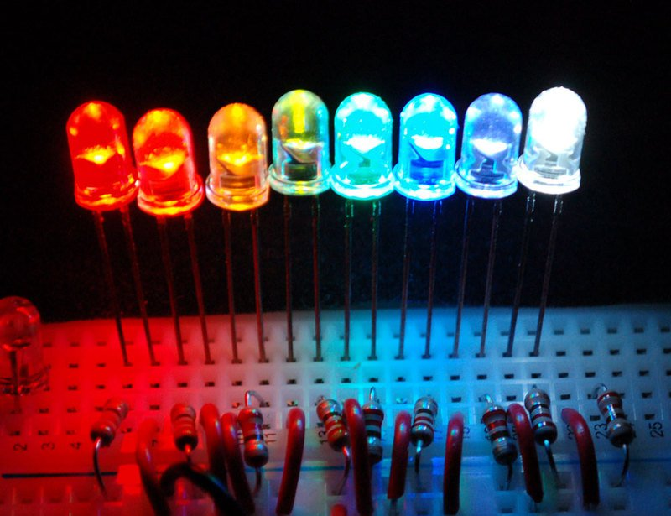
Bias
Bias is direct current ( DC ) deliberately made to flow, or DC voltage deliberately applied, between two points for the purpose of controlling a circuit .
Forward bias on a semiconductor. Current Flows
Reverse bias on a semiconductor. Current does not Flow
Forward bias a LED to light the light
G6B08

Slide 3
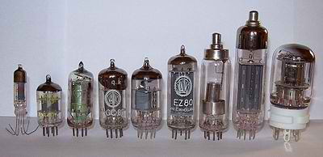
Vacuum Tubes
Tubes general operating characteristics very similar to FET transistors

Slide 4
1904 – The magic begins.
John Ambrose Fleming

Slide 5
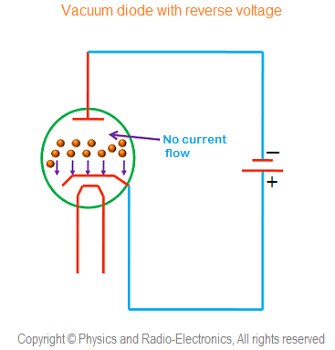
The one-way Valve

Slide 6
Control the Flow
The Triode, 1906 Robert von Lieben

Slide 7
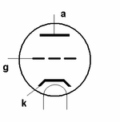
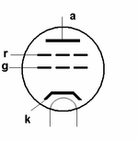
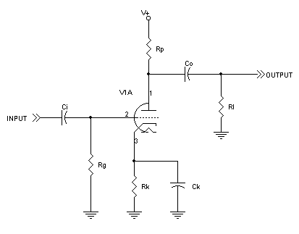
Screen grid, used to reduce grid to plate capacitance G6A12
Control grid used to control electron travel. G6A10

Slide 8
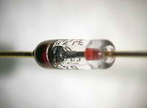
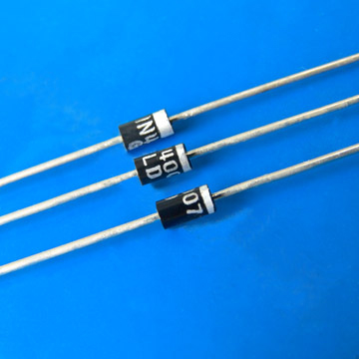
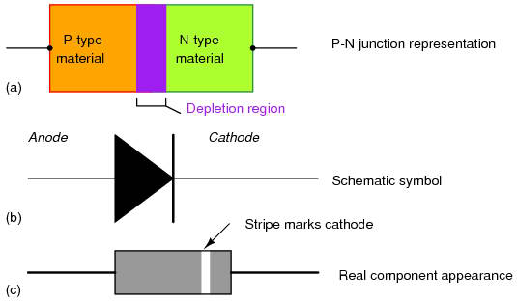
Diodes and Rectifiers One way Valves
Diodes designed for low power are often called signal or switching diodes.
Diodes designed for high power and current are called rectifiers

Slide 9
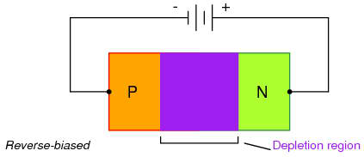
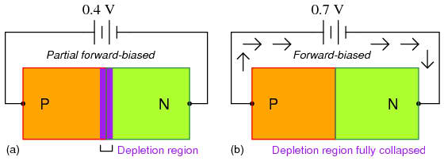
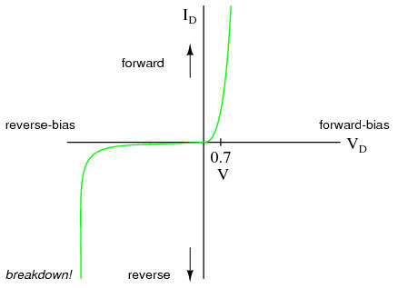
It takes a little forward voltage (bias) to cause the diode to conduct
Silicone diodes V_{F} ≈ .7 v G6A05
Germanium diodes V_{F} ≈ .3 v G6A03

Slide 10
Two diodes can be connected in Parallel to increase the current carrying capacity.
Two resistors are connected in series with the diodes to
ensure that one diode doesn't carry most of the current
E = IR
Schottky diodes for high frequencies, designed with lower internal capacitance.

Slide 11
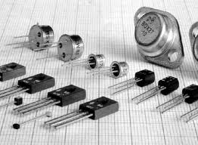
Transistors

Slide 12
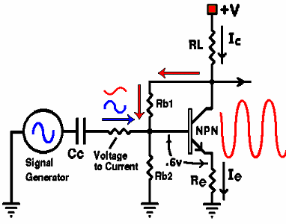
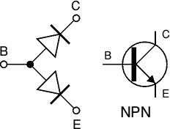
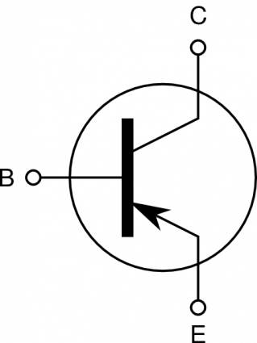
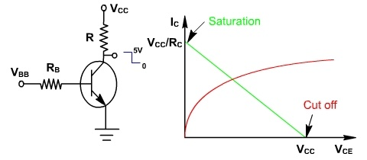
G6A07 (A)
What are the stable operating points for a bipolar transistor used as a switch in a logic circuit?
A. Its saturation and cutoff regions
B. Its active region (between the cutoff and saturation regions)
C. Its peak and valley current points
D. Its enhancement and depletion modes
Transistors are essentially two diodes back to back.
PNP
Transistors are amplifiers.
Transistors can be used as a switch when operated in the saturation or cut-off region. G6A07

Slide 13
Types of Transistors
Bipolar Junction Transistors
Bipolar Junction Transistors are transistors which are made up of 3 regions, the base, the collector, and the emitter. Bipolar Junction transistors, unlike FET transistors, are current-controlled devices.
Field Effect Transistors
Field Effect Transistors are transistors which are made up of 3 regions, a gate, a source, and a drain. Unlike bipolar transistors, FETs are voltage-controlled devices.
Field Effect Transistors come in 2 main types: JFETs and MOSFETs. JFETs and MOSFETs are very similar but MOSFETs have even higher input impedance values than JFETs.

Slide 14
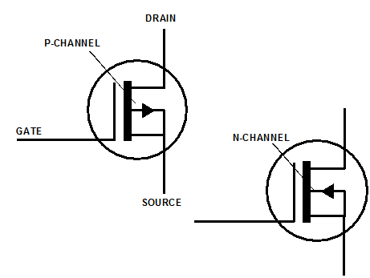
Metal Oxide Semiconductor Field Effect Transistor MOSFET
The gate is separated from the channel with a thin insulating layer. G6A09
The MOSFET and JFET use different insulating layers.
They both are very sensitive. Small amount of voltage can control source-drain current.

Slide 15
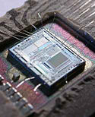
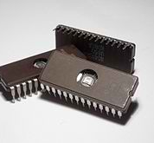
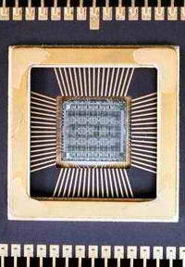
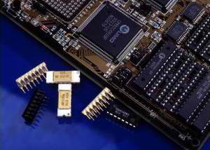
Integrated Circuits

Slide 16
RF Integrated Circuits
ICs that take the place of discrete components in RF circuits.
Such as
Amplifiers
Modulators
Mixers
De-modulators
Filters
etc.

Slide 17
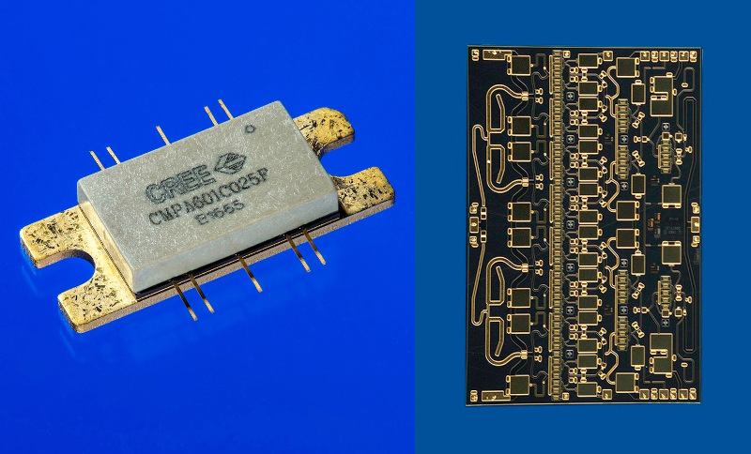
MMIC Monolithic Microwave Integrated Circuit
G6B02
integrated circuit (IC) device that operates at microwave frequencies (300 MHz to 300 GHz).

Slide 18
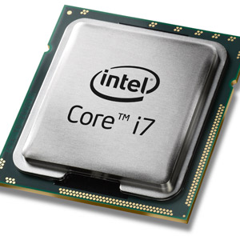
Micro Processor
An integrated circuit that contains all the functions of a central processing unit of a computer.

Slide 19
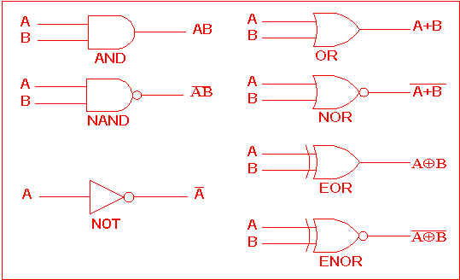
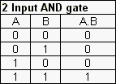
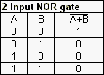
Digital Logic Basics
G7B03
G7B04

Slide 20
G7B03
Which of the following describes the function of a two input AND gate?
A. Output is high when either or both inputs are low
B. Output is high only when both inputs are high
C. Output is low when either or both inputs are high
D. Output is low only when both inputs are high
(B)
AND Take the high road

Slide 21
G7B04
Which of the following describes the function of a two input NOR gate?
A. Output is high when either or both inputs are low
B. Output is high only when both inputs are high
C. Output is low when either or both inputs are high
D. Output is low only when both inputs are high
(C)
NOR Take the low road when either or both are high

Slide 22
Flip Flops
A two state digital circuit, on or off 1 or 0
To calculate the number of combinations with binary states
2^{N}
Where N is the number of bits in a string
G7B05
How many states does a 3-bit binary counter have?
A. 3
B. 6
C. 8
D. 16
(C)

Slide 23
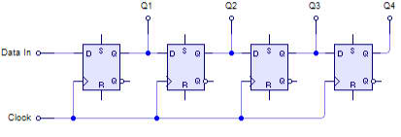
Shift Register
A clocked array of circuits that passes data in steps along the array
G7B06

Slide 24
Memory
Volatile
(Random Access Memory)
RAM
SRAM
DRAM
Non-volatile
(Read only memory) G6B04
ROM
EPROM
PROM
CD-ROM
Flash
Memory is erased after power is removed
Memory remains stored even after power is removed G6B05

Slide 25
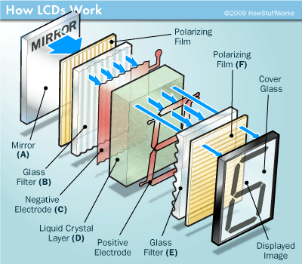
Visual Interface
Incandescent lights
LEDs
(low power)
(forward bias)
G6B08
Displays
Liquid /crystal Display (LCD)
Utilizes ambient or back lighting
G6B09

Slide 26
Practical Circuits
The Power Supply
Rectifier circuits
@ 60 cycles
Half Wave
Only use one half or 180⁰
of the input sine wave.
G7A05
Unfiltered output = 60 PPS
Rectifier diode PIV = 2 X peak V.
Only one diode is required G7A04
Full Wave
Uses the full input sine wave
360⁰
G7A06
Unfiltered output = 120 PPS
Requires center tapped transformer
Rectifier diode PIV = 2 X peak V.

Slide 27
Power Supply Filter circuit
Power supply filter networks commonly use capacitors and inductors. G7A02
A well designed and safe power supply would incorporate a bleed resistor. G7A01

Slide 28
Half Wave
+
-
E_{RMS}
+
-
Half-wave PS only uses one diode (Advantage)? G7A04
Only 180 degrees of the input signal is converted to DC G7A05
A series of DC pulses at twice the input frequency G7A07
Full Wave.
E_{RMS}
A Full-wave PS uses two diodes and a center tapped transformer. G7A03
Output frequency is twice the input frequency G7A07
360 degrees of the input signal is converted to DC G7A06

Slide 29
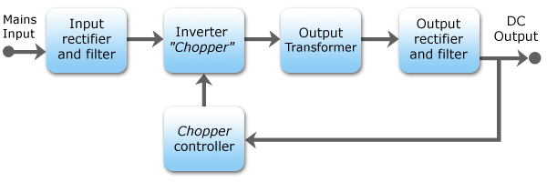
Switching Power Supplies
(C)
G7A08
Which of the following is an advantage of a switch-mode power supply as compared to a linear power supply?
A. Faster switching time makes higher output voltage possible
B. Fewer circuit components are required
C. High frequency operation allows the use of smaller components
D. All of these choices

Slide 30
Linear vs. Switching PS
25 A. Switching
35 A. Linear

Slide 31
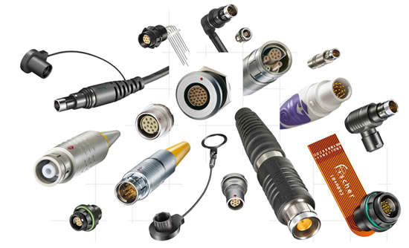
Connectors
Keyed connectors prevent improper mating of connectors
RCA or phono jacks commonly used for audio, video, an low level RF signals. G6B12
RF connectors
PL-259 Commonly used RF connector for frequencies up to 150 MHz G6B13
Type N A moisture-resistant RF connector useful to 10 GHz G6B07
SMA A small threaded connector suitable for signals up to several GHz G6B11

Slide 32
DE-9 Connector. A good choice for a serial data port. G2E12

Slide 33
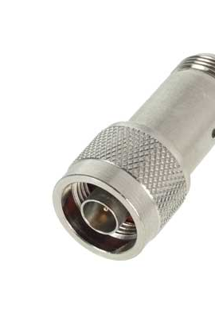
Type N connector. A moisture-resistant RF connector useful to 10 GHz G6B07

Slide 34
SMA connector. A small threaded connector suitable for signals up to several GHz G6B11

Slide 35
RCA connector. Commonly used for audio signals in Amateur Radio stations? G6B12

Slide 36
PL 259 connector. Commonly used for RF connections at frequencies up to 150 MHz G6B13

Slide 37
Basic Test Equipment
Digital and analog multi-meters.
Antenna Analyzer
Field Strength meter
Oscilloscope

Slide 38
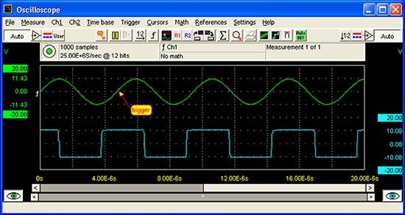
Oscilloscope
For measuring fast changing and complex waveforms. G4B02
Contains both horizontal and vertical channel amplifiers. G4B01
For measuring a transmitters waveform the RF is connected to the attenuated output of the transmitter. G4B04
Oscilloscope is useful for measuring the keying waveform. G4B03

Slide 39
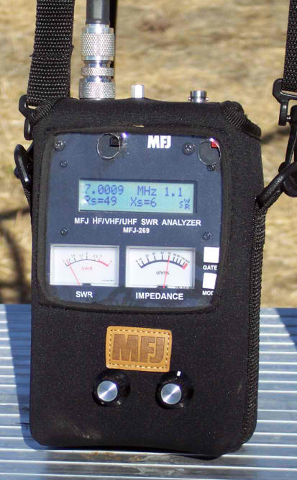
Impedance and Resonance Measurement
Antenna Analyzer
Produces a signal at a frequency within a tuning range
Receives the frequency as it is reflected back from the connected load
Connected directly to the antenna feed-line and antenna, it will measure SWR and antenna resonance. G4B11
An analyzer also can determine the impedance of an unknown or unmarked coaxial cable G4B13
Strong signals from nearby transmitters can affect accuracy G4B12

Slide 40
Multi-Meter
Sometimes analog meters are preferred to digital when adjusting tuned circuits G4B14
Both digital and analog meters should have a high impedance input to decrease loading of a circuit. G4B05

Slide 41
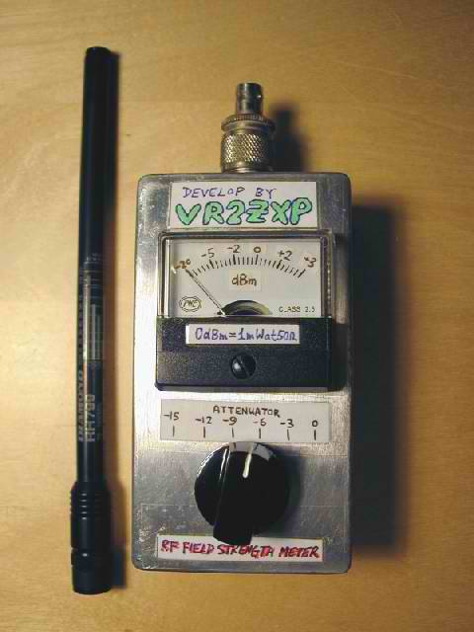
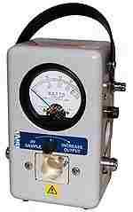
Field Strength
Measures relative RF output when adjusting transmitters G4B08
Power Meters
Measures forward and reflected RF power
This measurement will you to calculate SWR G4B10

Slide 42
Alternative Power
Solar Cells
Photovoltaic conversion G4E08
PN junction silicon
Open circuit voltage across the junction is .5 volt. G4E09
Conversion factor about 20%
1 sq. meter almost 1 kW
Storage
Power generated from solar and wind needs to be stored for when there is no wind or solar energy. G4E11
Storage batteries are commonly used.
Diodes are put in series with the solar panels to prevent discharge back into the solar panel. G4E10

Slide 43
Batteries and Chargers
Two classifications of batteries
Primary
Disposable batteries
Secondary
Chargeable batteries
Nickel cadmium NiCd
Nickel metal hydride NiMH
Lithium-ion Li-ion
Lead acid
Lead acid or storage batteries should not be discharged below approximately 10.5 volts
Low internal resistance in NiCd batteries allow for high current draw P=I²R

Slide 44
Which symbol in figure G7-1 represents a field effect transistor?
1

Slide 45
Which symbol in figure G7-1 represents a Zener diode?
5

Slide 46
Which symbol in figure G7-1 represents an NPN junction transistor?
2

Slide 47
Which symbol in Figure G7-1 represents a solid core transformer?
6

Slide 48
Which symbol in Figure G7-1 represents a tapped inductor?
7

Slide 49
For Next Week
Study flash cards www.hamexam.org
Radio
Fundamentals
ARRL Ch. 1, 2, 3, 6
Electricity
ARRL Ch. 4
Equipment
ARRL Ch. 5
Equipment
Cont.
ARRL Ch. 5
Propagation
ARRL Ch. 8
Antennas
ARRL Ch. 7
Digital
ARRL Ch. 6
General
Intro
Resistors
Capacitors
AC Power
The Reactive
components
Semi-
conductors
Radio signals
And equipment
Filters, DSP
Station Installation
Propagation
Antennas
Feedlines
Rules & Regs
Lesson 1
G1A
G1C
G2A
G2B
G4A part
G4D part
G8A
Lesson 2
G1B part
G2B
G2C
G1D
G1E part
G8C part
Lesson 4
G5A
G5B
G6A
Lesson 5
G4B
G4E
G6A
G6B
G7A
G7B
Lesson 6
G4E
G9A
G9B
G9C
G9D
Lesson 7
G4A
G4B
G4C
G4D
G7B
G7C
G8A
G8B
Lesson 8
G3A
G3B
G3C
Lesson 9
G4E
G9A
G9B
G9C
G9D
Lesson 10
G2C
G2E
G8A
G8B
G8C
Lesson 3
G5B
G5C
Safety
Ch. 9
Lesson 11
G0A
G0B
73
Tom and Jack

