Slide 1
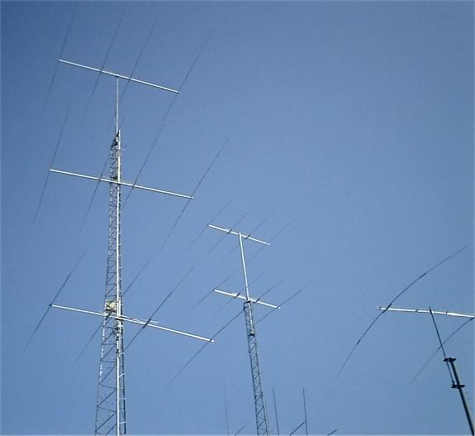
Antennas and Feedlines
Sections
G4E
G9A
G9B
G9C
G9D

Slide 2
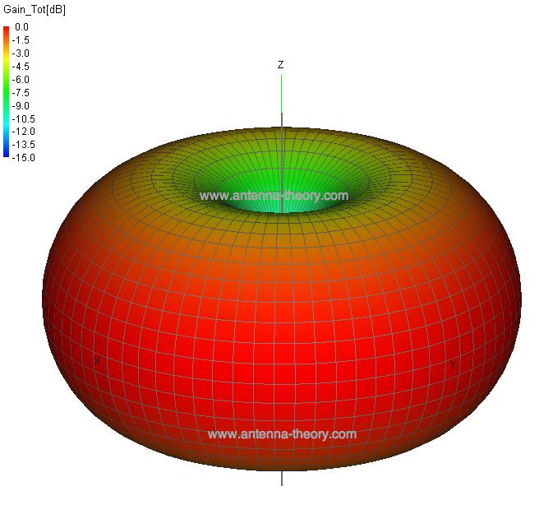
?Antenna Gain?
dbi or dbd ?

Slide 3
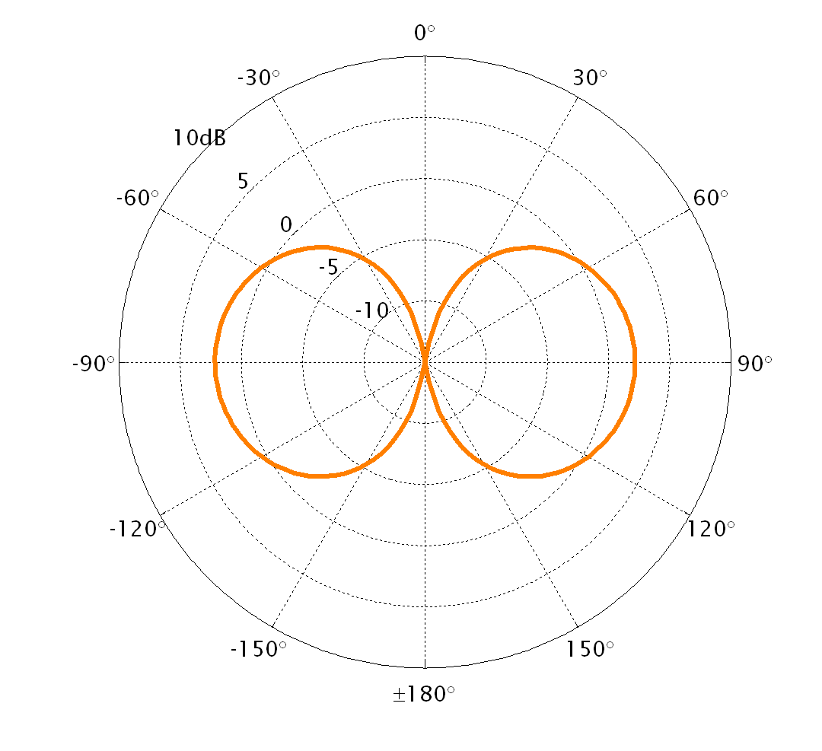
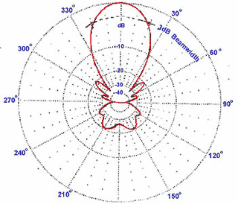
?Antenna Gain?
Gain of a dipole is 2.15 db greater
than an isotropic. G9C04
F/B
G9C07
Main lobe, direction of maximum radiated field strength G9C08

Slide 4
Vertical antenna pattern
G9B03
Omni-Directional

Slide 5
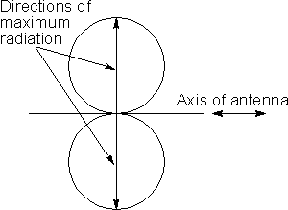
Dipoles
Maximum radiation (fig. 8) at right angles to antenna G9B04
E
½ wavelength
¼ wavelength
Horizontal dipole feed point impedance ≅ 72 ohms
300
Frequency
(MHz)
Wavelength
Meters

Slide 6
Dipoles
Calculate using metric
measurements
or
468 / Freq(MHz)
What is the approximate length in feet of a 1/2 wave dipole for 14.25 MHz.
G9B10
468 / Freq(MHz)
= 32.8 ft.
20 mtr
8 ft
16 ft
24 ft
32 ft
½ wavelength
Horizontal dipole feed point impedance ≅ 72 ohms
300
Frequency
(MHz)
Wavelength
Meters

Slide 7
Dipoles
Calculate using metric
measurements
or
468 / Freq(MHz)
What is the approximate length in feet of a 1/2 wave dipole for 3.55 MHz.
42 ft
84 ft
131 ft
263 ft
468 / Freq(MHz)
= 131.8. ft.
80 mtr
G9B11
½ wavelength
300
Frequency
(MHz)
Wavelength
Meters

Slide 8
Dipoles
E
½ wavelength
Impedance = E/I
Increase Z
Feed point impedance of a half wave end fed would be very high. G9D02
Impedance increases as feed point is moved away from center G9B08

Slide 9
Vertical Antennas with Ground Planes
Feed point ≅ 35 ohms
¼ wavelength
¼ wavelength
Ground plane
¼ wavelength radius min.
Feed point ≅ 35 ohms
Radials can be laying on the ground or buried G9B06
¼ wavelength

Slide 10
Vertical antenna impedance
≅35 Ω
≅50 Ω
≅72 Ω
°
°
°
G9B02
How can we change the feed point impedance of a quarter wave ground plane antenna
What happens to the feed-point impedance of a ground-plane antenna when its radials are changed from horizontal to downward-sloping?
It increases

Slide 11
Vertical Antenna Length Calculation
Use Metric measurements for calculations
or
234 / Freq (MHz)
234 / Freq (MHz)
= 8.21. ft.
(A)
G9B12
What is the approximate length in feet for a 1/4-wave vertical antenna cut for 28.5 MHz?
A. 8 feet
B. 11 feet
C. 16 feet
D. 21 feet
10 mtr

Slide 12
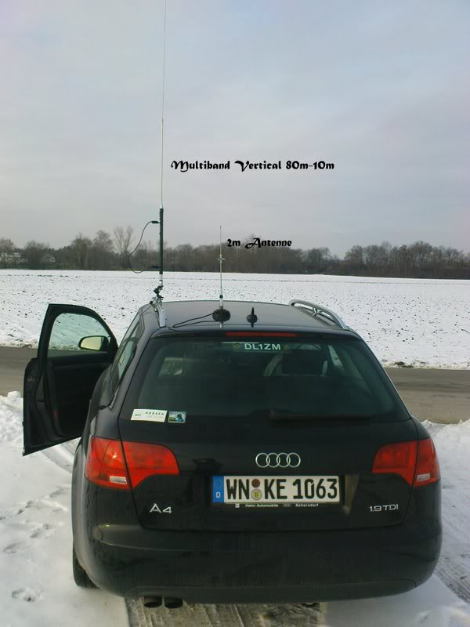
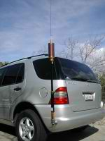
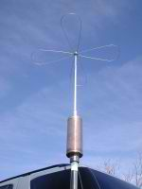
Mobile HF Antennas
"corona ball” G4E02
Operating on a short mobile antenna reduces operating bandwidth G4E06
Capacitive hat, electrically lengthens the antenna G4E01
Loading coil

Slide 13
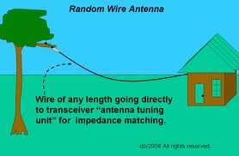
Random Wire Antenna
Feed point is random impedance
Antenna tuner must be used
May result with high RF currents and voltages on equipment and in the shack.
These could result in RF burns. G9B01

Slide 14
How High?
½ wavelength
A change in antenna height above the ground, changes the feed point impedance in a dipole.
Below ½ wavelength in height, as antenna gets closer to the ground the feed point impedance decreases. G9B07
Below ½ wavelength in height, as antenna gets closer to the ground the azimuth pattern becomes more Omni directional. G9B05

Slide 15
Horizontal Advantage
Horizontal polarized antennas have Lower ground reflection losses G9B09

Slide 16
Yagi
Theoretical max forward gain
of a three element Yagi 9.7 dBi
Direction of gain
Front to Back Ratio
The power radiated in the major direction, compared to the power in opposite direction. G9C07
Director
(parasitic)
Shorter than
driven element
G9C03
Reduced interference from the sides and behind
Driven element
½ wave dipole
G9C02
G9C11
Reflector
(parasitic)
Longer than
driven element
G9C03

Slide 17
Yagi
More directors increase gain
Increase the diameter of the elements you increase band width G9C01
A longer boom and adding directors, increases gain. G9C05
14.000
14.350
Feed point impedance of a Yagi
20 to 25 ohms typical
Red lines Represent bandwidth
When designing a Yagi, all of the following variables need to be considered. G9C10
A. The physical length of the boom
B. The number of elements on the boom
C. The spacing of each element along the boom

Slide 18
Gamma, thanks to the Greek

Slide 19
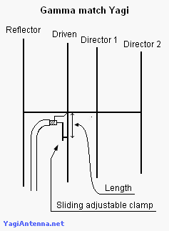
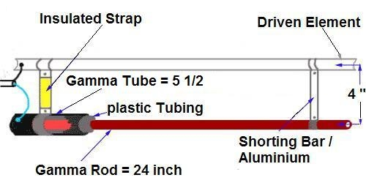
Impedance Matching
In a Yagi antenna, a gamma mach is used to To match the relatively low feed-point impedance to 50 ohms
An advantage of a gamma match, The driven element does not need to be insulated from the boom. G9C12
Several other types of matching methods are used,
And can be found in the ARRL antenna handbook

Slide 20
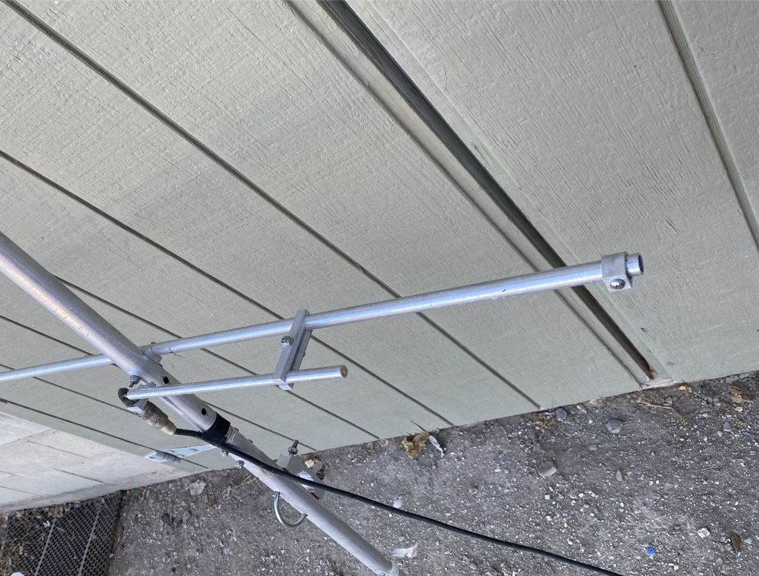

Slide 21
The hairpin match
A shorted transmission line stub placed at the feed point of a Yagi antenna to provide impedance matching. G9C16

Slide 22
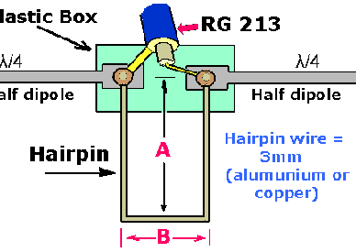
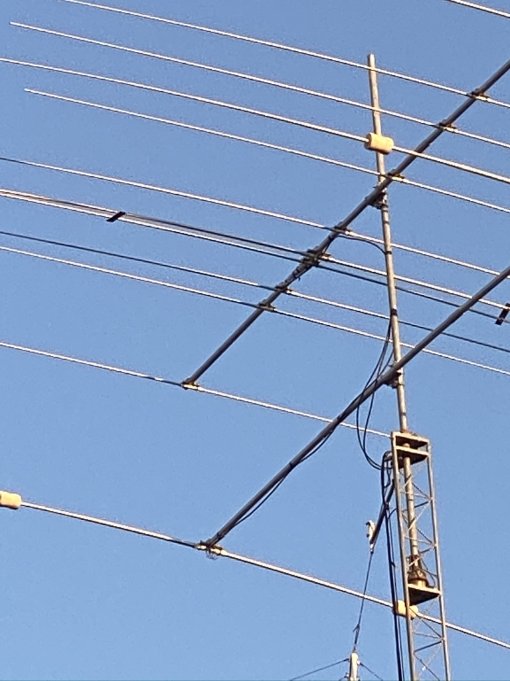
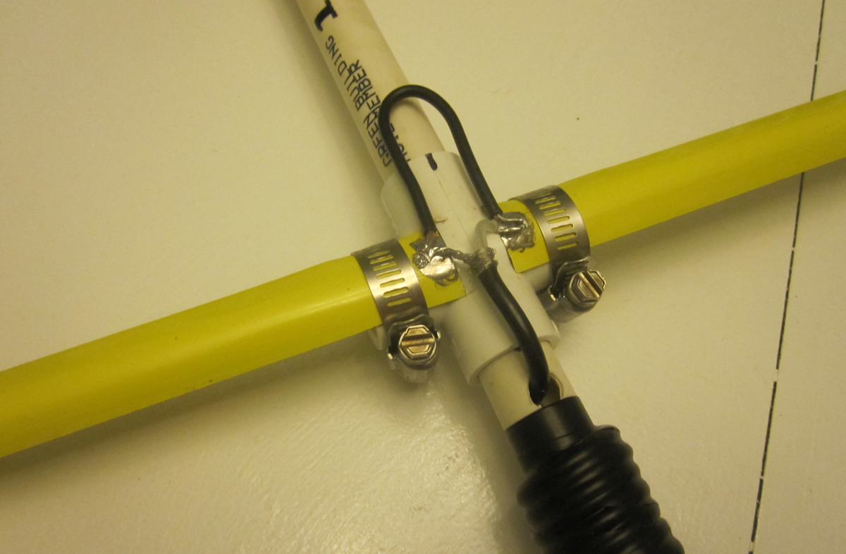

Slide 23
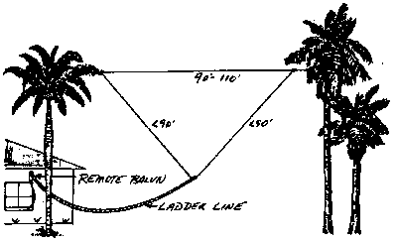
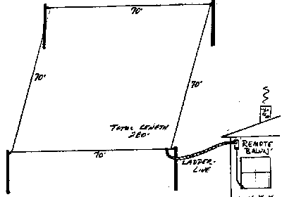
Loop Antenna
A loop antenna consists of a long usually 1 wavelength or longer looped conductor, with the feed point at the two ends.
Virtually omnidirectional with a lower peak vertical radiation angle than a dipole. G9D13
Shortened loop antennas will have nulls broadside to the plane. G9D10

Slide 24
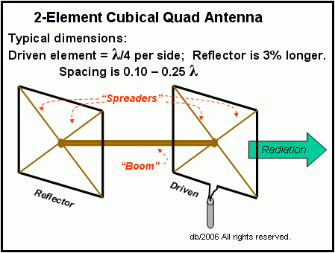
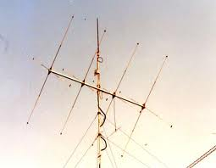
Quad Antenna
Feed point at the side of the loop,
Vertical polarization polarization.
Feed point at the bottom of the loop,
Horizontal polarization.
Length of each side is approx. ¼ wavelength. G9C13
Reflector element approximately 5 % longer. G9C06

Slide 25
‘bout the same
(B)
G9C14
How does the forward gain of a two-element quad antenna compare to the forward gain of a three-element Yagi antenna?
A. About 2/3 as much
B. About the same
C. About 1.5 times as much
D. About twice as much
(D)
How does the gain of a two-element delta-loop beam compare to the gain of a two-element quad antenna?
A. 3 dB higher
B. 3 dB lower
C. 2.54 dB higher
D. About the same

Slide 26
Halo Antenna
Omni-directional in the plane of the halo. G9D03

Slide 27
Screwdriver mobile antenna
A “screwdriver” mobile antenna adjust its feed-point impedance by varying the base loading inductance. G9D08

Slide 28
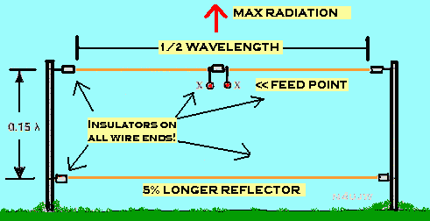
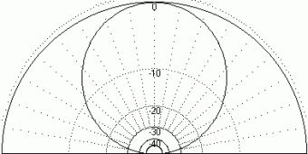
NVIS Near Vertical Incidence Sky-wave
Short distance MF or HF propagation using high elevation angles G3C10
G9D01
Antenna heights between .1λ to .25 λ
NVIS Advantage:
High vertical angle radiation for working stations within a radius of a few hundred kilometers
http://www.athensarc.org/nvis.asp

Slide 29
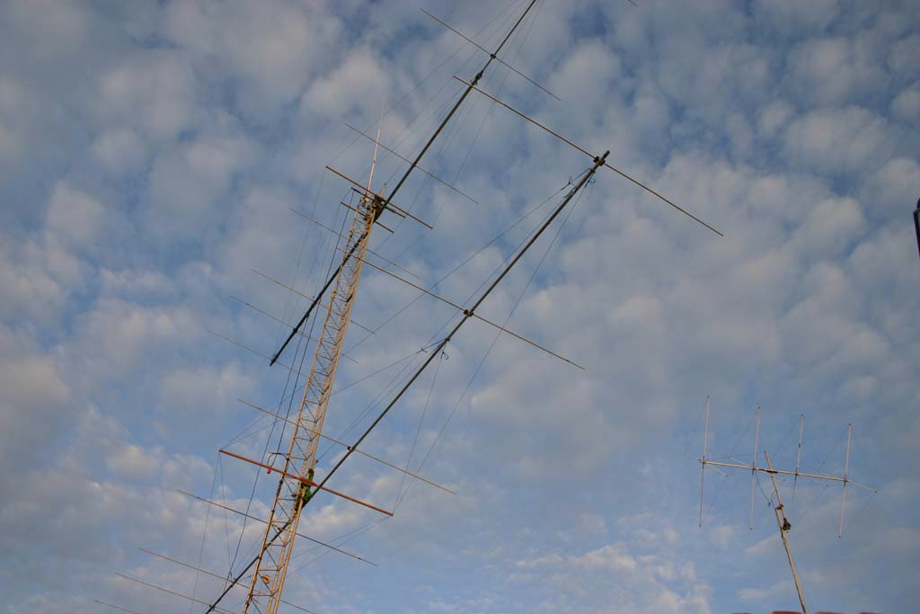
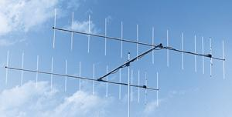
Stacked Antennas
Vertically stacking antennas increase the gain and narrows the elevation beam width G9D05
Stacking two horizontal Yagis at ½ λ apart increases gain 3dB
G9C09

Slide 30
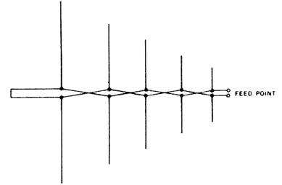
Log Periodic Antenna LPA
LPA Advantage
Wide band width. G9D06
Length and spacing of the elements increases logarithmically from one end of the boom to other. G9D07

Slide 31
Beverage Antenna Traveling Wave Antenna
Invented by Harold Beverage in 1922
A long low directional receiving antenna
Usually less than 20 ft. in height
Receiving end terminated with a resistor
The beverage antenna has high losses, not suitable for transmitting
The primary use for the Beverage antenna is for receiving on the low HF bands G9D09

Slide 32
Beverage Antenna

Slide 33
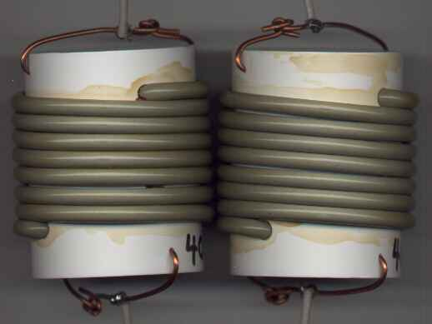
Multi Band Antennas
Traps are used to permit multiband operation. G9D04
Disadvantage of trap antennas,
Trapped antennas have poor harmonic rejection. G9D11
Traps have losses and reduce the efficiency of the antennas.

Slide 34
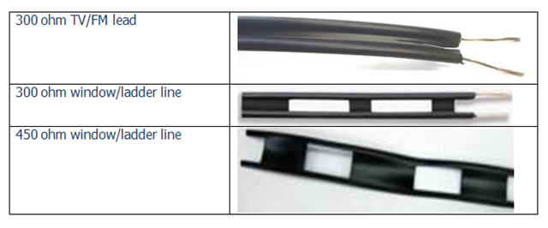
Feed Lines
All Feed lines have a characteristic impedance
The impedance is based on the following physical characteristics:
The geometry of the feed line conductors
The distance between the the center of the conductors
The radius of the conductors. G9A01
Flat line twin conductor window feed line = 450 ohms G9A03
For amateur radio use, we use coax feed line with 50 and 75 ohm impedance. G9A02
All feed lines have loss. Usually measured in dB loss/ 100 Ft. G9A06
As frequency increases, loss increases G9A05
Small diameter feed lines generally have higher losses than large diameter.

Slide 35
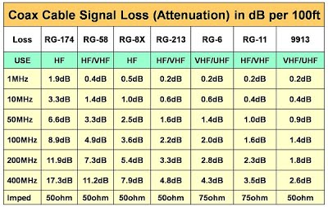
Coax Loss

Slide 36
SWR
Reflected power can occur when ever there is a mismatch in impedance G9A04
Standing waves occur whenever reflected waves interfere with forward waves.
SWR is always greater than 1:1
SWR is the ratio of the higher impedance to the lower. SWR = higher impedance/lower
G9A09
What standing wave ratio will result from the connection of a 50-ohm feed line to a non-reactive load having a 200-ohm impedance?
A. 4:1
B. 1:4
C. 2:1
D. 1:2
(A)
G9A10
What standing wave ratio will result from the connection of a 50-ohm feed line to a non-reactive load having a 10-ohm impedance?
A. 2:1
B. 50:1
C. 1:5
D. 5:1
(D)
There are five similar questions G9A09 – G9A13

Slide 37
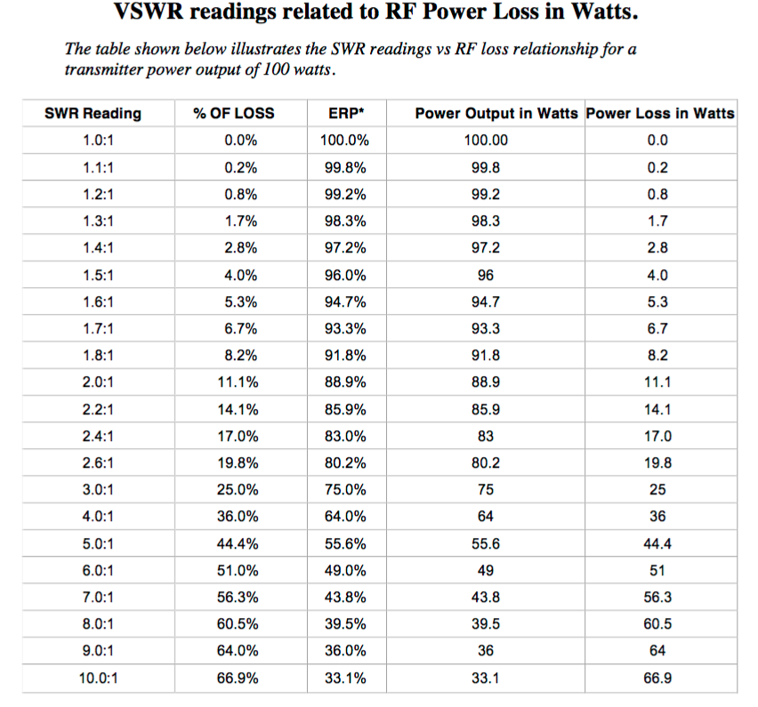
SWR vs. Loss

Slide 38
Impedance Matching
The ideal situation is to have feed line and load impedance match
to prevent standing waves G9A07
Most often the impedance is matched between the transmitter and the feed line.
This matching is usually done with an antenna coupler or antenna tuner G4A06

Slide 39
Antenna
50 Ω impedance
G9A11
What standing wave ratio will result when connecting a 50 ohm feed line to a non-reactive load having 50 ohm impedance?
Transmitter
50 Ω impedance
Feed line 50 Ω
SWR = 1:1
SWR = Antenna Impedance divided by feed line impedance
Answer always is + number 1 or over, to 1

Slide 40
Antenna
200 Ω impedance
G9A09
What standing wave ratio will result when connecting a 50 ohm feed line to a non-reactive load having 200 ohm impedance?
Transmitter
50 Ω impedance
Feed line 50 Ω
SWR = 4:1
36% loss of power

Slide 41
Antenna
250 Ω impedance
G9A08
If the SWR on an antenna feed line is 5 to 1, and a matching network at the transmitter end of the feed line is adjusted to 1 to 1 SWR, what is the resulting SWR on the feed line?
Transmitter
50 Ω impedance
Antenna Tuner
Feed line 50 Ω
G4A06
SWR = 5:1

Slide 42
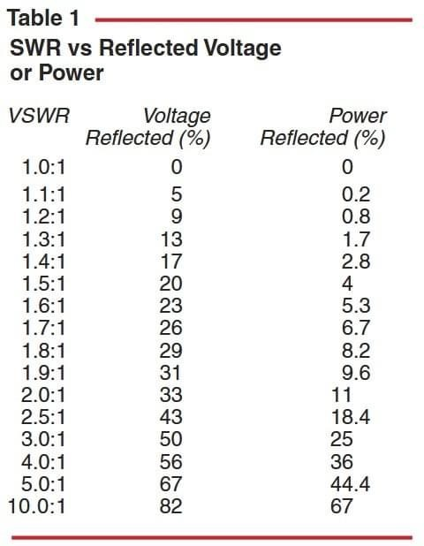
Loss is Loss

Slide 43
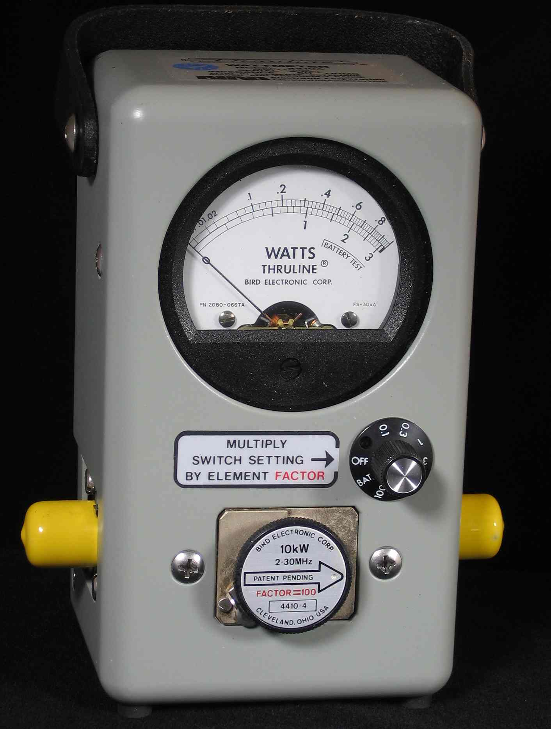
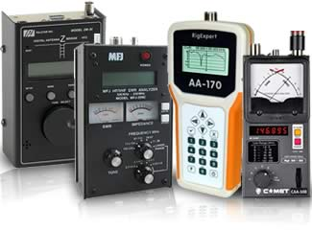
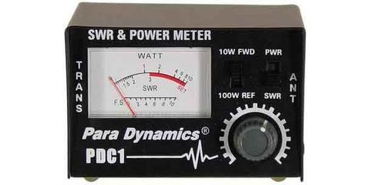
How do we measure impedance matching and SWR
^{G4B10}
Antenna Analyzer
SWR Meter

Slide 44
For Next Week
Study flash cards www.hamexam.org
Radio
Fundamentals
ARRL Ch. 1, 2, 3, 6
Electricity
ARRL Ch. 4
Equipment
ARRL Ch. 5
Equipment
Cont.
ARRL Ch. 5
Propagation
ARRL Ch. 8
Antennas
ARRL Ch. 7
Digital
ARRL Ch. 6
General
Intro
Resistors
Capacitors
AC Power
The Reactive
components
Semi-
conductors
Radio signals
And equipment
Filters, DSP
Station Installation
Propagation
Antennas
Feedlines
Rules & Regs
Lesson 1
G1A
G1C
G2A
G2B
G4A part
G4D part
G8A
Lesson 2
G1B part
G2B
G2C
G1D
G1E part
G8C part
Lesson 4
G5A
G5B
G6A
Lesson 5
G4B
G4E
G6A
G6B
G7A
G7B
Lesson 6
G4E
G9A
G9B
G9C
G9D
Lesson 7
G4A
G4B
G4C
G4D
G7B
G7C
G8A
G8B
Lesson 8
G3A
G3B
G3C
Lesson 9
G4E
G9A
G9B
G9C
G9D
Lesson 10
G2C
G2E
G8A
G8B
G8C
Lesson 3
G5B
G5C
Safety
Ch. 9
73
Tom and Jack
Lesson 11
G0A
G0B

