Slide 1
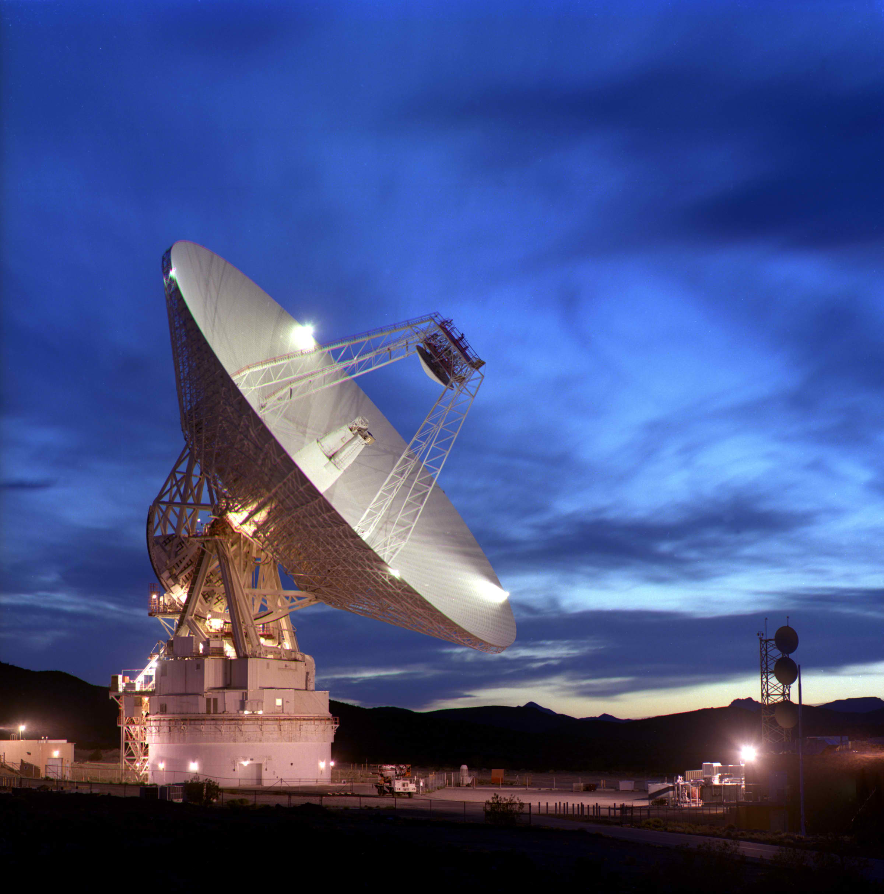
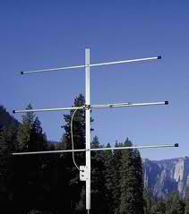
Welcome to Amateur Radio 101 0r officially Element 2 Technician Class License
Instructors
Jack Lindley W6YOY
John (Tom) Foster N6FVY
Update 7/2022
G. West: Tech Class Privileges p. 2 - 27
Tech Frequencies p.55
Arrl: Chapter 1 & 2

Slide 2
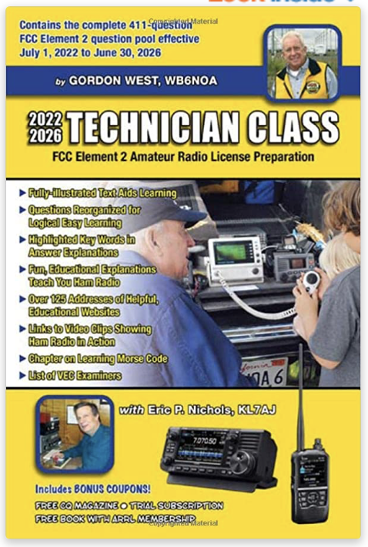
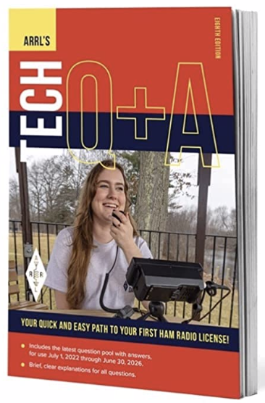
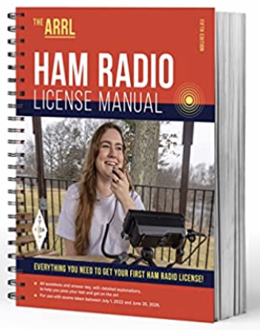
Class Reference
wednettraining.com
Flash Card Study
Notes:
Chapter 10 Glossary important. New jargon to learn.

Slide 3
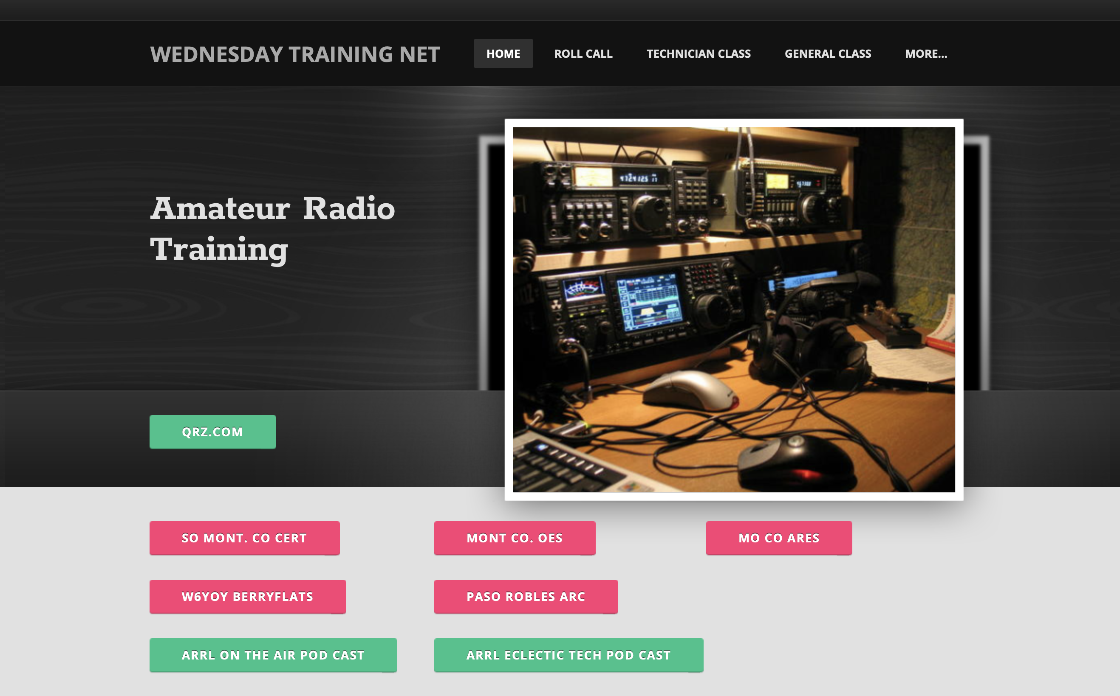
wednettraining.com

Slide 4
Wednettraining.com

Slide 5
Internet Resources
Hamexam.org Good reference for flash cards, but you must work with your stats. Web based
Ham Radio Exam iOS APP excellent.
by Roy Watson
Hamstudy.org Good reference for flash cards, Many great links. Get on and play.

Slide 6
For Next Week
Study flash cards www.hamexam.org
Radio
Fundamentals
Rules &
Regs
Comm w/
Others
Antennas
Propagation
Equipment
Electricity
Safety
Lesson 1
T1B
T3B
Lesson 2
T1A
T1C
TID
T1E
T1F
Lesson 4
T2A
T2B
T2C
T8B
T8C
Lesson 5
T3A
T3C
T9A
T9B
T7C
Lesson 6
T4A
T4B
T7A
T7B
T8D
Lesson 7
T5A
T5B
T5C
T5D
T6A
T6B
T6C
T6D
T7D
Lesson 8
T0A
T0B
T0C
73
Tom and Jack
Modulation
Lesson 3
T8A

Slide 7
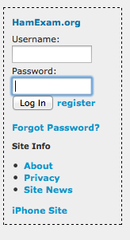
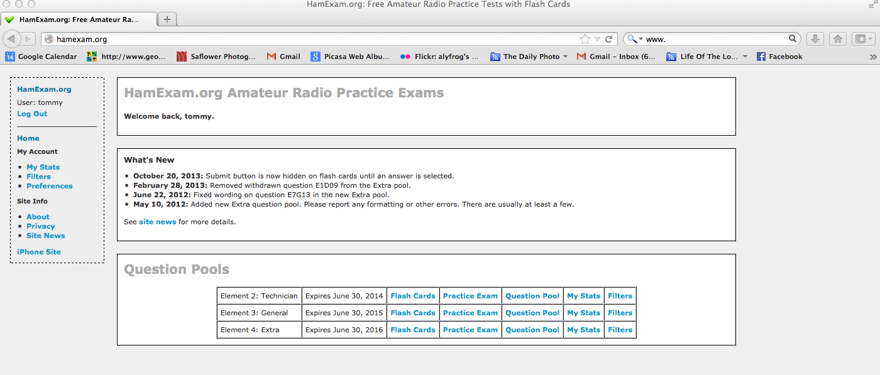
Hamexam.org
Reset Stats if needed
Select user name and register for Hamexam

Slide 8
Hamexam.org
Select Filter
1. Go to element 2 and select filters

Slide 9
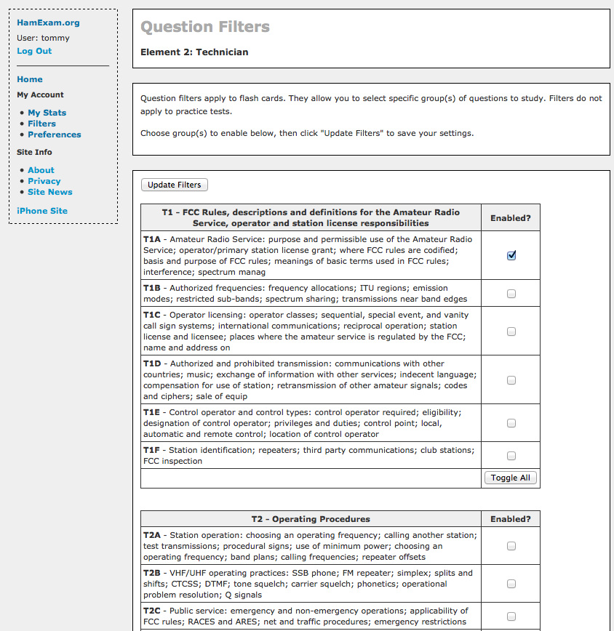
1. Set your Question Filters
2. Update filters
3. Go home

Slide 10
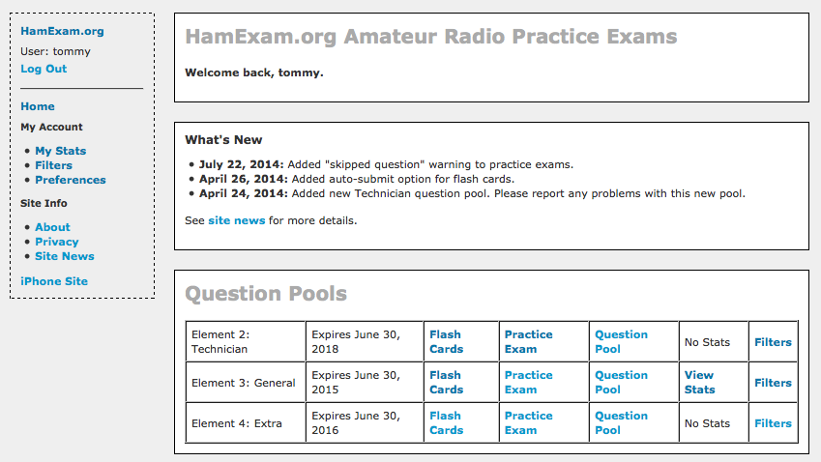
2. Start your flash card study

Slide 11
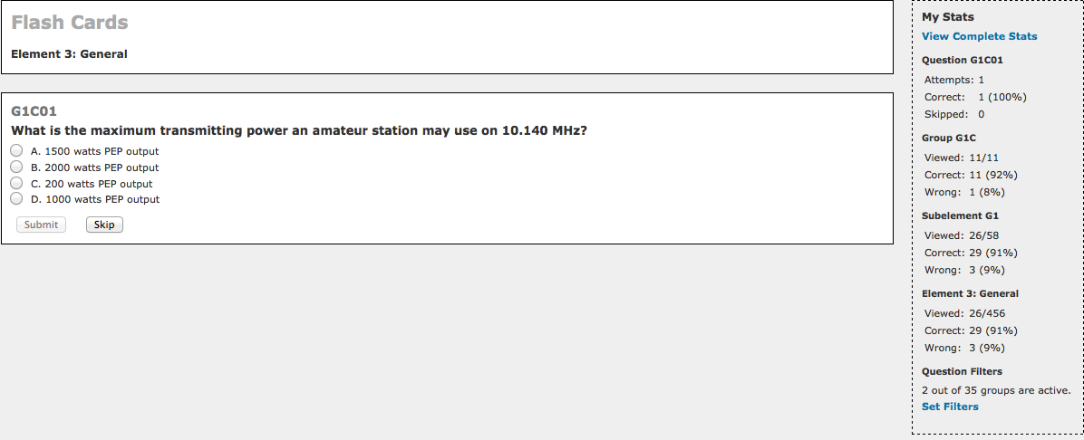
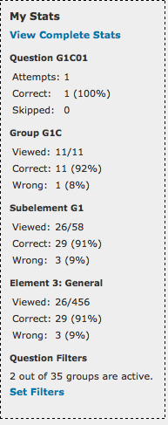

Slide 12
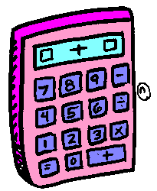
Practice exams
Flash cards
Use your Calculator.

Slide 13
The Test
423 Questions
35 Sections
Question from each section
35 Questions on the test
26 Correct to pass
All questions are published
http://www.ncvec.org/page.php?id=373
Notes:
Two ways to study for your license exam
Cram – take a one day class Learn answers but very little about radio.
Radio Class Learn by doing and hands on.

Slide 14
Study Hints
Mark the questions in your books with a color code
1. Study the right answer
2. Use a color code to mark questions. (mark with colored pencil)
Green – Answers you immediately know
Yellow – Answers you know after seeing one time
Orange – Answers you need to study to learn
Red - Answers you have a hard time learning
3. Before test study red and orange marked questions
4. Day of the test study red questions

Slide 15
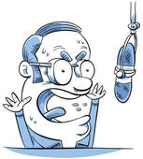
Technician Class
Ridiculous Relationships
Find a connection with the question to the answer
by Grace

Slide 16
What is The Purpose of Amateur Radio?
Ridiculous Relationships
T1A01 (C) [97.1]
Which of the following is part of the Basis and Purpose of the Amateur Radio Service?
A. Providing personal radio communications for as many citizens as possible
B. Providing communications for international non-profit organizations
C. Advancing skills in the technical and communication phases of the radio art
D. All of these choices are correct
Find the key to unlock your minds memory link
Advancing skills in the technical and communication phases of the radio art
Notes:
If you have the technology, you might consider playing a few video clips of ham radio related activities such as the Cronkite video or perhaps some of the material produced by Icom.
Tell the audience what ham radio means to you, your personal stories will be very motivational.
A key point to make is the private nature of ham radio. Don’t overemphasize this point so that it becomes boring, but simply state that you can’t make money operating a ham radio. (Also don’t quibble about the special exceptions on making money through ham radio. The only exception that most hams are likely to encounter is teachers using ham radio in the classroom…this might be a good exception to bring up.)

Slide 17
Ham Radio
Something for Everyone

Slide 18
What is Ham Radio used for?
Hobby ……….. Emergency Communications
Radio communications between two or a multiple of operators
For community events
For travel
Hunting, fishing, outdoor exploring, off-roading
Experimentation
DIY project building
A working knowledge of RF theory and electricity
A variety of events and contests
Gateway to a career.

Slide 19
Emergency Communications
§ 97.1 Basis and purpose.
(a) Recognition and enhancement of the value of the amateur service to the public as a voluntary noncommercial communication service, particularly with respect to providing emergency communications.

Slide 20
Guglielmo. Marconi
1874 – 1937
Italy
First trans-Atlantic broadcast
1901
Visionary, businessman
Cornwall, England, to Newfoundland, Canada
Sent Morse Code symbol “S”
Nikola Tesla
1856 – 1943
Austrian Empire, Croatia
First concept of radio
Experimenter, Imaginary
1891 – 92 developed RF transmission with resonate coils, two U.S. patients 1n 1897

Slide 21
“Wireless Registry” 1908
The “Blue Book”
“Radio Act of 1912”
(KDA-KZZ)
First U.S. Amateur radio license issued
American Radio Relay League
1915

Slide 22
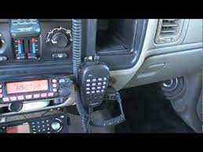
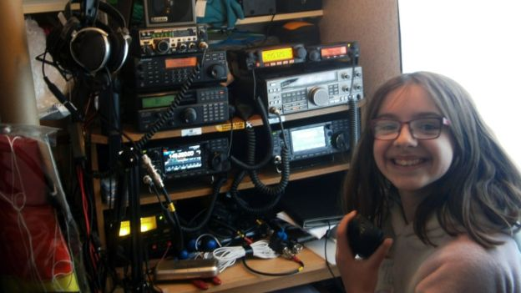
Who can become a Ham
Open to All
No age Requirement
Hams range in age from 5 to 106 + years
One restriction
Can not be a representative of a foreign government
Element 2 Technician Class
Element 3 General Class
Element 4 Extra Class
Notes:
The three different elements
Element 1

Slide 23
Amateur Radio Different from other Radio Service
28 Bands
of which
15 in common use
Broad Frequency Coverage
Work on or build your own equipment
Experiment
Max Power - 1500 W PEP
FRS Family Radio Service - no license 2 watts max
GMRS General Mobile Radio Service - License required 5 W
CB Citizen Band - No License - 4 watts output.
MURS Multi User Radio Service - No license - 2 watts max

Slide 24
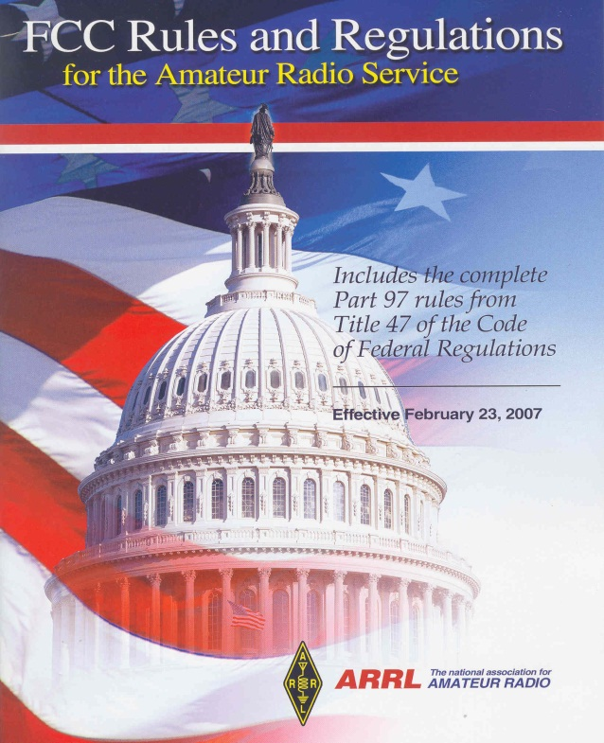
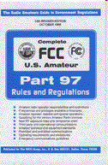
FCC
T1A02 The agency that regulates and enforces the rules for the Amateur Radio Service in the United States is the FCC.
Part 97 of the FCC rules contains the rules and regulations governing the Amateur Radio Service.
Part 97 Amateur Radio regulations are contained in Title-47 Telecommunication. (3 inches thick)
FCC governs Amateur Radio Service
Notes:
Just learn

Slide 25
Internationally
The ITU (International Telecommunications Union) is a United Nations agency for information and communication technology issues.
Notes:
Just learn

Slide 26
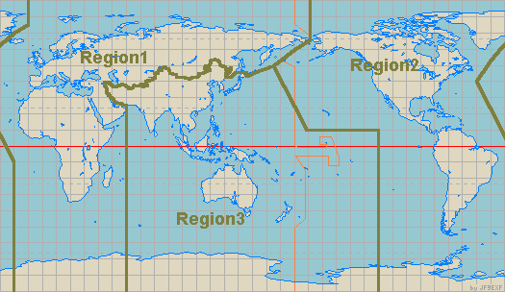
Three ITU Regions
North American amateur stations are located in ITU Region 2
Some US territories are located in other ITU Regions
Maritime Mobile (can be in any ITU region)
North America
ITU
Region 2
Notes:
Just remember we are in region 2

Slide 27
For Next Week
Study flash cards www.hamexam.org
Radio
Fundamentals
Rules &
Regs
Comm w/
Others
Antennas
Propagation
Equipment
Electricity
Safety
Lesson 1
T1B
T3B
Lesson 2
T1A
T1C
TID
T1E
T1F
Lesson 4
T2A
T2B
T2C
T8B
T8C
Lesson 5
T3A
T3C
T9A
T9B
T7C
Lesson 6
T4A
T4B
T7A
T7B
T8D
Lesson 7
T5A
T5B
T5C
T5D
T6A
T6B
T6C
T6D
T7D
Lesson 8
T0A
T0B
T0C
73
Tom and Jack
Modulation
Lesson 3
T8A

