Slide 1
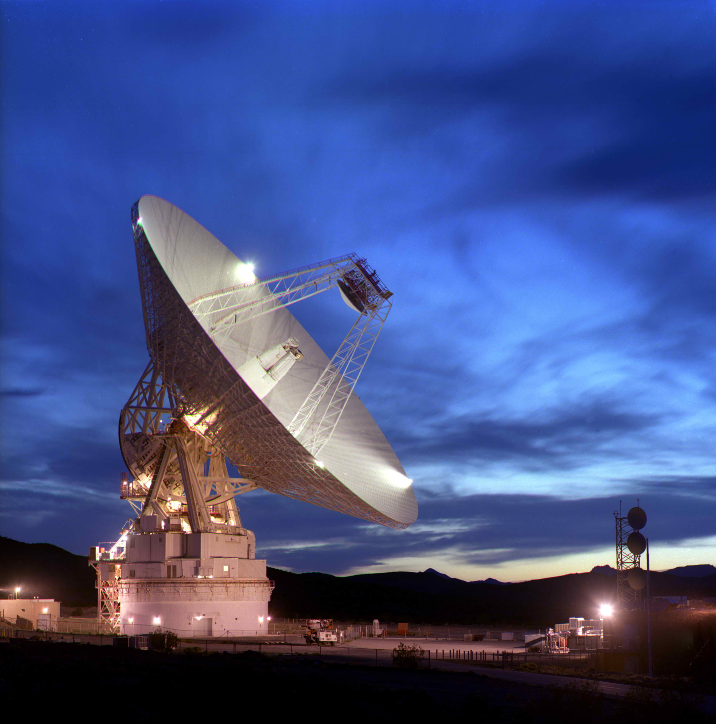
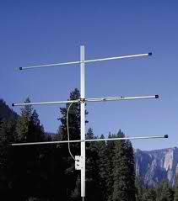
Frequency Spectrum
and
Modulation
Adding info to a radio wave
Update 7/2022
G. West: Tech Class Privileges p. 2 - 27
Tech Frequencies p.55
Multi-Mode Radio Excitement p.119
Arrl: Chapter 1 & 2

Slide 2
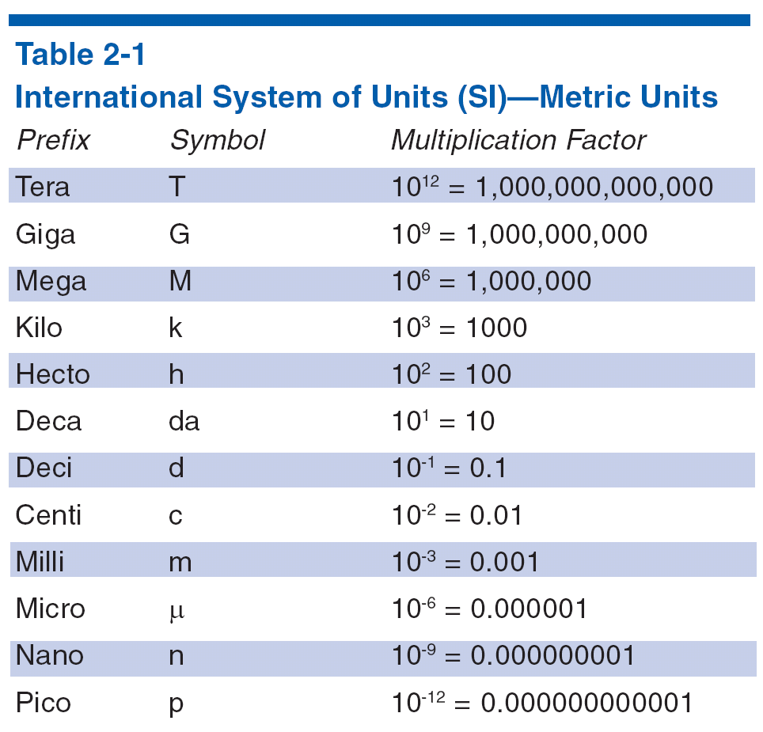
Metric Units
Grace Says “ Left up right Down”
T5B01
T5BO2
T5B03
T5B04
T5B05
T5B06
T5B07
T5B08
Convert up
Decimal Left
Convert down
Decimal Right
Unit
Example
7.2 MHz = ? Kilo Hz
7.2 (move decimal three places to the right)
7200. KHz
Notes:
Point out the most likely units the students will have to deal with on the exam like milli, micro, kilo, mega, etc. Using examples from test questions give the students some homework to convert between units. Remembering that Ohm’s Law, the basic units for voltage, current and resistance are required.

Slide 3
The Radio Frequency Spectrum
Technician
playground
80
40
15
10
6
2
1.2
.7
160
20
60
30
17
12
We refer to frequency bands by either approx. wavelength or frequency T3B07
Wavelength = 300 / Frequency ( MHz ) T3B06

Slide 4
Simple Math calculator
300
T3B06
Frequency
(MHz)
Wavelength
Meters
Example 2. T1B03
What frequency is within the
6 meter band?
Example 1. T1B04
Which amateur band includes 146.52 MHz?
= 50
- 54
49.00 MHz
52.525 MHz
2.047 or
Approximately 2 meters
28.50 MHz
222.15 MHz
Notes:
Keep it simple. Work all frequency and wavelength problems using meter. Convert to feet or inches at the last step if necessary. Average is close enough to fit the given answers.

Slide 5
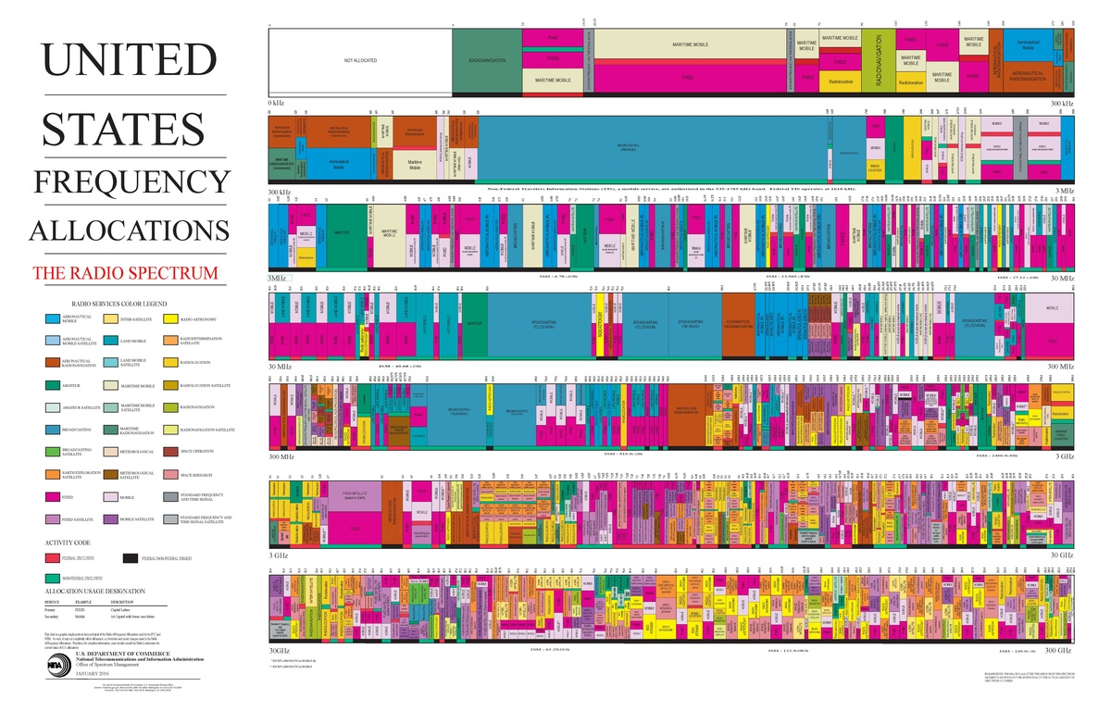
HF
VHF
UHF

Slide 6
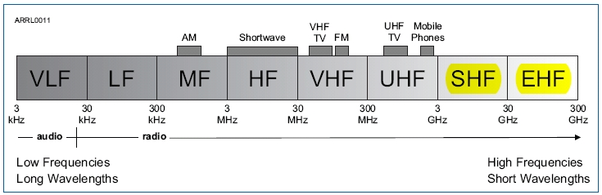
Radio Frequency (RF) Spectrum
High Frequency
3 – 30 kHz VLF
30 – 300 kHz LF
300 kHz – 3 MHz MF
3MHz – 30 MHz HF
30 MHZ – 300 MHz VHF
300 MHz - 3,000 MHz UHF
3 GHz – 30 GHz SHF
30 GHz – 300 GHz EHF
Very High Frequency
T3B10
T3B08
T3B09
Ultra High Frequency
Notes:
Point out on the diagram where familiar signals are located like AM/FM commercial radio, police and fire channels, TV, satellite TV. Point out how each segment acts differently from adjacent segments. Don’t be afraid to tell them that it isn’t that simple, that the lines between segments sometimes are a little fuzzy, that is part of the fun of radio.

Slide 7
Where does amateur radio live in the frequency spectrum
T3B05
>>Wavelength Gets shorter>>>frequency increases >>>>Loses increase>>>Communications become line of sight>>>>
 | MF |  |  | HF |  |  | VHF |  |  | UHF
300 KHz |  |  | 3 MHz |  |  | 30 MHz |  |  | 300 MHz
 |  |  | 3.5 MHz | 80 Meters | 4 MHz
 |  |  | 5.33 MHz | 60 Meters | 5.4035 MHz |  | CHP |  | 420 MHz | 70 cm | 450 Mhz
 |  |  |  |  |  |  |  |  |  | FRS/GMRS
 |  |  | 7 MHz | 40 Meters | 7.3 MHz | 50 MHz | 6 Meters | 54 MHz
 |  |  | Lower sideband
 |  |  | Upper sideband
 |  |  | 10.1 MHz | 30 Meters | 10.150 MHz
 | AM |  |  |  |  |  | TV
 |  |  |  |  |  | 88 | FM
 | Broadcast |  |  |  |  |  | Broadcast | 108 | 902 MHz | 33 cm | 928 MHz
 |  |  |  |  |  |  | TV
 |  |  |  |  |  |  | Aviation
 |  |  |  |  |  |  | Aviation |  |  | Cell Phone
 |  |  | 14 MHz | 20 Meters | 14.350 MHz |  | Military |  | 1240 MHZ | 23 cm | 1300 MHz
 |  |  |  |  |  | 144 MHz | 2 Meters | 148 MHz
 |  |  |  |  |  |  | Municipal
1.8 MHz | 160 Meters | 2 MHz
 |  |  |  | 17 Meters
 |  |  |  | 15 Meters
 |  |  |  |  |  | 219 MHz | 1.25 Meters | 225 MHz
 |  |  |  | 12 Meters
 |  |  |  | CB
 |  |  | 28 MHz | 10 Meters | 29.7 MHz
3 MHZ |  |  | 30 MHz |  |  | 300 MHz |  |  | 3000MHz
Primary a night time band. |  |  | Primary General and Extra Class privileges |  |  | Technician class home range |  |  | Technician class home range
Very short daytime range |  |  | Limited Technician privileges |  | SSB on 10 M | 6 meters the un-predictable band |  |  | Line of sight communications
 |  |  | CW on 40 and 15 meters |  |  | Line of sight communications |  |  | Suited for repeater operation
 |  |  | Long distance communications |  |  | Suited for repeater operation |  |  | 70 cm suited for mobile and portable
 |  |  | Large antennas. |  |  | FM and digital modes.
 |  |  | Day to night from upper to lower freq. |  |  | Suited for mobile and portable comm.
 |  |  | 60 and 30 meter special restrictions |  |  | 2 mtr SSB and CW at lower band edge
 |  |  | Solar activity critical |  |  | Satellite and EME |  |  | Satellite and EME
Wavelength = 300/ Freq. (MHz) |  |  | Frequency (MHz) = 300/ Wavelength (mtrs.) |  |  | Speed of light = 300,000,000 meters / sec.
462.5625 MHz
FRS/GMRS
1490 kHz
KRKC AM
Many of our
Handheld radios
102.1 MHz
KRKC FM

Slide 8
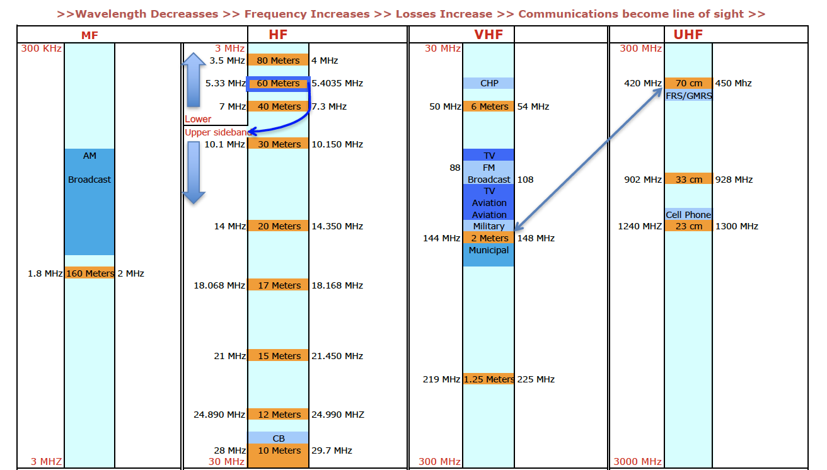
Notes:
A reference that you will always available at the site of your station.

Slide 9
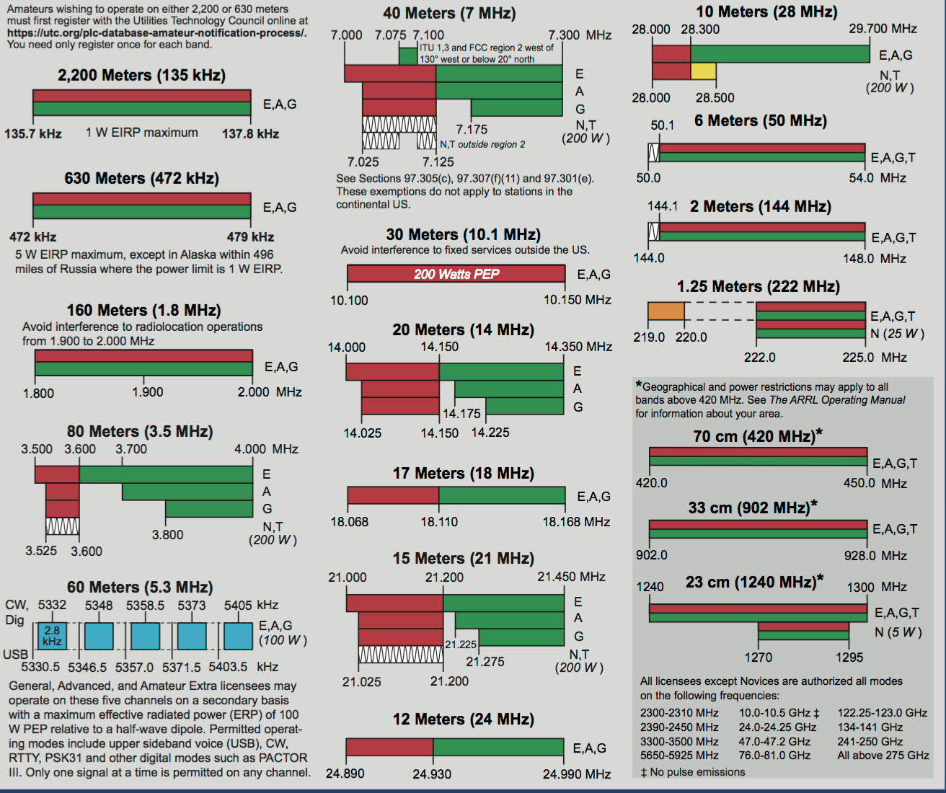
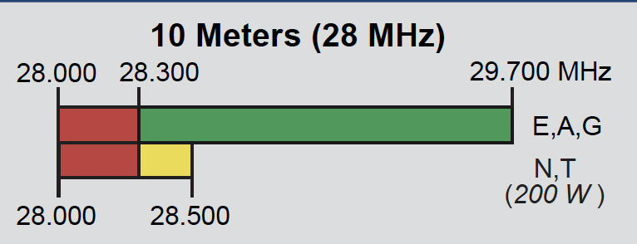

T1B01 Which of the following frequency ranges are available for phone operation by Technician licensees?
A. 28.050 MHz to 28.150 MHz
B. 28.100 MHz to 28.300 MHz
C. 28.300 MHz to 28.500 MHz
D. 28.500 MHz to 28.600 MHz
Answers to the question refer to the 10 meter band
T1B06 On which HF bands does a Technician class operator have phone privileges?
A. None
B. 10 meter band only
C. 80 meter, 40 meter, 15 meter and 10 meter bands
D. 30 meter band only
Ridiculous Relationship
Lowest of the choices

Slide 10
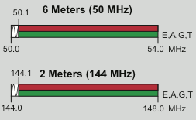
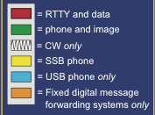
Mode Restricted Sub-Band
T1B07 Which of the following VHF/UHF frequency ranges are limited to CW only?
A. 50.0 MHz to 50.1 MHz and 144.0 MHz to 144.1 MHz
B. 219 MHz to 220 MHz and 420.0 MHz to 420.1 MHz
C. 902.0 MHz to 902.1 MHZ
D. All of these choices are correct
Ridiculous Relationship
Lowest of the choices
Notes:
On certain bands, and as a technician you are restricted to a particular mode in portions of some bands 6 and 2 meters has a restriction of CW only in the bottom 100kHz.

Slide 11
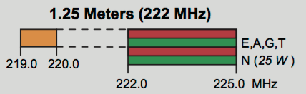
T1B05 How may amateurs use the 219 to 220 MHz segment of 1.25 meter band?
A. Spread spectrum only
B. Fixed digital message forwarding systems only
C. Emergency traffic only
D. Fast-scan television only
(B)
Some you just have to memorize
Notes:
In addition to 6 and 2 meter, 1.25 has a restriction to Fixed Digital Forwarding. There are other restrictions, but only need to know these three. And on this one, not the type of restriction.

Slide 12

Radio Waves are AC
Radio waves (electromagnetic Energy) are AC waves. (Alternating Current)
Radio waves are used to carry the information you want to convey to someone else.
"You see, wire telegraph is a kind of a very, very long cat. You pull his tail in New York and his head is meowing in Los Angeles. Do you understand this? And radio operates exactly the same way: you send signals here, they receive them there. The only difference is that there is no cat." Albert Einstein

Slide 13


Slide 14
LET’S MAKE AN
ELECTRO-MAGNETIC
WAVE

Slide 15
Guglielmo Marconi's spark gap transmitter, with which he performed the first experiments in practical radio communication in 1895-1897

Slide 16
Alexanderson alternator, a huge rotating machine used as a radio transmitter at very low frequency from about 1910 until World War 2

Slide 17
Radio Waves
To the moon
380,000,000 m
Around the earth
40,000,000 m
= 1.26 sec.
= .13 sec.
  T3B03 Electric and magnetic fields are the two components of a radio wave.
  T3B04 Radio waves travel through free space at the speed of light.
  T3B05 As the wavelength gets shorter the frequency increases.
      Higher in frequency the shorter the distance between each wave.
      They are at right angles to each other and together are called “electromagnetic” radio waves
T3B11
Speed of light= 300,000,000 meters / sec.
Notes:
When we discuss the polarization of an antenna, weather horizontal or vertical, re refer to the Electric or E field.

Slide 18
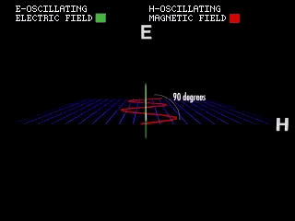
http://www.youtube.com/watch?v=cfXzwh3KadE

Slide 19
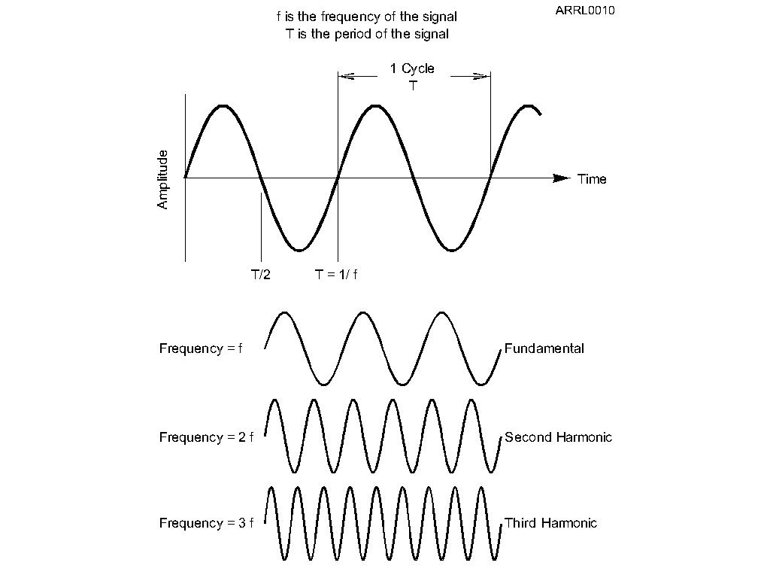
Wave Vocabulary
Before we study radio waves, we need to learn some wave vocabulary.
  Amplitude
  Frequency
  Wavelength
  Harmonics
The strength of the signal
T5A12
The number of cycles in one second
The distance the wave travels
during one complete cycle
Integer multiple of the frequency
Hz (Hertz) = 1 cycle per second
Notes:
Spend some time with live demonstration to make sure the students are really familiar with the concepts and vocabulary of waves. These demonstrations could include using audio frequency generator connected to a speaker and oscilloscope to allow students to hear a audio sine wave and see the wave. This will allow you to point out the differenced between amplitude and frequency, the relationship between frequency and wavelength, the relationship between frequency and period.

Slide 20
Modes
The type of, or method of, putting information on a radio wave.
Common mode types:
Voice, or (PHONE)
AM, SSB, FM
CW (Continuous Wave) Morse Code
Digital
Video

Slide 21
Modulation
Adding Information -
When we add information on the radio wave, we modulate the wave.
  Turn the wave on and off – CW
  Voice -- AM and FM
  Data
Different modulation techniques are called modes.
Only three ways to add information to a RF wave
AM
FM
PM
Notes:
You now need to make the jump from the discussion of radio spectrum and antenna resonance to the concept of modulation. The important concept here is understanding that modulation is imprinting information on the carrier radio wave. There are different ways to do this imprinting; those different ways are called modes.

Slide 22
Bandwidth
When information is added to a carrier frequency bandwidth is created.
CW Signals have the narrowest bandwidth T8A05
CW ≈ 150 Hz.
SSB ≈3 kHz.
AM ≈ 6 kHz.
FM ≈ 15 kHz.
FS Analog TV ≈ 6MHZ.
Notes:
Must know bulleted bandwidth. The questions that appear in the pool in reference to Mode type.

Slide 23
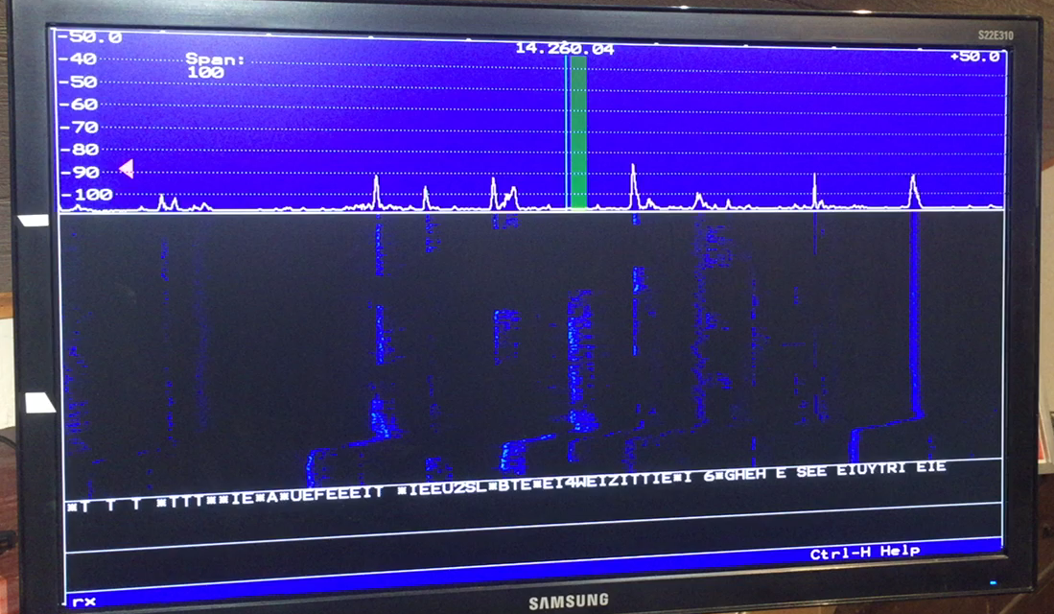
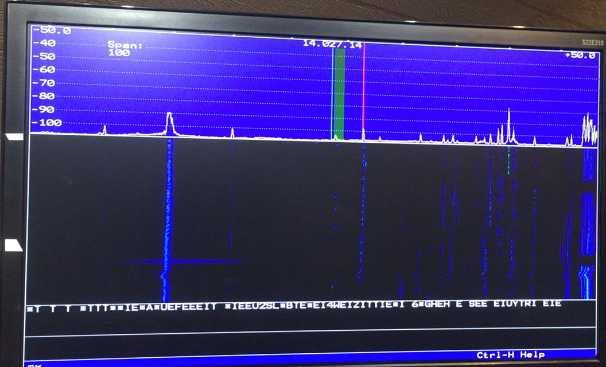
Single Side Band
3kHz
CW
150 Hz

Slide 24
Center Frequency
Band Edge
T1B09 Why do we set our transmitter
Frequency away from the band edges?
Transmit Freq
CW ≈ 150 Hz
T8A08 – T8A11
Its all about bandwidth of the modes
So sidebands do not extend beyond band edges
AM ≈ 6 kHz
To allow for calibration error of transmitter display
SSB ≈ 3 kHz
To allow for transmitter frequency drift.
FM ≈ 10-15 kHz
TV ≈ 6 MHz
Notes:
An arbitrary band with relative bandwidth of different modes. Illustrates that wide bands are required for the larger bandwidth signals. Again this is just a relative illustration not to scale.

Slide 25
Modulation

Slide 26
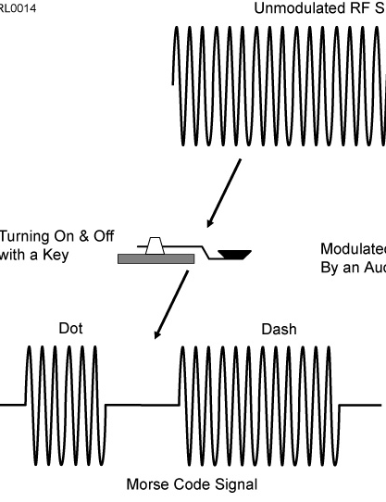


CW - Morse Code – On and Off
T8A11, Bandwidth for CW
150 Hz
Notes:
The information is in the radio wave itself turning on and off. The original on Digital mode called international Morse.

Slide 27
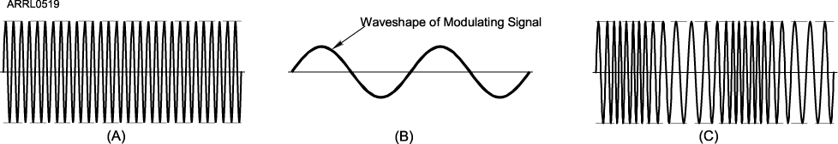
FM Modulation
T8A02, T8A04 Most common for Packet, and Repeater voice.
Information is added to the carrier by slightly changing the frequency, called deviation
Added information creates bandwidth
T8A09, Bandwidth of amateur VHF repeater FM phone signal
10 – 15 kHz
Notes:
The frequency of the radio wave is changed (deviated) by the amount determined by amplitude of the modulating signal. The louder you speak the greater the deviation. The frequency of our voice
Is contained in the frequency in which the deviation occurs.

Slide 28
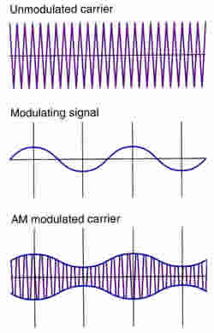
Amplitude Modulation (AM)
In AM, the amplitude of the carrier wave is modified in step with the waveform of the information (voice).
Bandwidth, 6 kHz.
Notes:
An audio signal is added to a RF signal combining to give a Amplitude Modulated carrier.

Slide 29
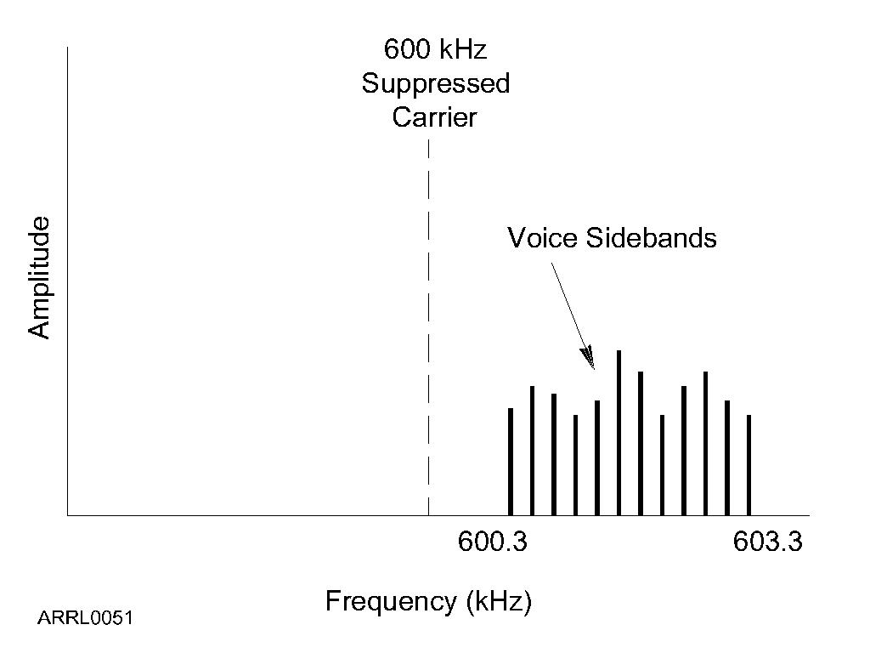
Lower sideband
Single Sideband Modulation (SSB)
Upper sideband
Since voice is made up of identical mirror image sidebands:
We can improve efficiency of transmission by transmitting only one sideband and then reconstruct the missing sideband at the receiver.
T8A08 approx 3 kHz
T8A07
What is the primary advantage of single sideband over FM for voice transmissions?
A. SSB signals are easier to tune
B. SSB signals are less susceptible to interference
C. SSB signals have narrower bandwidth
D. All of these choices are correct
(C)

Slide 30
Single Sideband Modulation (SSB)
Is:
Fun Facts:
A form of amplitude modulation. T8A01
Used on long distance weak signal signal VHF and UHF bands. T8A03
Upper sideband is normally used for 10 meter HF, VHF and UHF single sideband communications. T8A06
The approximate bandwidth of a SSB signal is 3 kHz. T8A08
SSB can be used in amateur bands above 50 MHz. T1B10
in at least some portion of all bands

Slide 31
For Next Week
Study flash cards www.hamexam.org
Radio
Fundamentals
Rules &
Regs
Comm w/
Others
Antennas
Propagation
Equipment
Electricity
Safety
Lesson 1
T1B
T3B
Lesson 2
T1A
T1C
TID
T1E
T1F
Lesson 3
T2A
T2B
T2C
T8B
T8C
Lesson 4
T3A
T3C
T9A
T9B
T7C
Lesson 5
T4A
T4B
T7A
T7B
T8D
Lesson 6
T5A
T5B
T5C
T5D
T6A
T6B
T6C
T6D
T7D
Lesson 7
T0A
T0B
T0C
Modulation
73
Tom and Jack
Lesson 1.2
T8A

