Slide 1
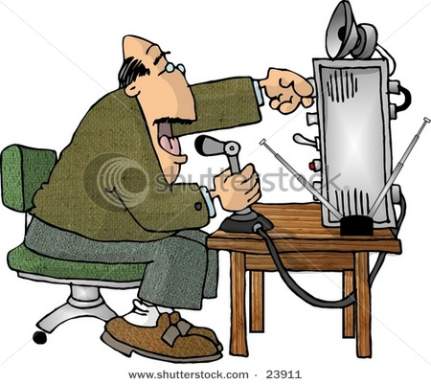
Communicating with other Hams
Get on the Air
G. West Your first Radio p. 65
Going Solo p. 69
Repeaters p. 79
Emergency p. 87
Talk to outer space p. 103

Slide 2
Quiz
VHF
UHF
Very High Frequency
Meaning
Ultra High Frequency
30 – 300 MHz
Freq Range?
300 – 3000 MHz
Mode for
repeaters
FM
FM

Slide 3
Nets
Social nets
Least formal and most common
Traffic - Formal messages exchanged by net stations T2C05
The original net. Established the NTS
Passes traffic from station.
ARRL
Emergency and public service
The way to practice your skills in the event of an emergency
Assist with public service event. Parades, events, etc.

Slide 4
Net Operation
IC
All traffic goes through Net Control
Net Control logs all traffic.
Net Control mediates
Field unit can communicate with field unit
only when authorized by net control.
Often assigned a different channel
Use phonetics if necessary. T2C03
Net Control Station T2C02
T2C07 Unless you are reporting an emergency, transmit only when directed by the net control station
T2C08 Pass messages exactly as it is received
(Traffic)
T2C05
Unit 1
Unit 2
Unit 3
Unit 4
Field units
Notes:
A quick discussion of net operation

Slide 5
VHF / UHF vs. HF

Slide 6
Net Check In
KC6ERT, My name is __________, and I am transmitting from Jolon,
(from NET Control)
Acknowledgement, or further questions. If you become
engaged in exchange, sign off with (back to net, KC6ERT)
Next person check in as above

Slide 7
Calling CQ CQ CQ T2A12
T2A08
Calling any station
Primarily for HF operation
1. Make sure you are in your assigned band.
2. Listen first
3. Ask if the frequency is in use.
On repeaters
  T2A09 A brief statement of saying your call sign is often used in place of "CQ" to indicate that you are listening.

Slide 8
Answering CQ CQ CQ T2A05
Their
Call sign
1st
2nd
Your
Call sign
Answer Up
  Always use good radio manners.
  Give your (first) name
  Location
  Signal Report RST The 5 9 9 system
  Rag Chew or keep it brief
  Sign off
  Always ID

Slide 9
HF Signal Reports
Readability
1--Unreadable
2--Barely readable, occasional words distinguishable.
3--Readable with considerable difficulty.
4--Readable with practically no difficulty.
5--Perfectly readable.
Strength
1--Faint signals, barely perceptible.
2--Very weak signals.
3--Weak signals.
4--Fair signals.
5--Fairly good signals.
6--Good signals.
7--Moderately strong signals.
8--Strong signals.
9--Extremely strong signals.
Tone
1 - 9
CW only

Slide 10
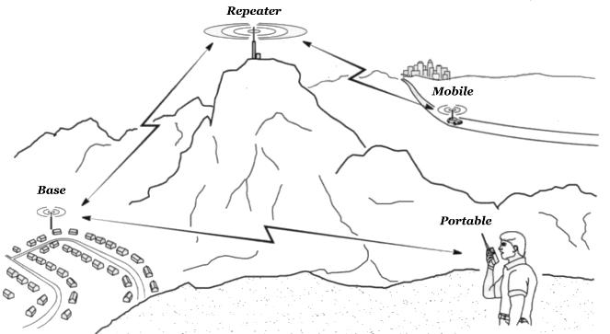
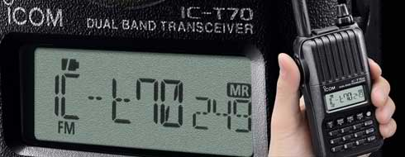
VHF UHF - Signal Report
Full Quieting
White Noise
Scratchy
Dropping Out
Broken

Slide 11
Tango MIKE INDIA
  T1A03 Use of a phonetic alphabet is the method encouraged by the FCC when identifying your station when using phone.
11

Slide 12
Q – Shortcuts
Primarily for HF operation
QRM
Interference from other stations.
Interference by static or noise.
I am running low power.
I am going off the air.
Who is calling me?
Your signal is fading.
Receipt of message. Don’t over use
A conservation.
I am changing frequency to _____.
My location is _______.
T2B10
QRN
QRP
QRT
QRZ
QSB
QSL
QSO
QSY
T2B11
QTH
12
12
Notes:
12

Slide 13
Simplex Operation
Talking directly to another station is called Simplex
Sometimes referred to as “direct” or “car to car”.
T2A11
446.000 MHz National calling frequency 70 cm
146.52 National calling frequency on 2 meters T2A02
T2B09 Consider operating simplex instead of a repeater when in mutual range.

Slide 14
Repeater Operation

Slide 15
Repeater
Offset frequency
Antenna
(shared)
T2B02
CTCSS
PL tone
Transmitted signal out
Different frequency
Received Signal in
Transmitter
Duplexer
Receiver
Speech from received signal
T1F09 A repeater transmits simultaneously a received signal on another frequency

Slide 16
Linked Repeaters
A network of repeaters where signals received by one repeater are repeated by all the repeaters T2B03
RF
or

Slide 17
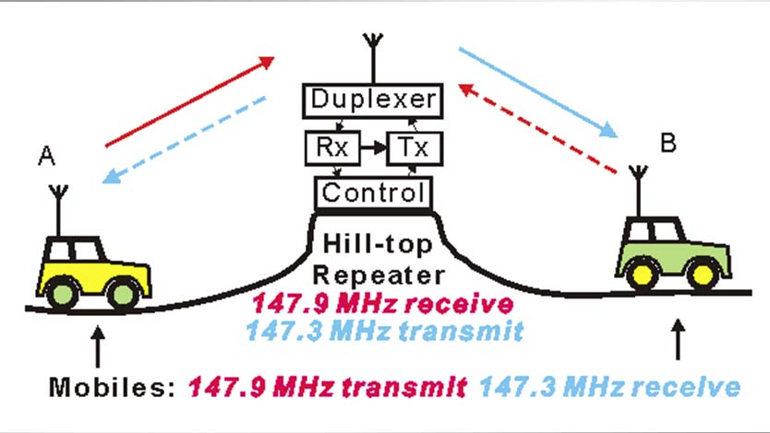
Repeater offset frequency
The difference between the repeaters transmit and receive frequency. T4B11
Reverse Split function on your VHF / UHF transceiver
Allows you to listen to the repeaters input frequency. T2B01
It might allow you to receive the station’s signal if repeater is too weak T2B03

Slide 18
Repeater Operation
Which of the following is a common repeater frequency offset in the 2 meter band?
A. Plus or minus 5 Mhz
B. Plus or minus 600 kHz
C. Plus or minus 500 kHz
D. Plus or minus 1 Mhz
What is a common repeater frequency offset in the 70 cm band?
A. Plus or minus 5 Mhz
B. Plus or minus 600 kHz
C. Plus or minus 500 kHz
D. Plus or minus 1 Mhz
Standard Repeater Input/Output Offsets
Band Offset +/-
6 meters 1 MHz
1.25 meters 1.6 MHz
33 cm 12 MHz
23 cm 20 MHz
TABLE OF COMMON PL TONES (in Hz)
67.0 94.8 131.8 171.3 203.5
69.3 97.4 136.5 173.8 206.5
71.9 100.0 141.3 177.3 210.7
74.4 103.5 146.2 179.9 218.1
77.0 107.2 151.4 183.5 225.7
79.7 110.9 156.7 186.2 229.1
82.5 114.8 159.8 189.9 233.6
85.4 118.8 162.2 192.8 241.8
88.5 123.0 165.5 196.6 250.3
91.5 127.3 167.9 199.5 254.1
T2A01
2 meters 600 kHz
T2A03
70 cm 5 MHz

Slide 19
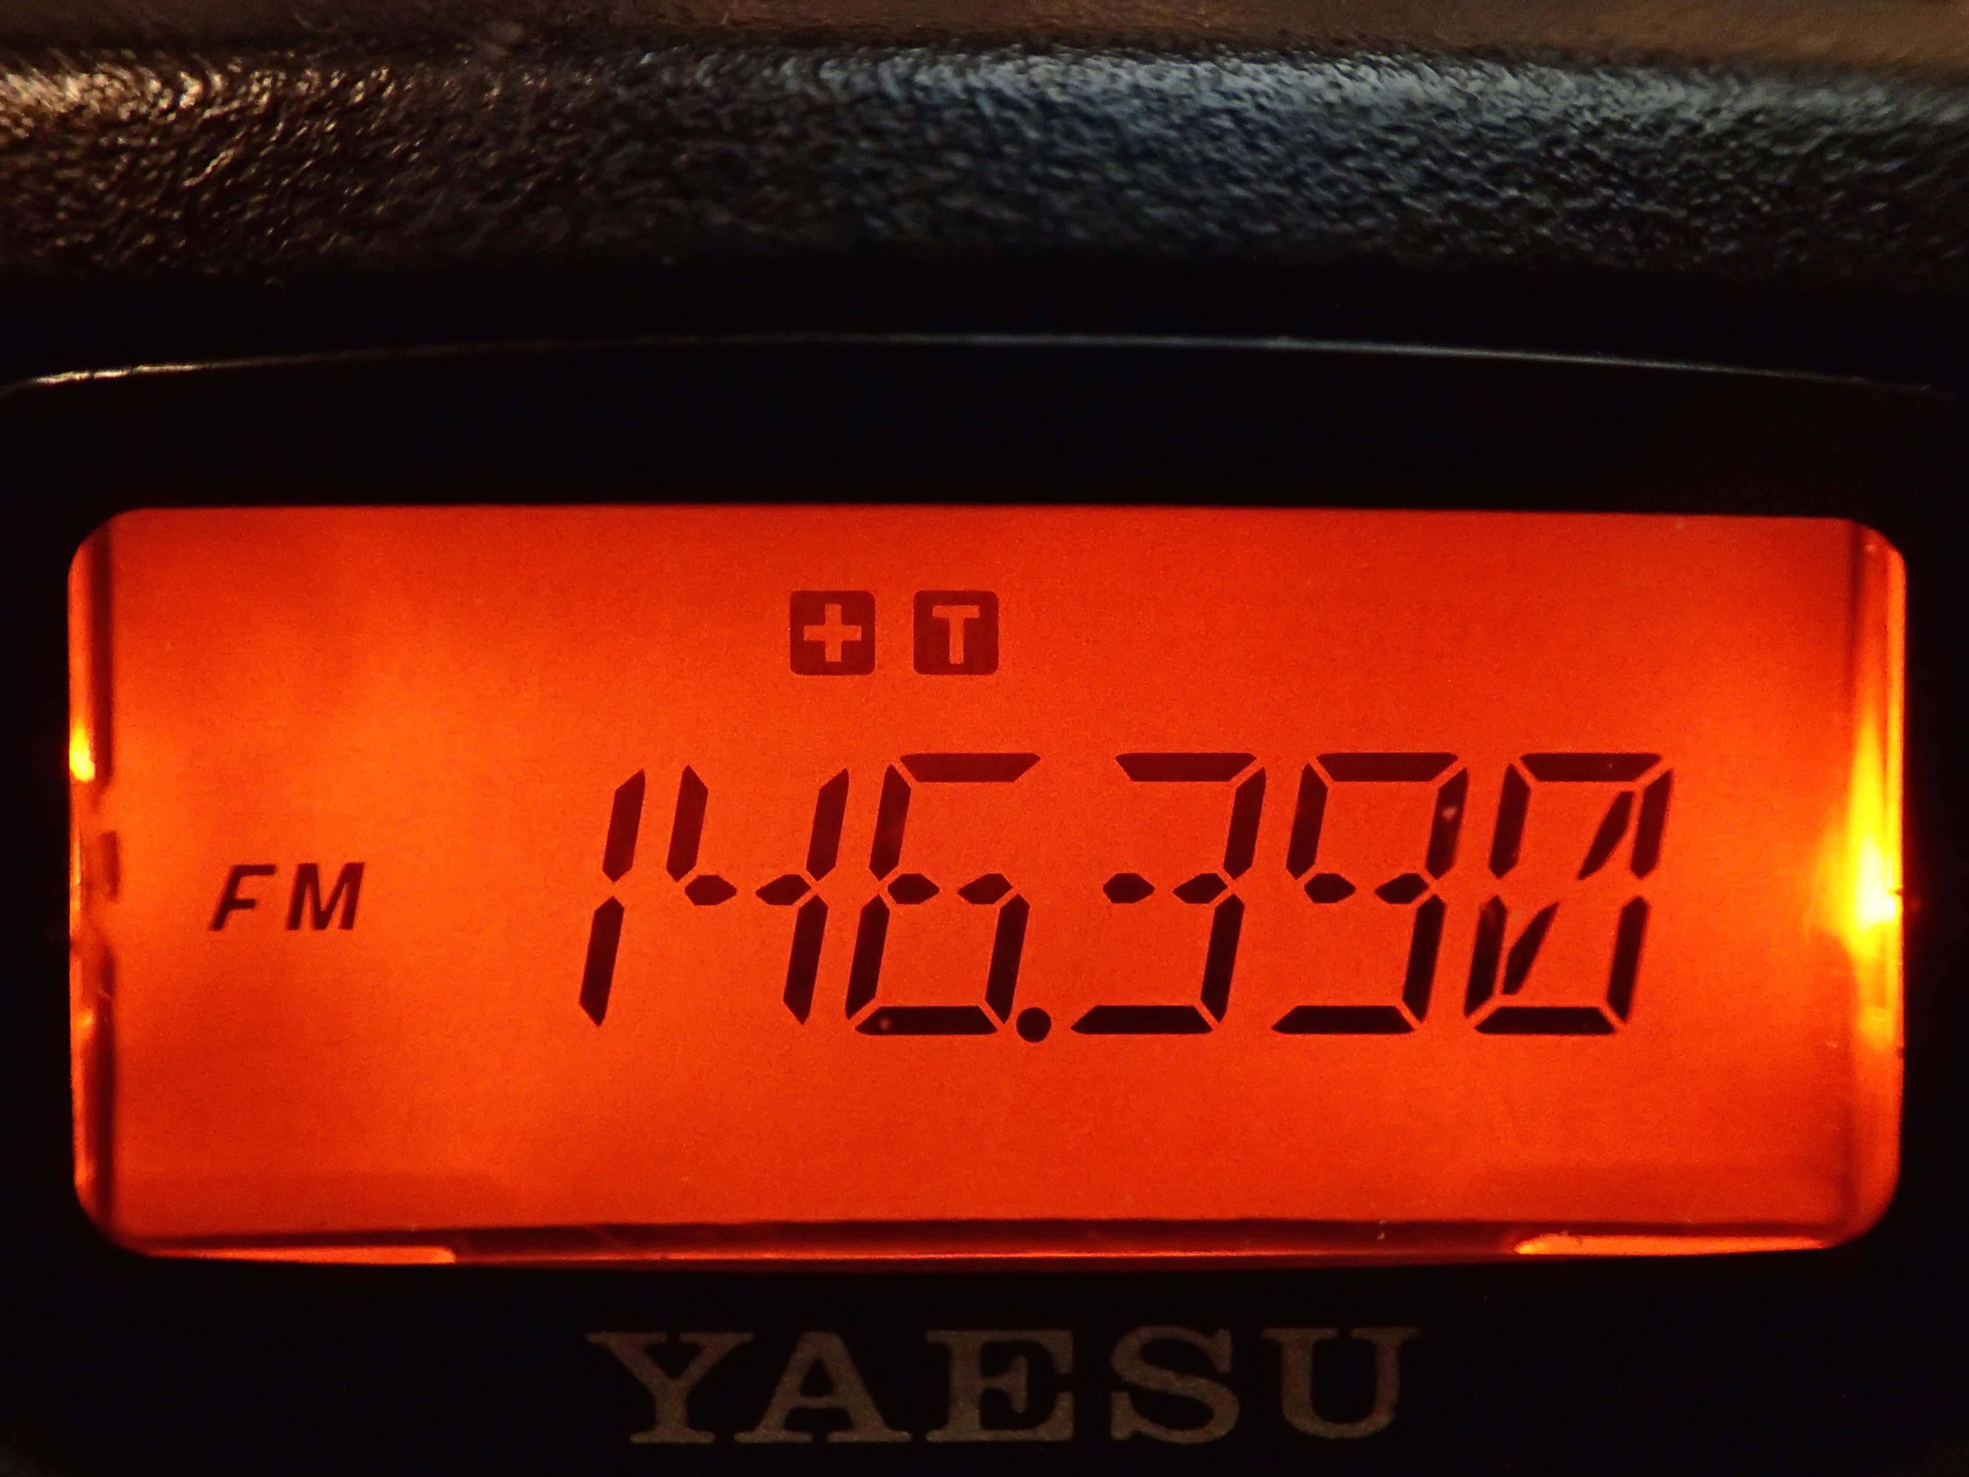
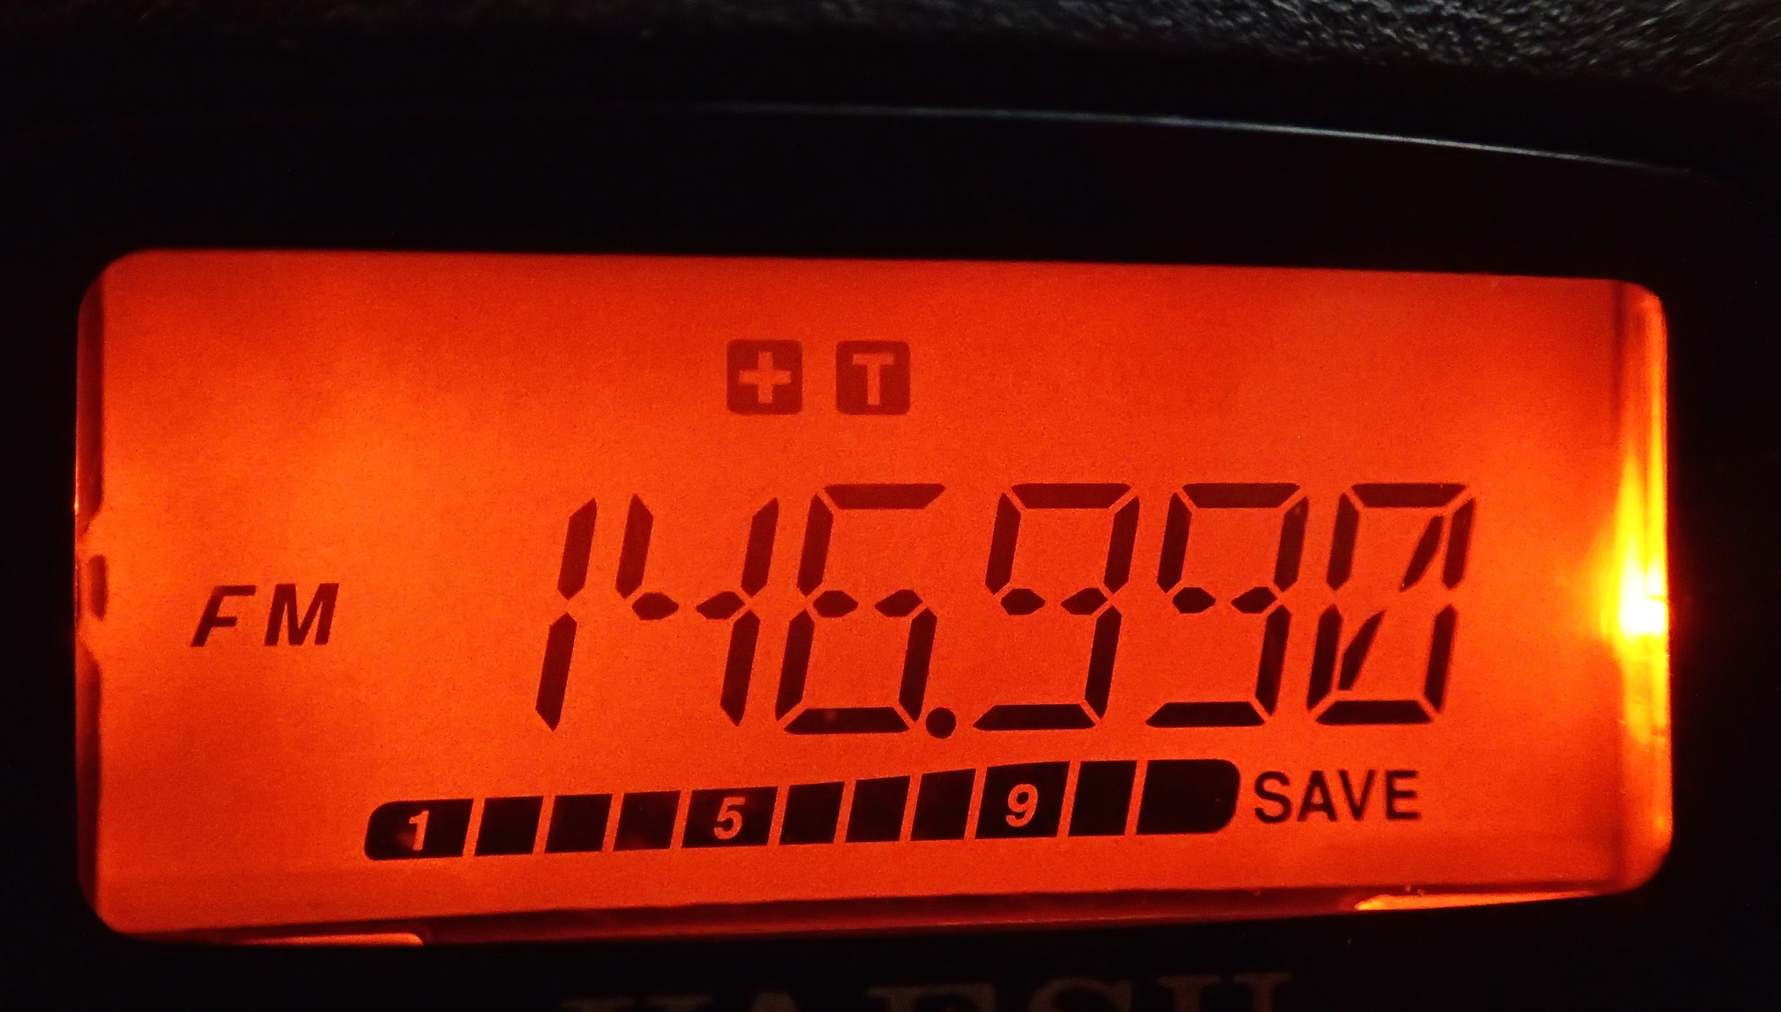
REPEATER OFFSETS
T2A07
REPEATER OUTPUT FREQUENCY
REPEATER RECEIVE FREQUENCY
POSATIVE OFFSET
TRANSMIT FREQ. + 600KHZ
ALSO CTCSS TONE IS SET

Slide 20
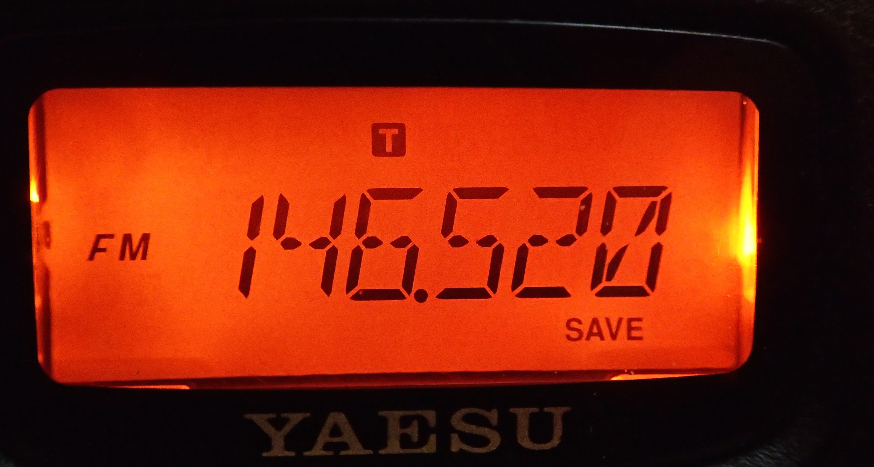
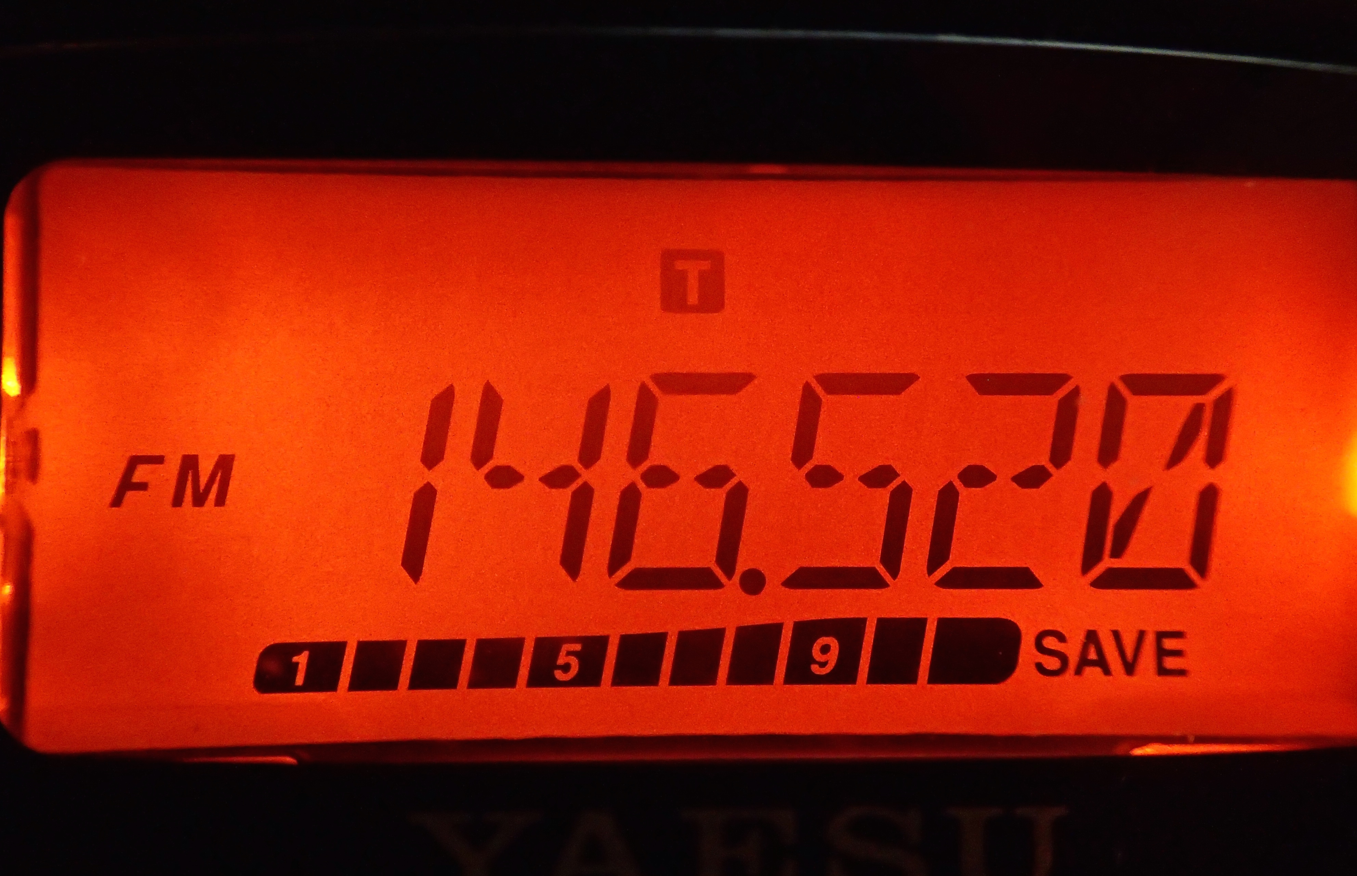
Simplex
No Offset
T2A11
SIMPLEX FREQUENCY
NO OFFSET
TRANSMIT FREQ.
ALSO CTCSS TONE IS SET

Slide 21
Talking through repeaters
Q. Unable to access a repeater whose output you can hear?
T2B04
Possibly
A. Improper transceiver offset
B. The repeater may require a proper CTCSS tone from your transceiver
C. The repeater may require a proper DCS tone from your transceiver
AOTA

Slide 22
Talking through repeaters
Repeater user says your transmissions are breaking up or distorted on voice peaks. T2B05
Possibly
You are talking too loudly
Technically this is referred to as over deviating
Talk further from the microphone T7B01

Slide 23
Talking through repeaters
Q. What might be a problem if you receive a report that your audio signal through the repeater is distorted or unintelligible? T7B10 T4B12
Possibly any one of these
Your transmitter is slightly off frequency
Your batteries are running low
You are in a bad location
AOTA

Slide 24
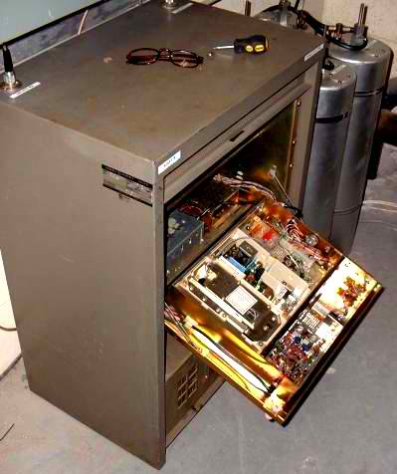
How to make a repeater contact
Always listen first to determine if the repeater is in use.
When you key a repeater, ID (call sign) your station.
(no need to say for ID)
If you want to make a random contact, Your call sign
followed by “listening or Monitoring”. T2A09
When calling another station, Their call sign followed by your call sign.
During a QSO ID your station at least every ten minutes.
Use plain English, No jargon.
ID at the termination of your contact.
Just listening is the best way to learn.
T2A04

Slide 25
Band Plan
  T2A10 A voluntary guideline for using different modes or activities within an amateur band.
44.0-144.05 EME CW
144.05-144.10 CW and weak signal
144.10-144.20 EME and weak signal SSB
144.200 National calling frequency
144.20-144.275 SSB
144.275-144.30 Beacons
144.3-144.5 New OSCAR subband
144.5-144.6 Linear translator inputs
144.6-144.9 FM repeater inputs
144.9-145.10 Weak signal and FM simplex
145.01,03,05,07,09 widely used for packet
145.1-145.2 Linear translator outputs
145.2-145.5 FM repeater outputs
145.5-145.8 Misc. and experimental modes
145.8-146.0 OSCAR subband
146.01-146.37 Repeater inputs
146.4-146.58 Simplex
146.61-147.390 Repeater outputs
147.42-147.57 Simplex
147.60-147.99 Repeater inputs
Example: 2 meter band plan
Band plans are established by amateur radio operators.

Slide 26
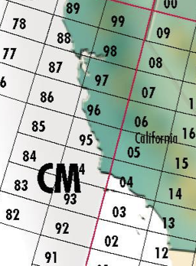
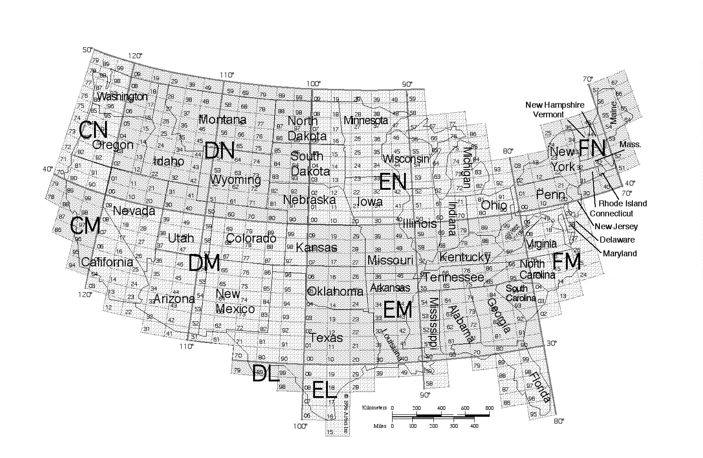
Where am I? my QTH is
  Simply city and state.
  Sometimes just the state only.
  Sometimes use a letter number grid location.
  T8C05 A grid locator is a letter-number designator assigned to a geographic location.
For iOS
App
Ham Square
26

Slide 27
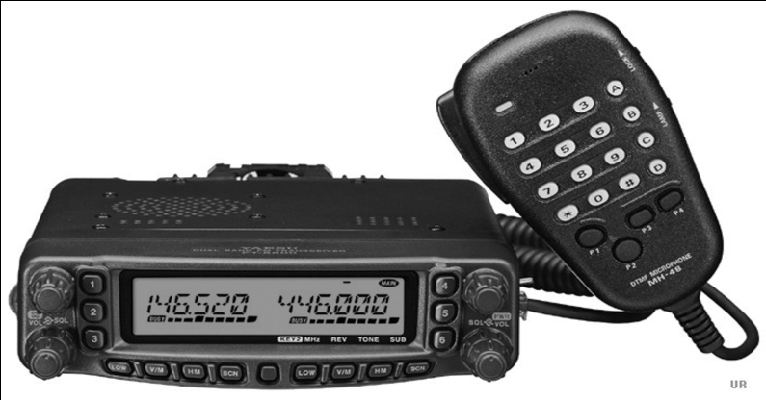
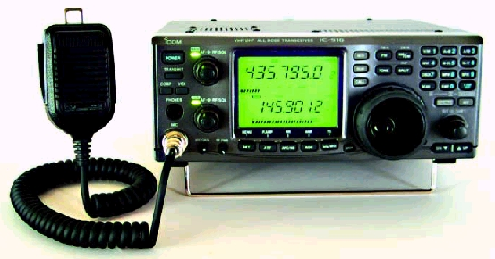
How Much Power
FCC rules regarding power levels used in the amateur bands state that an amateur should use the minimum transmitter power necessary to carry out the desired communication.
(No longer on the test but good to know)
Use the minimum amount of power output to make contact with another station

Slide 28
FLASH CARDS

Slide 29
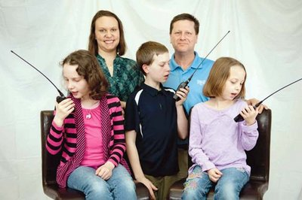
Get On The
Air

Slide 30
Handheld Digital
DMR
Digital Mobile Radio
ICOM ID-52A
144 / 430 MHz UHF/VHF D-STAR Digital
Yaesu FT-3DR
DIGITAL C4FM/FM

Slide 31
Digital Mobile Radio
DMR
A technique for time-multiplexing two digital voice signals on a single 12.5 kHz repeater channel T8D07
Must first register and get an ID
https://www.radioid.net
Talk Group
A way for groups of users to share a channel at different times without being heard by other users on the channel T8D02
To join the talk group
Program your radio with the group’s ID or code T2B07

Slide 32
Digital Mobile Radio
DMR
Color Code for DMR
Must match the repeater color code for access.
Think of it like an access tone. T2B12
Code Plug
Access information for repeaters and talkgroups. T4B07
Enter the group’s identification code
To select a specific group of stations on a digital voice transceiver. T4B09

Slide 33
Icom proprietary Digital
D-Star
Before transmitting into the D-Star system
Your Call sign must be programed into your radio T4B11

Slide 34
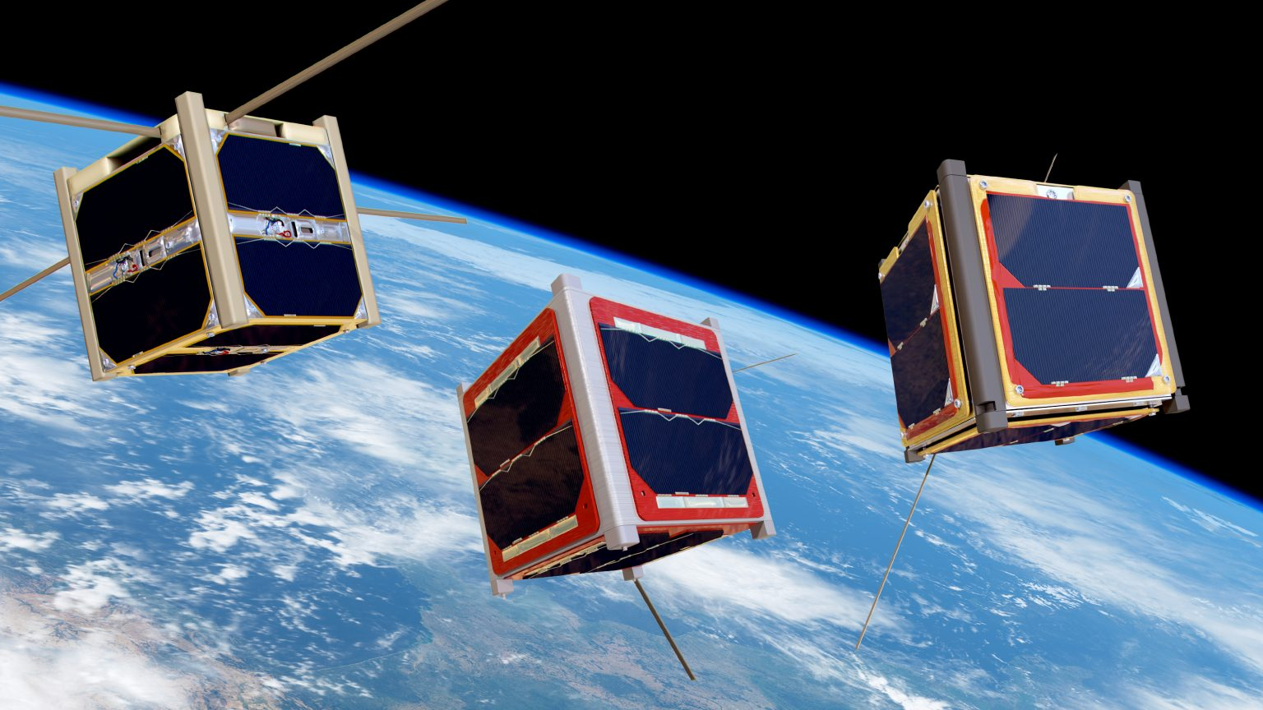
SATELLITE

Slide 35

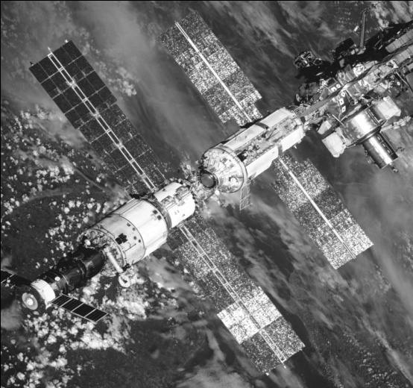
  Any amateur holding a Technician or higher class license may make contact with an amateur station on the International Space Station using 2-meter and 70 cm band amateur radio frequencies.
The International Space Station downlink, FM is 145.800 MHz. Use an HT to listen when it’s passing over you.
Many Astronaults are licensed radio amateurs.
International Space Station has a big ham station on board.
35

Slide 36
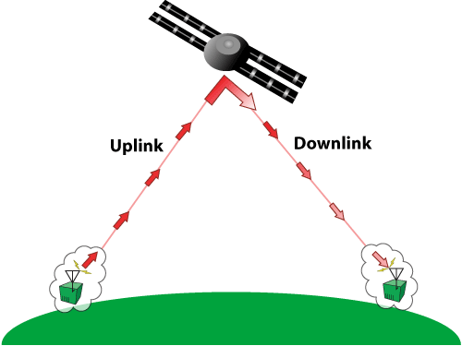
Amateur Radio Satellites
T8B08
Satellite operating U/V mode
LEO, A satellite in low earth orbit. T8B10
Uplink is UHF. (70 cm)
Downlink is VHF (2 mtr.)
36
T8B04 All modes can be used, SSB,FM CW/data

Slide 37
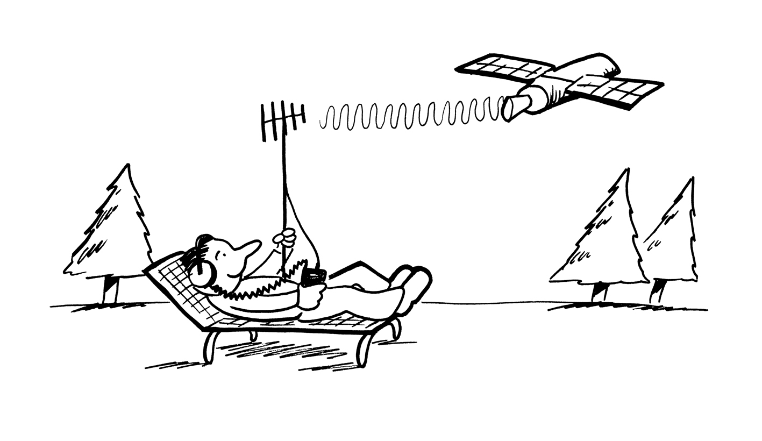
Amateur Radio Satellites
  T8B02 Use the minimum amount of power needed to complete the satellite contact.
  Using too much power may block access to other users.
You can work satellites with a handheld, and a directional antenna.
37

Slide 38
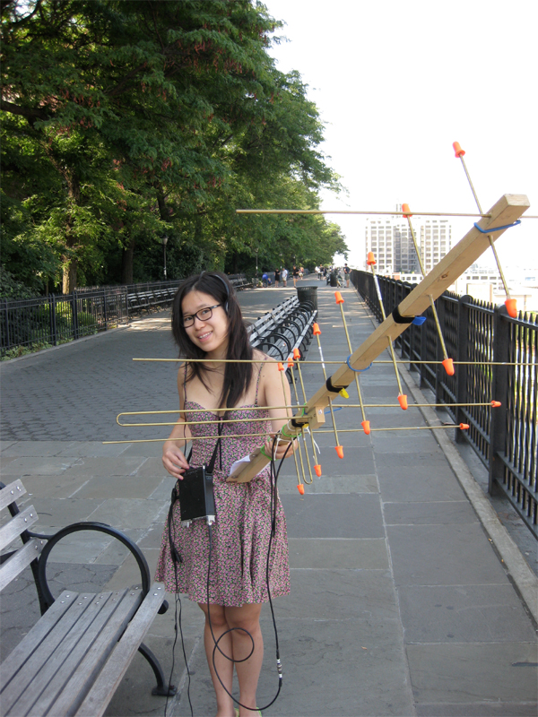
Diana Eng

Slide 39
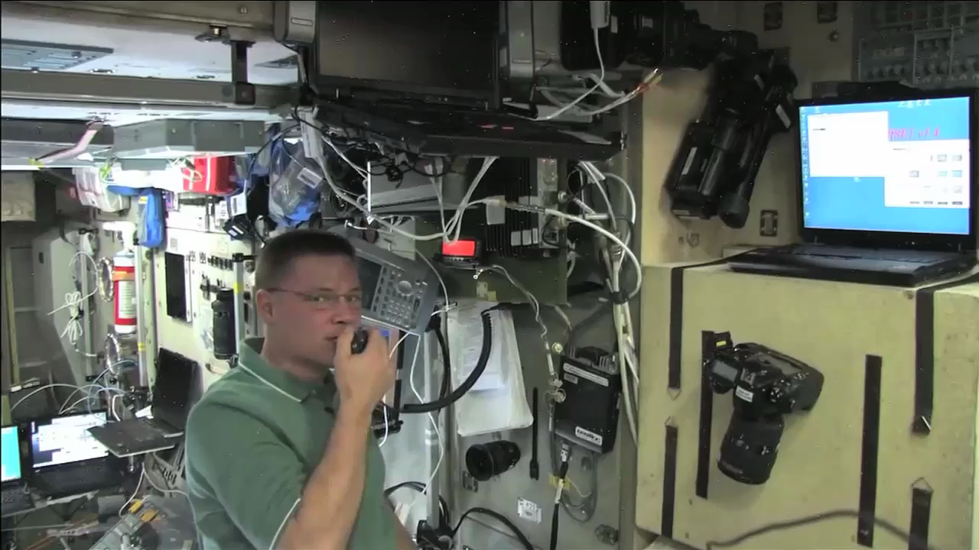

Slide 40
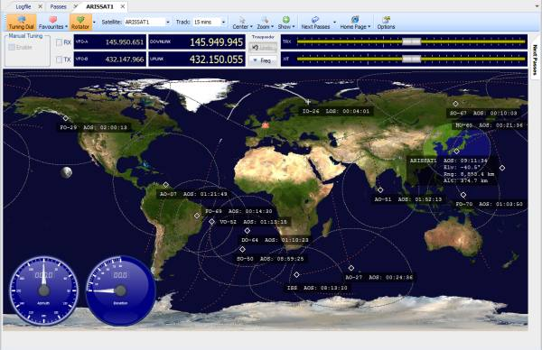
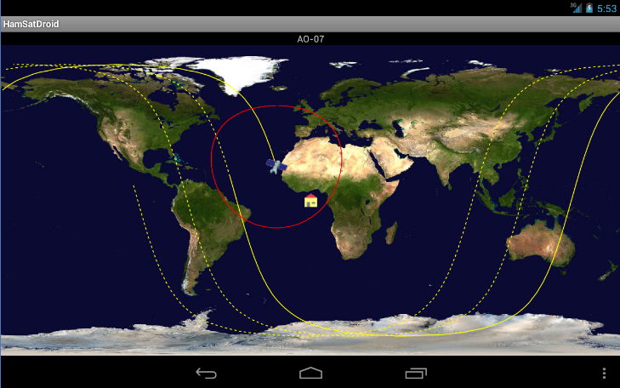
  T8B03 Which of the following are provided by a satellite tracking program
A. Maps showing the real-time position of the satellite track over the earth
B. The time, azimuth, and elevation of the start, maximum altitude, and end of a pass
C. The apparent frequency of the satellite transmission, including effects of Doppler shift.
D. All answers are correct.
40

Slide 41
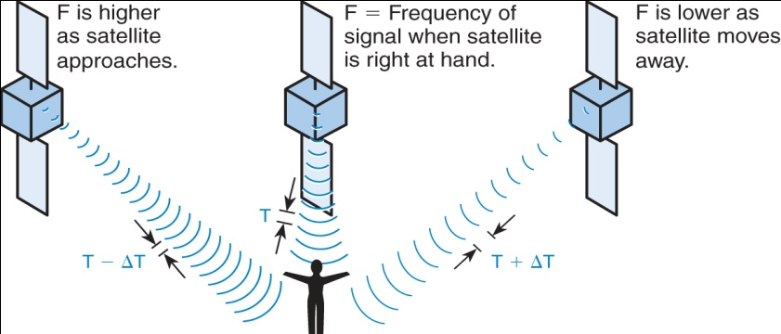
Doppler
  T8B07 With regards to satellite communications Doppler shift is a change in signal frequency caused by relative motion between the satellite and the earth station.
  T8B09 Spine Fade is caused by the rotation of the of the satellite and it’s antennas.
Doppler Effect
41

Slide 42
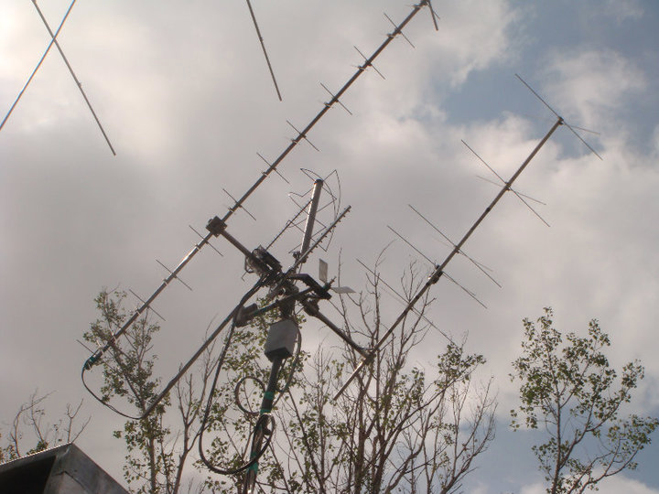
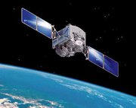
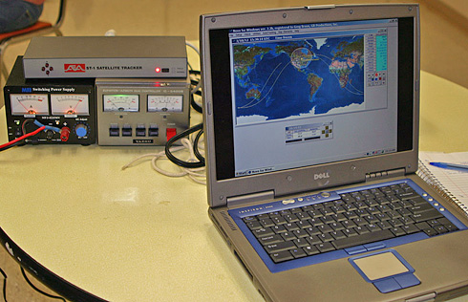
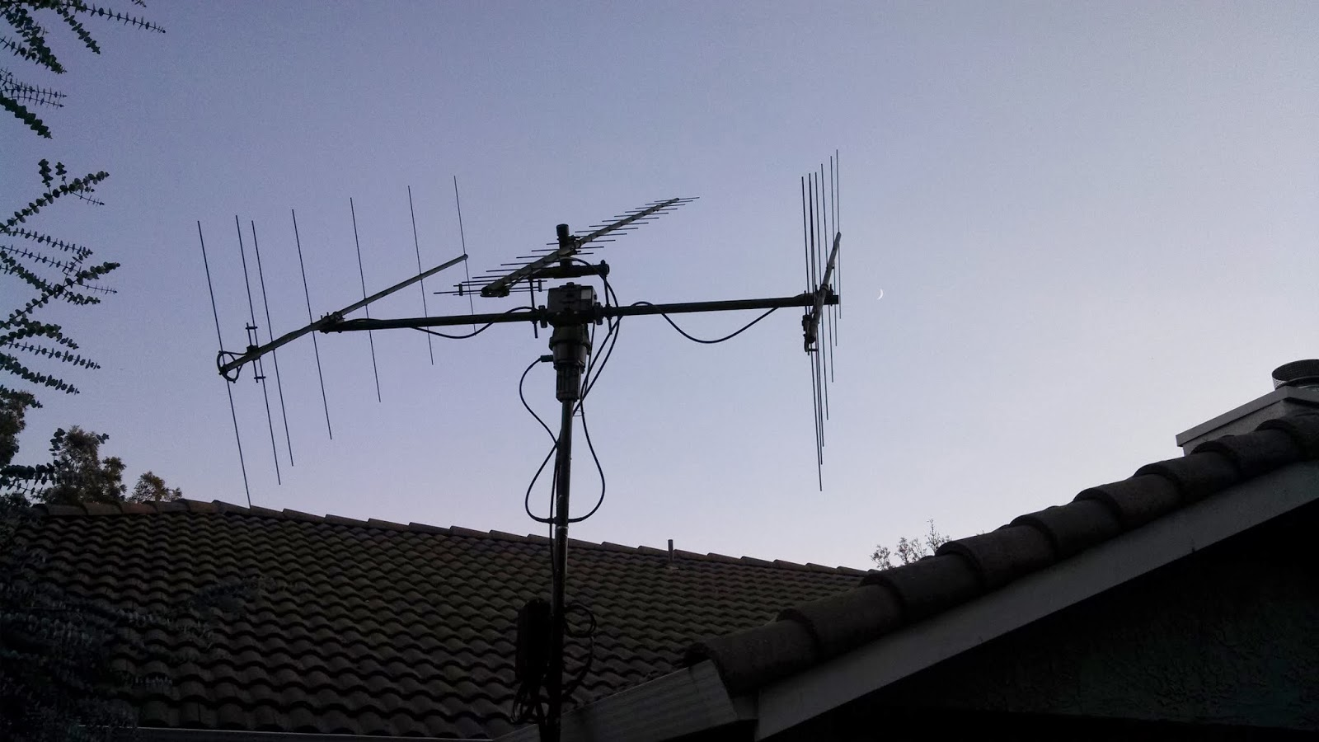
  T8B05 A satellite beacon is a transmission from a space station that contains information about a satellite. Can be RTTY, CW or Packet
  T8B06 Keplerian Elements are inputs to satellite tracking programs

Slide 43
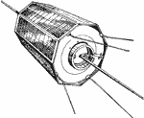
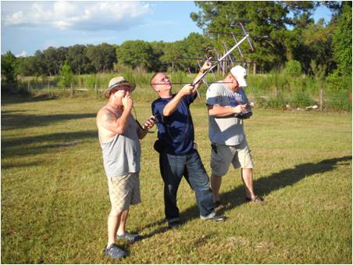
  T8B09 Rotation of the satellite and its antennas causes "spin fading" when referring to satellite signals.
      Rotation in space makes the signals fade in and out.
      This rotation keeps solar panels from overheating.
Tracking and communicating through amateur satellites can be done with a cross-polarized satellite antenna
43

Slide 44
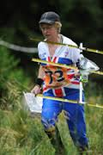
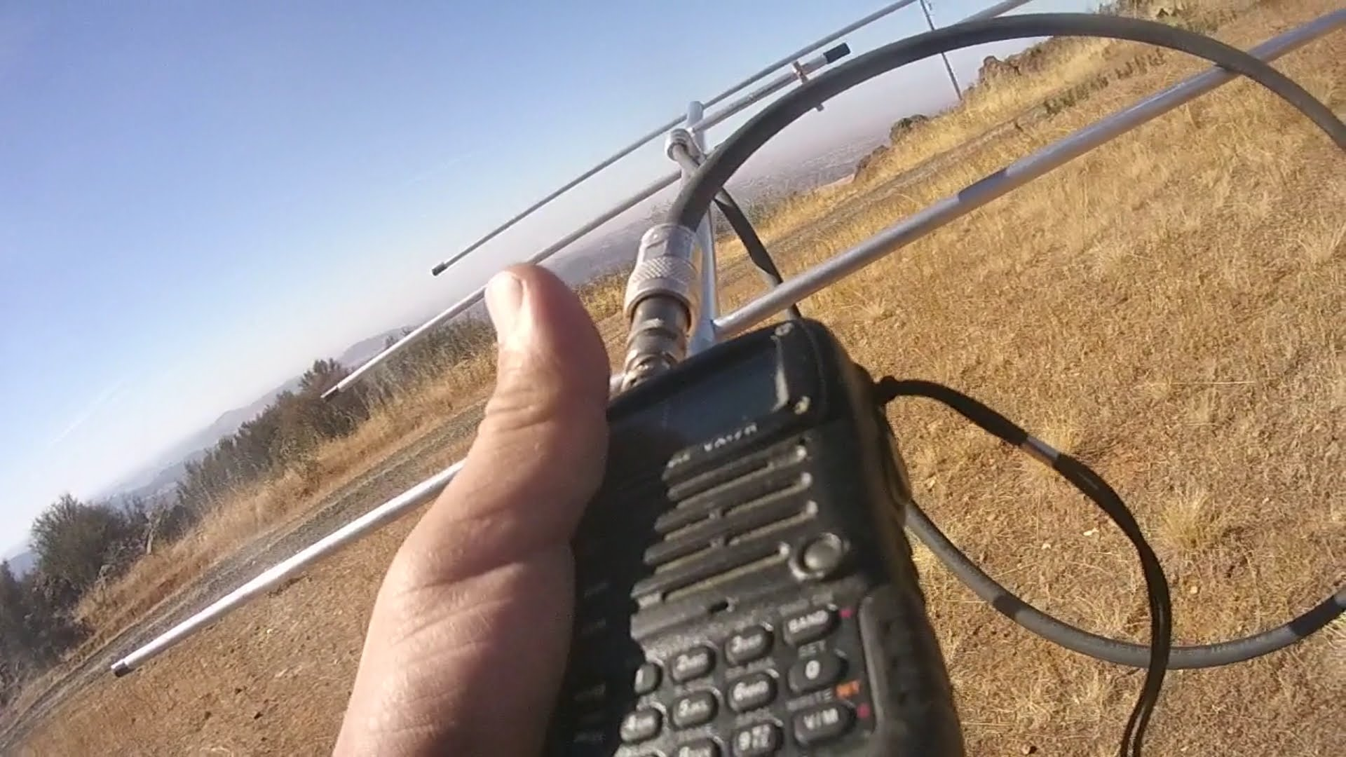
RDF
Radio Direction Finding
  T8C01 Radio direction finding methods are used to locate sources of noise interference or jamming.
3-element Yagi DF Antenna
3-element Yagi DF Antenna
44

Slide 45
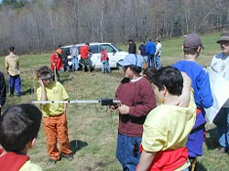
Fox Hunt
  T8C02 A directional antenna would be useful for a hidden transmitter hunt.
Hidden Transmitter Hunts are called Fox Hunting
All ages participate in a Fox Hunt
45

Slide 46
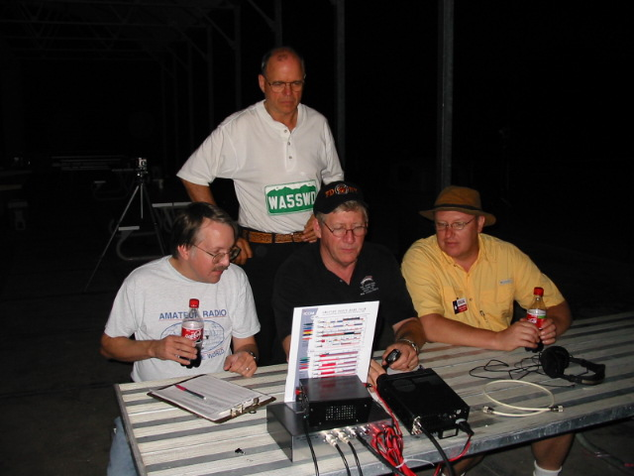
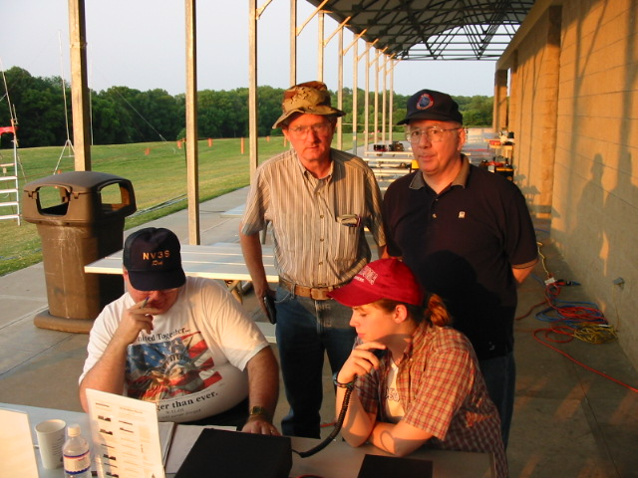
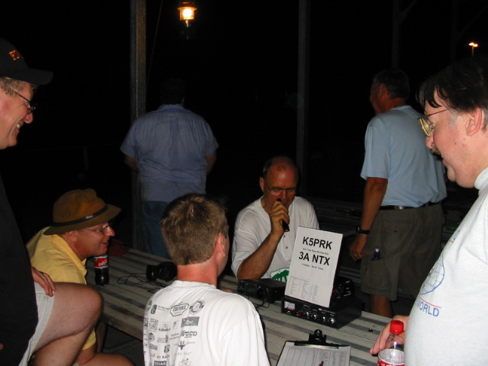
CQ Contest
  T8C03 Contesting is a popular operating activity that involves contacting as many stations as possible during a specified period of time.
Field Day Every June Enjoyed By Hams the World Over
46

Slide 47
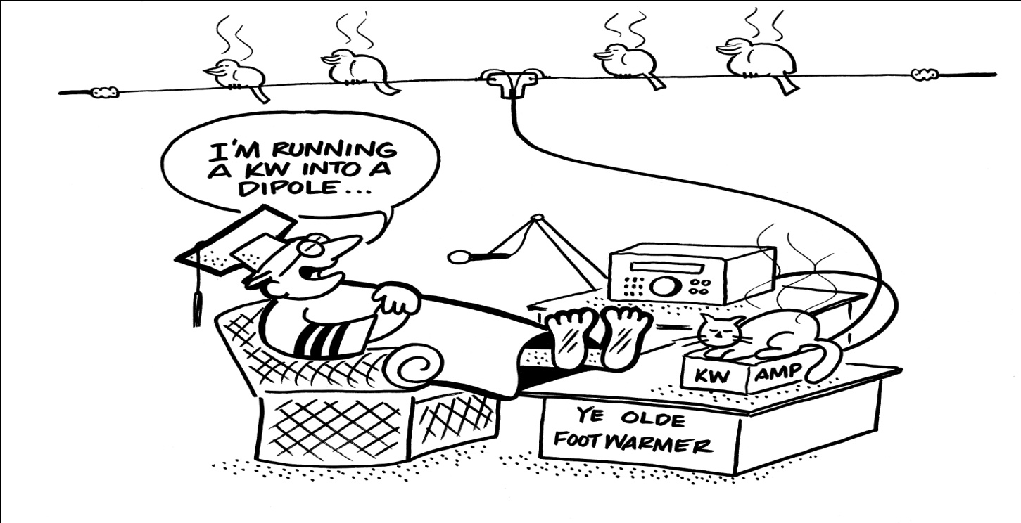
Contesting
  T8C04 Send only the minimum information needed for proper identification and the contest exchange.
Exchange:
Call
Signal Report
Location
Possible Serial #
Specific required info.
Chit chat is great for normal QSO’s, but not for contests
47

Slide 48
Voice over Internet Protocol
VoIP
A method of delivering voice communications over the internet using digital techniques. T8C07 T8C08

Slide 49
VoIP
Voice over Internet Protocol
DTMF. Dual Tone Multi Frequency
Tones generated by your microphone or radio’s keypad T8C06
Two popular VoIP methods
The connection to the internet is by a gateway
IRLP
node
node
Radio
DTMF
Repeater
Internet
Repeater
Radio
Echolink allows you to transmit through a repeater without using a radio T8C09
RADIO
Echolink requires you to register your call sign and provide proof of license T8C10
ECHOLINK
Computer
Or
Smart Device
node
Internet
node
Computer
Or
Smart Device

Slide 50
VoIP
Voice over Internet Protocol
  You might obtain a list of active nodes that use VoIP from a repeater directory, online, or repeater coordinator.
  T8C06 You can select a specific IRLP node when using a portable transceiver by use of the keypad to transmit the DTMF IRLP node ID.
  T8C11 A gateway is the name given to an amateur radio station that is used to connect other amateur stations to the Internet.
Keypad on this rig’s top corner and on back of microphone. (Not necessarily this way on all rigs.)
50

Slide 51
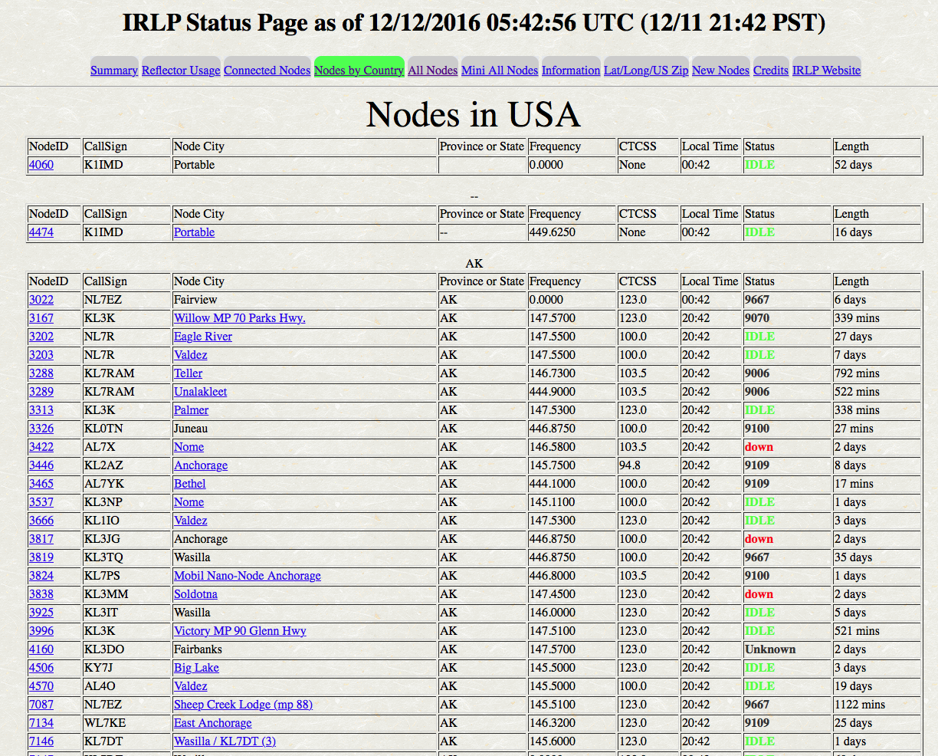

Slide 52
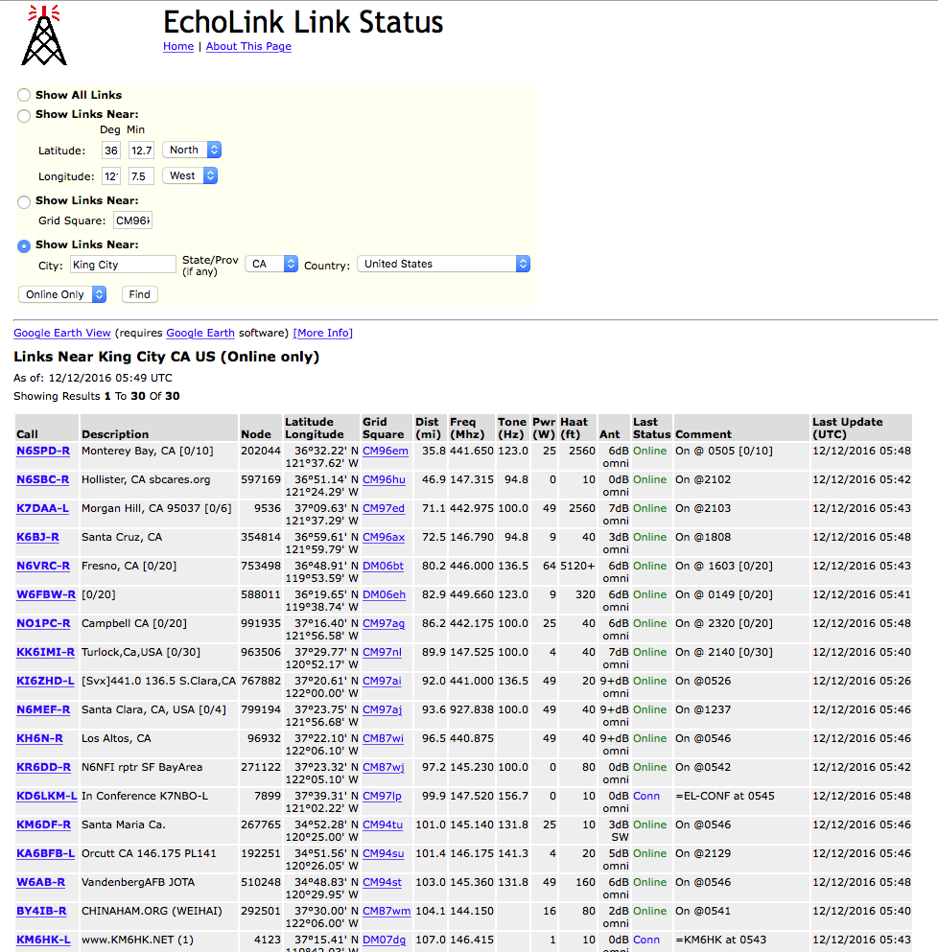

Slide 53
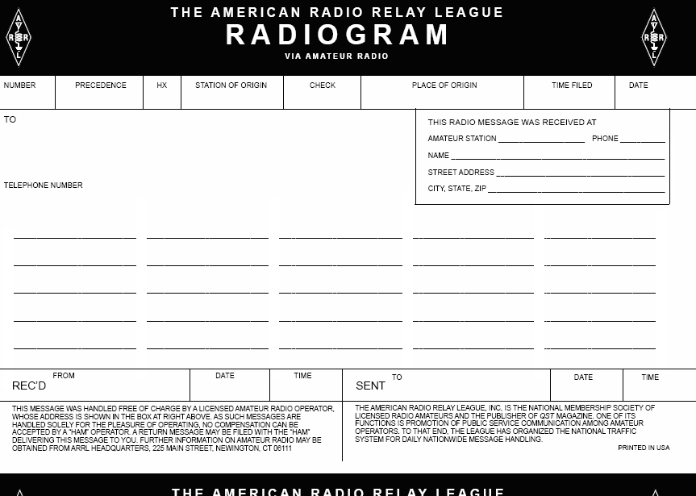
Emergency Traffic
T2C07 In order to minimize disruptions to an emergency traffic net once you have checked in, do not transmit on the net frequency until asked to do so by the net control station.
T2C08 Passing messages exactly as written, spoken or as received is usually considered to be the most important job of an amateur operator when handling emergency traffic messages.
      Write in block letters, word for word.

Slide 54
Radiogram
Preamble
T2C10
T2C11
Check – The number of words in the text
All of the information needed to to track the message through the system
Text

Slide 55

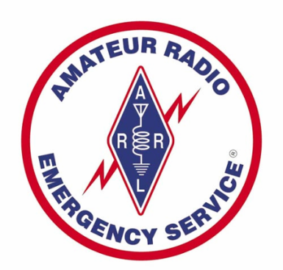
EMCOMM
Emergency Communications
  T2C01 FCC rules always apply to proper operation of your station when using amateur radio.
  T2C04 Both RACES (Radio Amateur Civil Emergency Service) and ARES (Amateur Radio Emergency Service) organizations may provide communications during emergencies.
  T1A10 Radio Amateur Civil Emergency Service (RACES) is a radio service using amateur stations for emergency management or civil defense communications.
  T2C06 (ARES), A group of licensed amateurs who have voluntarily registered their qualifications and equipment for communications duty in the public service

Slide 56
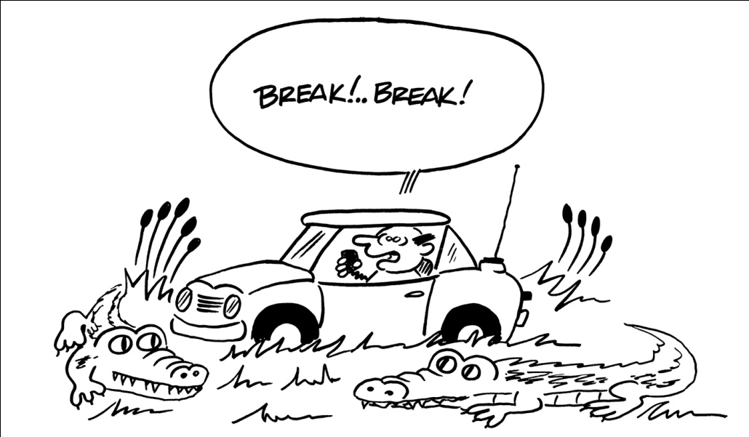
  Common practice during net operations to get the immediate attention of the net control station when reporting an emergency is to begin your transmission with “Priority” or “Emergency” followed by your call sign.

Slide 57
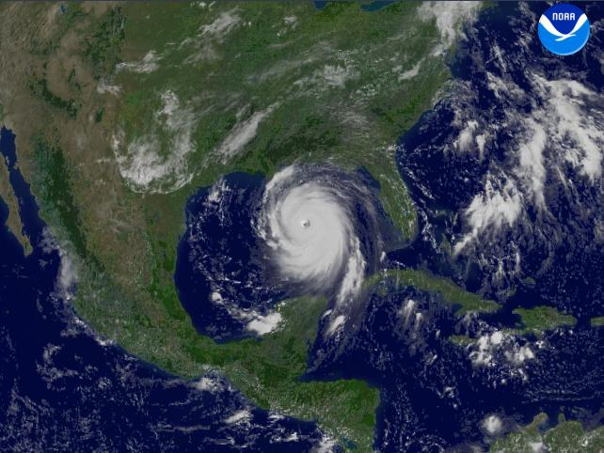
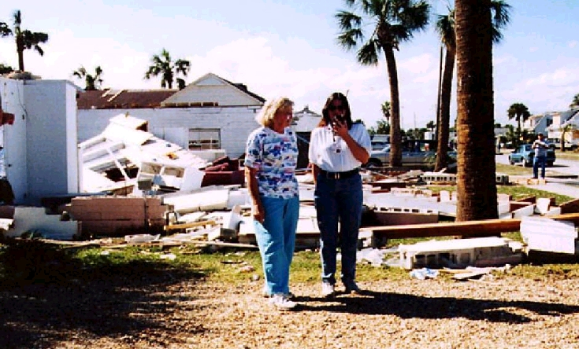
  T2C09 Are amateur operators ever permitted to operate outside their frequency privileges?
  When immediate safety of human life and protection of property are necessary.
        in an emergency, anything goes!

Slide 58
For Next Week
Study flash cards www.hamexam.org
Radio
Fundamentals
Rules &
Regs
Comm w/
Others
Antennas
Propagation
Equipment
Electricity
Safety
Lesson 1
T1B
T3B
Lesson 2
T1A
T1C
TID
T1E
T1F
Lesson 4
T2A
T2B
T2C
T8B
T8C
Lesson 5
T3A
T3C
T9A
T9B
T7C
Lesson 6
T4A
T4B
T7A
T7B
T8D
Lesson 7
T5A
T5B
T5C
T5D
T6A
T6B
T6C
T6D
T7D
Lesson 8
T0A
T0B
T0C
73
Tom and Jack
Modulation
Lesson 3
T8A

