Slide 1
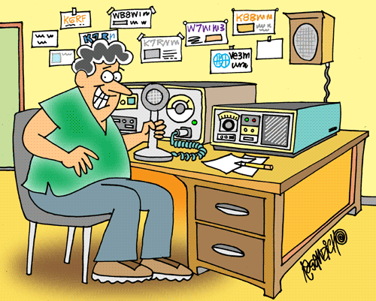
Lesson 5
G. West
Your First Radio p. 65
Your Computer goes Digital p. 109
Multi-mode Radio Excitement p. 119
Run Some Interference Protection p. 131

Slide 2
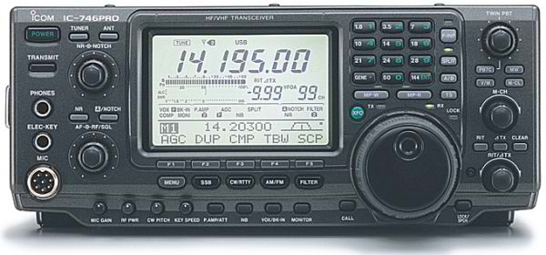
Lesson 5
Amateur Radio equipment
3/2/19
G. West
Your First Radio p. 73
Your Computer goes Digital p. 119
Multi-mode Radio Excitement p. 127
Run Some Interference Protection p. 137
ARRL: Ch. 2.3, 3.3, 5

Slide 3
Generalized Transceiver Categories
Single Band
Dual Band
Multimode
Multiband
Handheld (HT)
Notes:
In this lesson you will be comparing and contrasting the different kinds of equipment available. You can adjust these categories to meet your personal preferences and experiences. It would be a good idea to have examples of the different kinds of equipment. Catalogs from the major equipment retailers would be helpful to give an idea of the level of costs. Go ahead and deviate from any kind of lesson script during this lesson but keep in mind the time and keep from spending too much time on this topic.

Slide 4
Basic Station Organization
Station Equipment
Transmitter
Receiver
Antenna
Power Supply
Accessory Station Equipment
Notes:
Go over with the students the basic outline of the material to be presented during this lesson. This lesson is deceptively simple because there is a lot of preparation required to make this lesson effective. You should try to set up an operative station to give some demonstration contact. Use some care that you don’t set up a station that will intimidate the students on the first day, try to set up a station that would be typical of the type of station that they might set up in the beginning of their ham radio careers. Don’t spend a lot of time at this point demonstrating all the exotic modes available to the students, there will be plenty of time to do that later in the course. I would suggest a basic two meter set up and give demonstration contacts on repeaters and simplex. Then have a simple HF station and make one or two phone and one CW contact. Some advice on contact…don’t depend on a CQ being answered, it may or may not happen. I would suggest you have a few “planted” contacts from your club. These planted contacts are standing by on the frequency ready to step in and make a contact just in case your CQ goes unanswered. Try to get planted contact operators who are good at drawing out conversations on the radio. New operators are intimidated by radio and sometimes need to be prodded to say more than yes or no answers to questions.

Slide 5
Basic Radio Station
T7A02 A transceiver combines the functions of a transmitter and a receiver
Antenna
Transmitter
TR
Switch
Receiver
Power
Supply
Transceiver

Slide 6
What Happens During Radio Communication?
Transmitting (sending a signal):
Information is converted to electronic form.
Transmitter
Info
For class,
What kind of info?

Slide 7
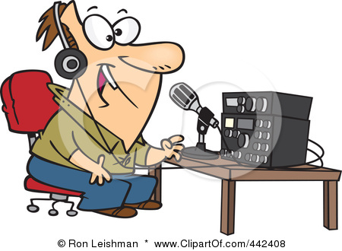
What Happens During Radio Communication?
Receiving end:
Receiver
front end

Slide 8
Our Basic Building Blocks
Converts a radio signal from one frequency to another.
T7A03
Mixer
T7A05
Oscillator
Produces a steady signal at a single frequency
Converts modulated RF
directly into data or voice
Detector
Makes signals stronger
Amplifier
Removes or blocks unwanted signals
Detects CW & SSB
Filters
Product
Detector
Puts information on the RF signal
T7A08
Modulator
Frequency
Discriminator
Removes information from FM signals
Demodulator
Removes information from modulated RF

Slide 9
The Superheterodyne Receiver Block Diagram
The mixer combines two signals to
To convert one frequency to another, T7A03
One mixer = single conversion
Two mixers = double conversion

Slide 10
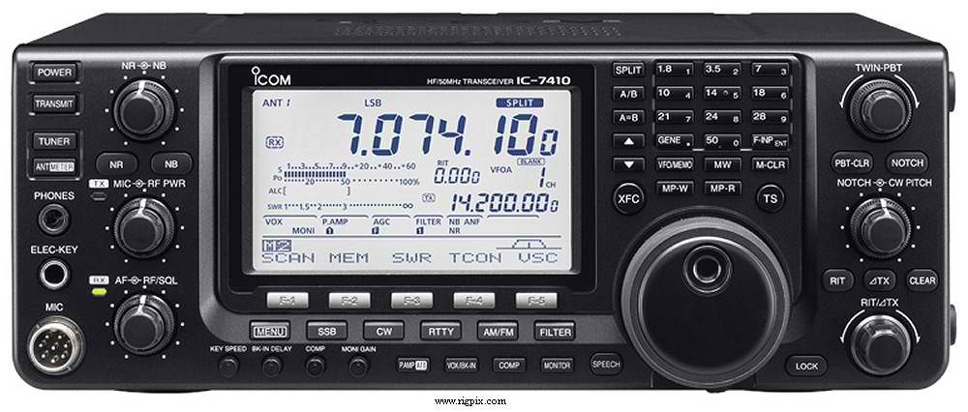
Icom IC-7410
T4Bo4 Memory controls
Quick access to favorite frequencies.
AGC, automatic gain control, To keep received audio relatively constant T4B12
Band select
VFO, Tuning Knob, T4B02 Used for frequency entry
Mode Select

Slide 11
Icom-7410
Antenna tuner
Noise blanker T4B05, T4B13
Help to eliminate
noise
T4B09 Filters, 2.4 kHz for SSB
T4B10 500 Hz for CW
T4B08 Some variable.
Squelch T4B03 Mutes receiver
output when no signal.
RIT Receive incremental tuning
T4B06 T4B07. change receive freq.

Slide 12
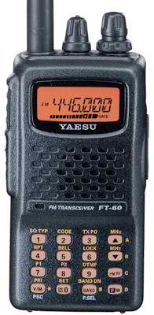
Yaesu FT-60
Tuning control
Select memory CH
or Frequency
Squelch
ARO Automatic Repeater Offset
T7A07
“PTT” Push to talk
Microphone
Scan function, scan through a range of frequencies to check for activity T4B14
F + Select type of tone
F + Select tone frequency
Memory or VFO operation
Direct frequency entry
In VFO operation

Slide 13
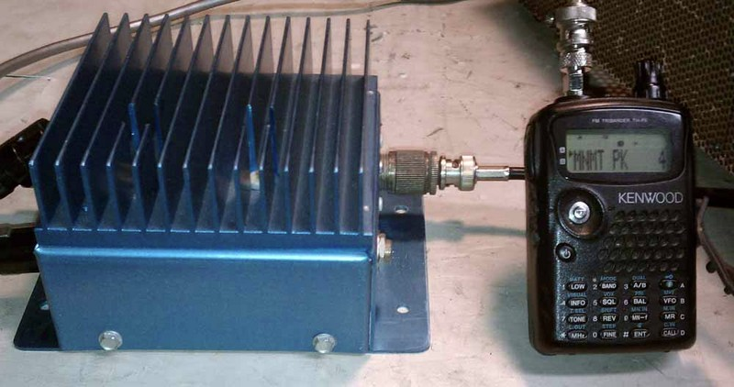
Increase Handheld output power
T7A10 An RF power amp can be used to increase power out
SSB/CW-FM switch sometimes found to set amplifier for proper mode. T7A09

Slide 14
Nice to have handheld accessories
Extra battery packs.
Drop-in, fast charger.
Extended antenna.
External microphone and speaker.
Headset.

Slide 15
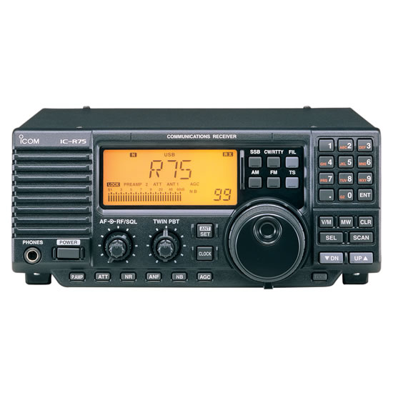
Receivers

Slide 16
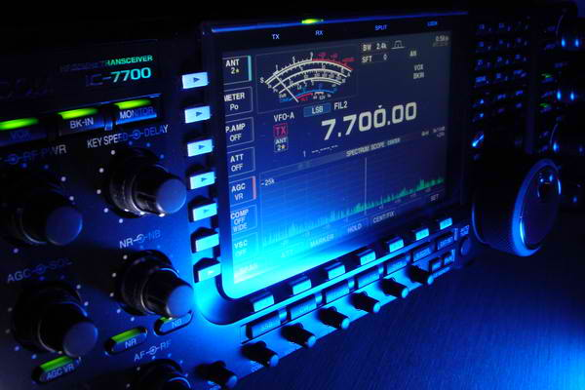
Selectivity / Sensitivity
Selectivity – The receivers ability to
Discriminate between multiple signals. T7A04
Sensitivity – The ability to receive and detect the presence of a signal.
T7A01

Slide 17
Increase Sensitivity
Pre
Amplifier
Receiver
T7A11

Slide 18
Transverter
Transverter is used to extend the the frequency
Capabilities of a HF transceiver.
222MHz
HF Transceiver
On 28 MHz
Transverter
222 MHz
Antenna connection
28 MHz in and out
T7A06
Example 1: A Transverter is being used to allow the HF transceiver to
operate on the 222MHz band.

Slide 19
Radio Frequency Interference RFI
Amateur Radio Station
RFI
RFI
Causes
T7B03
Fundamental overload
Harmonics
Spurious Emissions
Extra signals produced by all transmitters
Noise Sources
If it is related to electricity, it produces noise.
Good station practice. Ensure your station is not producing interference.

Slide 20
RFI
Part 15 An unlicensed device that may emit low-powered radio signals on frequencies used by a licensed service. T7B09
Part 15 rules,
Covers un-Licensed devices that use RF communications.
May not cause interference to licensed equipment
Must accept interference caused by licensed equipment operating properly under FCC rules

Slide 21
RFI
What would cause a broadcast AM or FM radio to receive an amateur radio transmission unintentionally? T7B02
The receiver is unable to reject strong signals outside the AM or FM band

Slide 22
Filters
Filter out what you don’t want
I don’t want interference to:
Telephone from my amateur radio. T7B04
Put a RF filter on the telephone
Overload interference by amateur to television T7B05
Block the amateur signal with a filter at the antenna input of the affected receiver
Overload to a VHF transceiver from a nearby FM broadcast station T7B07
Band-reject filter
Check your radio equipment;
Make sure that your station is functioning properly and that it does not cause interference to your own radio or television T7B06

Slide 23
Ferrite filter chokes
Distorted audio caused by RF current on the shield of a microphone cable? T4A09
Install a ferrite choke

Slide 24
T7B08 What should you do if a "Part 15" device in your neighbor’s home is causing harmful interference to your amateur station?
Work with your neighbor to identify the offending device
Politely inform your neighbor about the rules that require him to stop using the device if it causes interference
Check your station and make sure it meets the standards of good amateur practice
All of these choices are correct

Slide 25
T7B12
What might be the first step to resolve cable TV interference from your ham radio transmission?
Add a low pass filter to the TV antenna input
B. Add a high pass filter to the TV antenna input
C. Add a preamplifier to the TV antenna input
D. Be sure all TV coaxial connectors are installed properly
(D)

Slide 26
Digital Communications
Protocol
Packet
PSK31
MFSK
RTTY
A method for encoding, packaging, exchanging, and decoding digital signals
Keyboard to Keyboard
✔
Many of the digital modes use error detection and correction.
T8D11 ARQ. Automatic Repeat Request
T8D08 Packet includes in the transmission
Check Sum for error detection
Header for sender’s and receiver’s information
Automatic repeat request in case of errors.

Slide 27
T8D01 (D)
Which of the following is a digital communications mode?
A. Packet radio
B. IEEE 802.11. (Routers, LAN)
C. JT65
D. All of these choices are correct

Slide 28
Digital Communications
Keyboard to Keyboard
Most popular in the HF Bands
Found at the bottom of the bands just above CW
PSK31 most used mode on HF.
Phase Shift Keying 31 baud T8D06
Sends Data at a slow rate

Slide 29
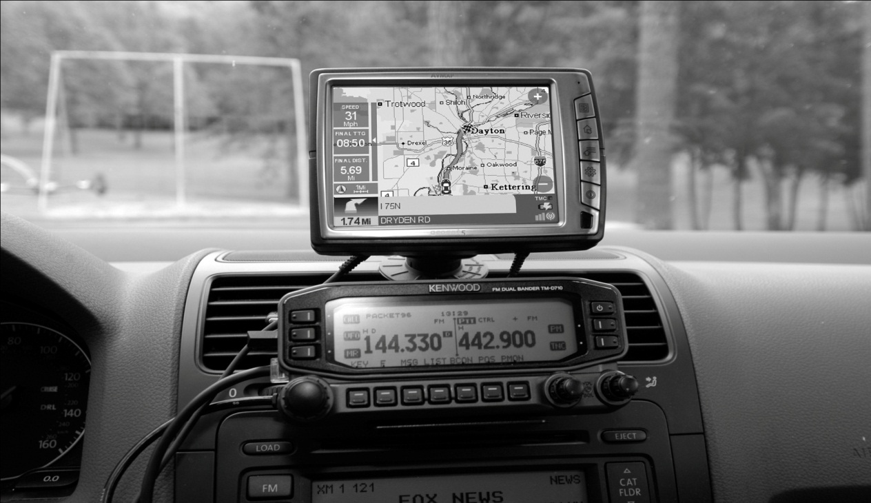
Digital Communications.
APRS
Automatic Packet Reporting System T8D02
Basically a packet station connected to a
GPS Global Positioning System T8D03

Slide 30
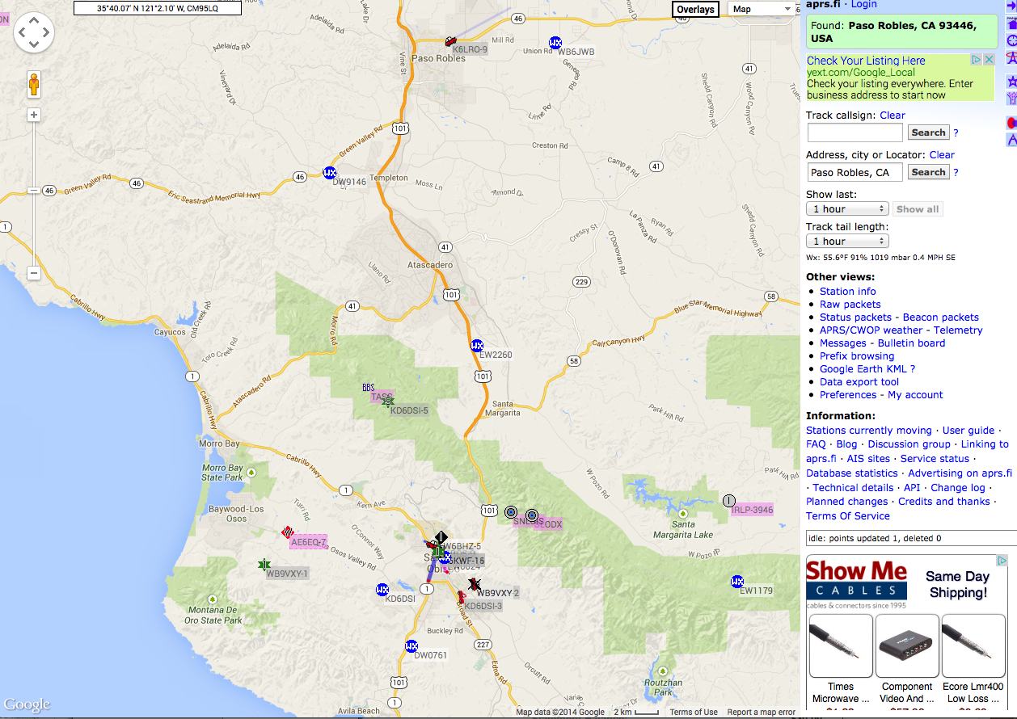
APRS
T8D05. Providing real-time tactical digital communications in conjunction with a map showing the locations of stations

Slide 31
Mesh Network
Broadband-Hamnet T8D12
Or, High Speed multi-media network
IEEE 802.11 A Wi-Fi digital standard.
An amateur-radio-based data network using commercial Wi-Fi gear with modified firmware

Slide 32
Computers
T4A02
A. For logging contacts and contact information
B. For sending and/or receiving CW
C. For generating and decoding digital signals

Slide 33
Computer control
T8D09 The code used when sending CW in the amateur bands is International Morse.
T8D14 Can be sent using a hand key, electronic keyer or computer
T8D10 Digital mode software
WSJT was designed for weak signal computer / radio operation as in:
A. Moonbounce or Earth-Moon-Earth B. Weak-signal propagation beacons C. Meteor scatter
T8D13 FT8 digital mode
A digital mode capable of operating in low signal-to-noise conditions that transmits on 15-second intervals
33

Slide 34
Digital Modes Station Set UP
The connection between the transceiver and computer
T4A06 Receive audio, transmit audio, and push-to-talk (PTT)
Soundcard
interface
Transceiver
Microphone of line input T4A04
Computer
Computer control
T4A07 The sound card provides audio to the radio's microphone input and converts received audio to digital form
Most modern transceivers have built in soundcards and usb connections to connect to the computer

Slide 35
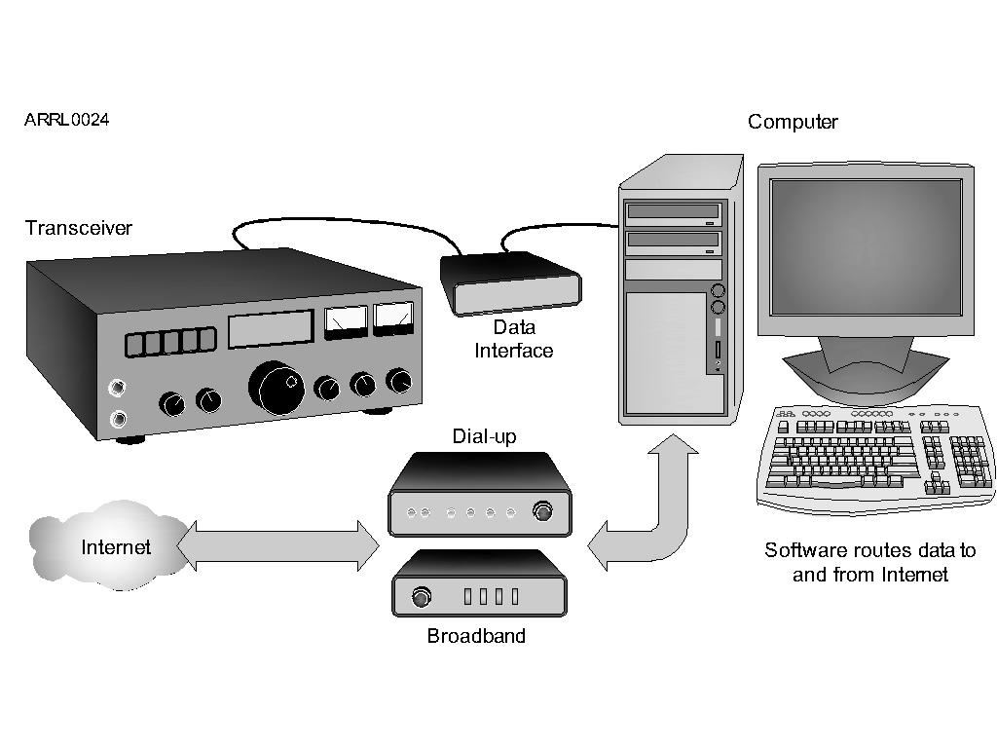
Gateways
T8C11 A gateway is used to connect other amateur
radio stations to the internet

Slide 36
Power Up
A power supply is a device that supplies electrical energy to
one or more electric loads.
T4A01 In selecting a power supply you must consider all of the following.
A. Efficiency of the transmitter at full power output
B. Receiver and control circuit power
C. Power supply regulation and heat dissipation
T6D05 A regulator is part of a power supply to maintain a stable voltage.
T4A10 A high-pitched whine that varies with engine speed in a mobile transceiver’s receive audio, is usually caused by the vehicles alternator.

Slide 37
Power Up
Mobile equipment
T4A11 The negative return connection of a mobile transceiver power cable should be connected At the battery or engine block ground strap
T5A06 Mobile radio equipment uses a 12 volt power source.
T4A03 Use heavy gauge wire to avoid voltage falling below that needed for proper operation

Slide 38
For Next Week
Study flash cards www.hamexam.org
Radio
Fundamentals
Rules &
Regs.
Comm. w/
Others
Antennas
Propagation
Equipment
Electricity
Safety
Lesson 1
T1B
T3B
T8A
Lesson 2
T1A
T1C
TID
T1E
T1F
Lesson 3
T2A
T2B
T2C
T8B
T8C
Lesson 4
T3A
T3C
T9A
T9B
T7C
Lesson 5
T4A
T4B
T7A
T7B
T8D
Lesson 6
T5A
T5B
T5C
T5D
T6A
T6B
T6C
T6D
T7D
Lesson 7
T0A
T0B
T0C
73
Tom and Jack

