Slide 1
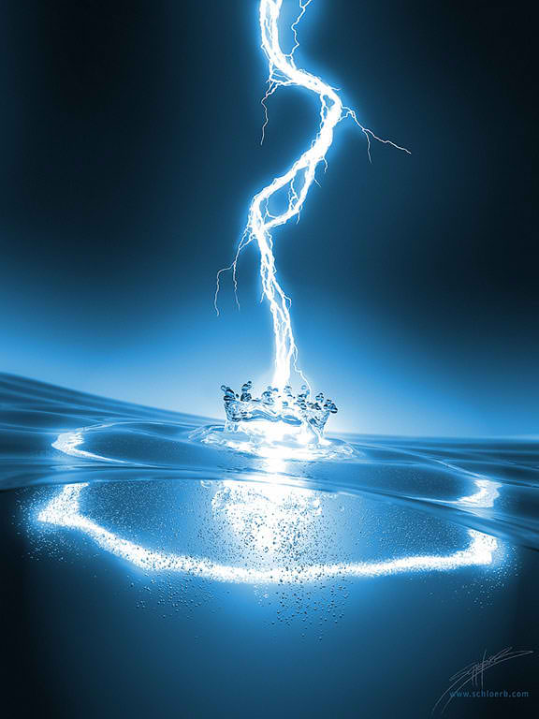
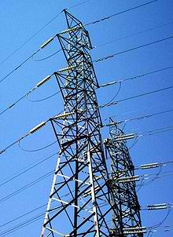
Lesson 6
Electricity, Components, Circuits
ARRL: Chapter 3.1 and 3.2
G. West
Electrons, Go with the flow

Slide 2
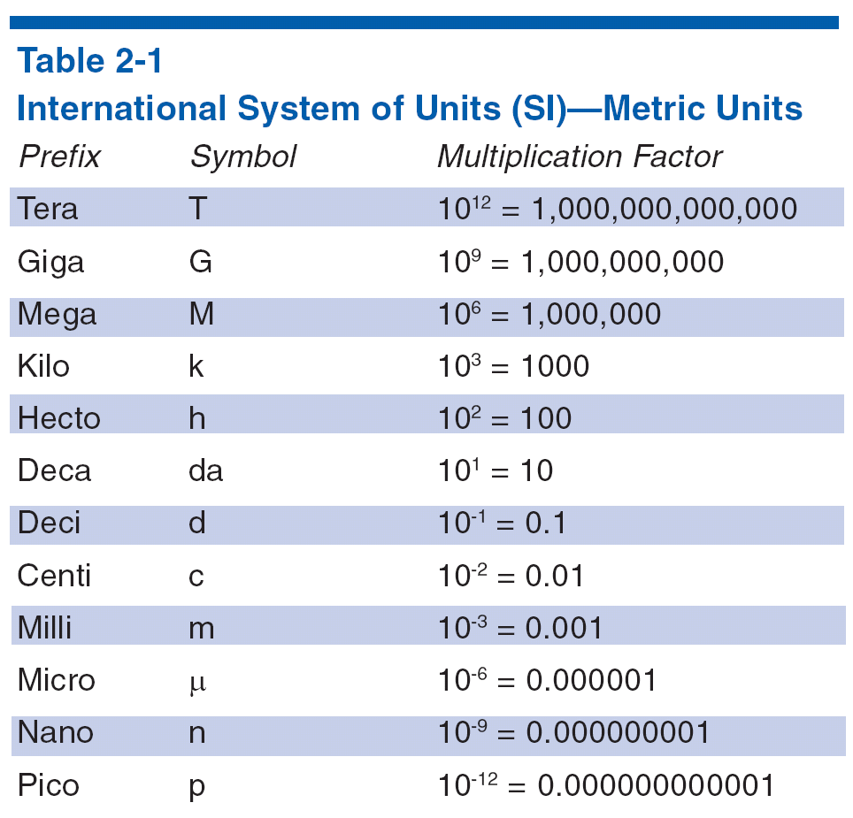
Metric Units
Grace Says “ Left up right Down”
T5BO2
T5B03
T5B04
T5B05
T5B06
T5B07
T5B08
Convert down
Decimal Right
Convert up
Decimal Left
Unit
Example 1: 5MHz = ? kHz
5000 kHz
Example 2: 1.00 dollar = ? dimes
10 dimes
Example 2: 50 mA = ? A
.05 A
Example 3: 1.00 dollar = ? pennies
100 cents
Notes:
Point out the most likely units the students will have to deal with on the exam like milli, micro, kilo, mega, etc. Using examples from test questions give the students some homework to convert between units. Remembering that Ohm’s Law, the basic units for voltage, current and resistance are required.

Slide 3
T5B02
What is another way to specify a radio signal frequency of 1,500,000 hertz?
A. 1500 kHz
B. 1500 MHz
C. 15 GHz
D. 150 kHz
(A)
1,500,000. hertz?
1.500,000 M hertz?
1.5 MHz
1,500.000 k hertz?
1500 kHz
.001,500,000 G hertz?
.0015 GHz

Slide 4
T5B06
If an ammeter calibrated in amperes is used to measure a 3000-milliampere current, what reading would it show?
A. 0.003 amperes
B. 0.3 amperes
C. 3 amperes
D. 3,000,000 amperes
milli = 1/1000 or .oo1 or divide by 1000
3000 / 1000 = 3
Or simply we are moving up the scale 3 powers of 10
From milli to unit. Move the decimal 3 places to the left
3 0 0 0. milliamp = 3 amps

Slide 5
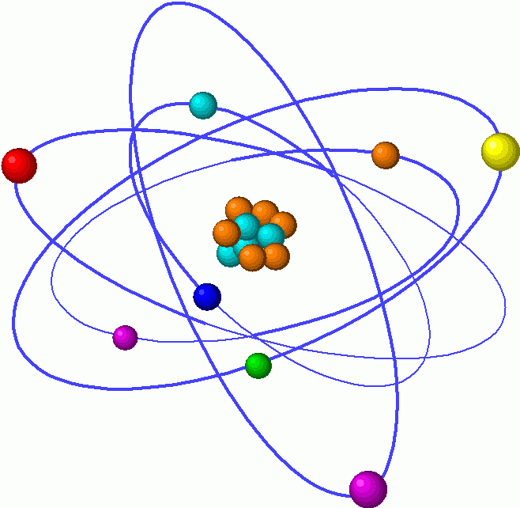
The atom
The basic building block of matter
Electron,
Our negative friend

Slide 6
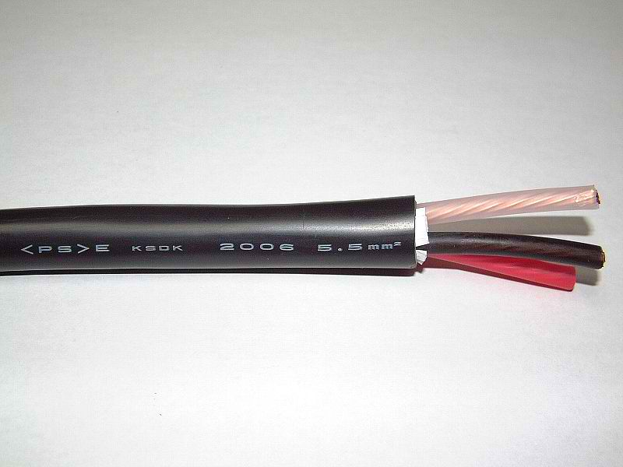
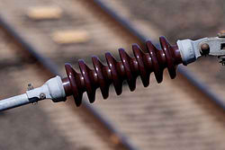
Conductors
Loosely bonded electrons
Example: copper T5A07
Insulators
Tightly bonded electrons
Example: Glass, wood, plastic
T5A08

Slide 7
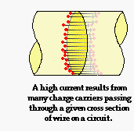
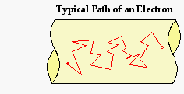
CURRENT
The flow of electrons
The Flow of electrons
Random electron movement
Add an electrical potential
Symbol I
Unit of measure is ampere
Abbreviated A
An ammeter is used to measure electrical current
T7D04

Slide 8
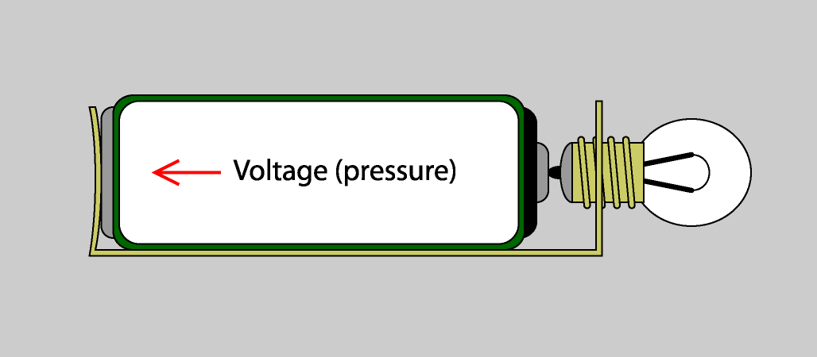
VOLTAGE
Voltage is the force that moves electrons T5A05
Symbol E Electro Motive Force
The magnitude is measured in Volts
Abbreviated V
Voltage is measured with a voltmeter

Slide 9
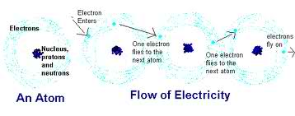
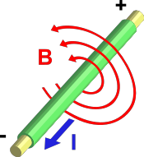
Electric current is the flow of electrons.
T5A03
Electrons flowing through a conductor
Create a magnetic field.

Slide 10
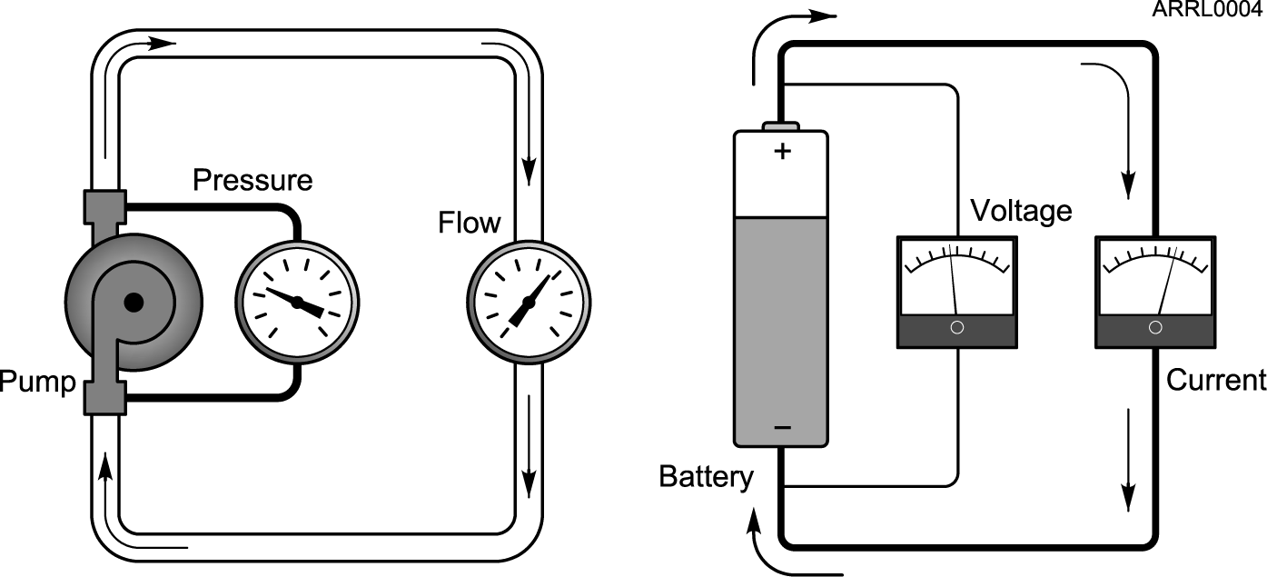

Voltage is always measured across or parallel to a component T7D02
Current is always measured in line or series with a component T7D03
You can damage a multimeter by measuring voltage using the resistance scale. T7D06 T7D11
Schematic symbol for a battery
(Grace says “current is serious business”)

Slide 11
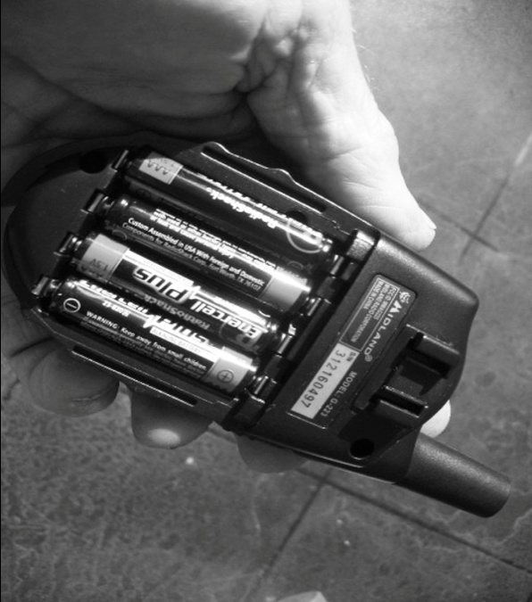
Portable Batteries
Portable batteries
T6A10 T6A11 Batteries
T6A10 Chargeable
T6A11 Not Chargeable
Nickel-metal hydride
Lithium-ion
Lead-acid gel-cell
Nickel-cadmium
Carbon-zinc

Slide 12
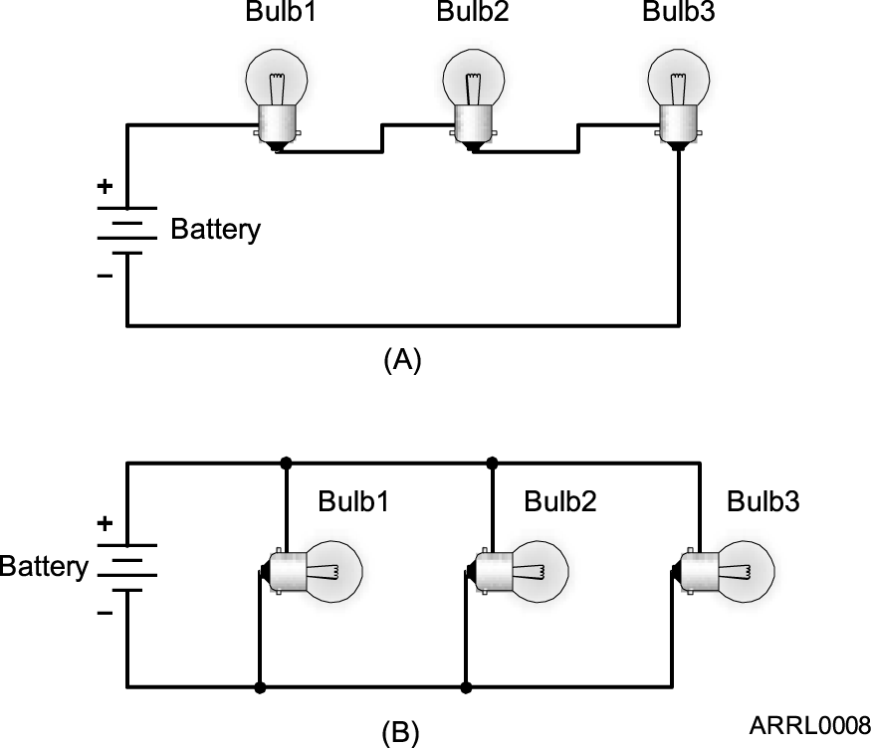
Series circuit
Parallel circuit

Slide 13
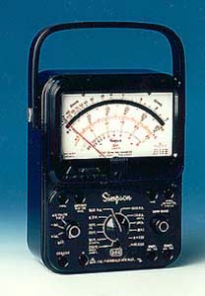
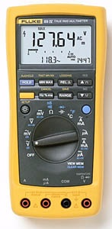
Multimeter
  T7D06 Attempting to measure voltage when using the resistance setting might damage a multimeter.
  T7D07 Voltage and resistance are measurements commonly made using a multimeter.
T7D11 Ensure the circuit is not powered
when measuring resistance
Digital Volt Ohm Meter Much more accurate
Volt Ohm Meter VOM

Slide 14
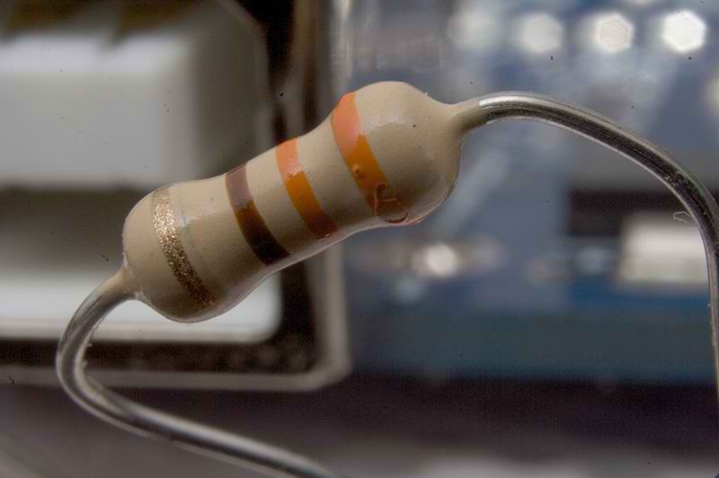
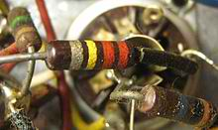

Resistors
Symbol R for resistance
Unit of measure is the Ohm
Abbreviated Ω
Schematic symbol
Resistors are poor conductors and
Resist the flow of Current
Resistance is measured with an ohmmeter
T7D05

Slide 15
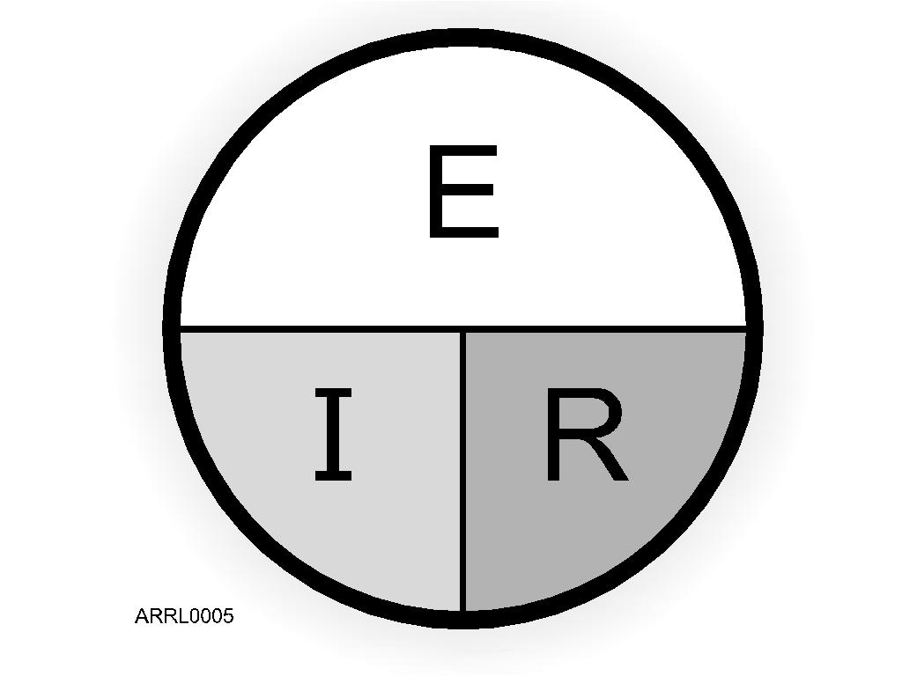
Ohm’s Law
E is voltage
  Units - volts
I is current
  Units - amperes
R is resistance
  Units - ohms
R = E/I
I = E/R T5D01 02 03
E = I x R
Examples: T5D04 - T5D12
Notes:
Go over the simple Ohm’s Law math and provide a few examples of how to solve problems. Give some homework problems that are the same as test questions (without telling them that they are test questions). Have the students solve these problems so they are confident that they can do the math.

Slide 16
T5D05
What is the resistance in a circuit for which the applied voltage is 12 volts and the current flow is 1.5 amperes?
A. 18 ohms
B. 0.125 ohms
C. 8 ohms
D. 13.5 ohms
(C)
T5D09
What is the current flowing through a 24-ohm resistor connected across 240 volts?
A. 24,000 amperes
B. 0.1 amperes
C. 10 amperes
D. 216 amperes
(C)

Slide 17
Two Basic Kinds of Current
When current flows in only one direction, it is called direct current (dc). T5A04
  Batteries are a common source of dc.
  Most electronic devices are powered by dc.
When current flows alternatively in one direction then in the opposite direction, it is called alternating current (ac). T5A09
  Your household current is ac.
Notes:
Discuss the two different kinds of current and what they might be used for. Point out to the students that their household ac current is frequently converted into dc to run many household appliances. That conversion is done inside the appliance or inside an external converter like a wall transformer.
Explain why house current is ac (easier to transmit the electricity from the power plant to the home).

Slide 18
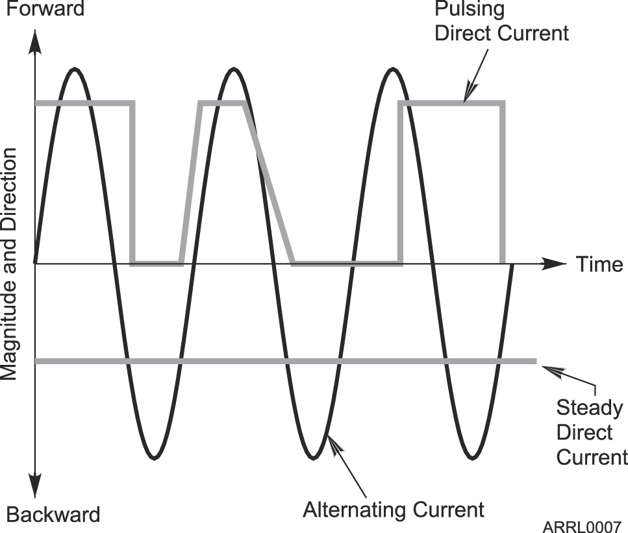
AC / DC
+
Electrons can either flow in one direction
or alternate and flow in the opposite direction
by changing the polarity of the voltage.
0
-

Slide 19
Moving Electrons
Doing Something Useful
Any time energy is expended to do something, work is performed.
When moving electrons do some work, power is consumed.
Power is measured in the units of watts (W). T5A02
Notes:
Discuss the concept of power in electronics. Student will probably be familiar with this concept because of their electric bill.

Slide 20
Power Formula
Power is defined as the amount of current that is being pushed through a conductor or device to do work.
  P = I x E T5C08
  E = P/I
  I = P/E
P
I
E
Notes:
Go through some simple problems using the power formula. Again use test question examples for homework.

Slide 21
T5C09 How much power is being used in a circuit when the applied voltage is 13.8
Volts DC and the current is 10 amps
P=IE
P= 13.8 X 10
P= 138 Watts

Slide 22
Other basic circuit components
Capacitors Stores energy in an electric field
Unit of measure – Farad, F
Inductors Stores energy in a magnetic field
Unit of measure – Henry, H
Semiconductors
Diodes One way valve
Transistors Electronic switch or amplifier
Integrated circuits Electronic component integrating many components
in one package

Slide 23
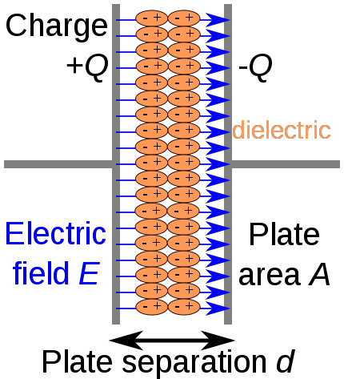
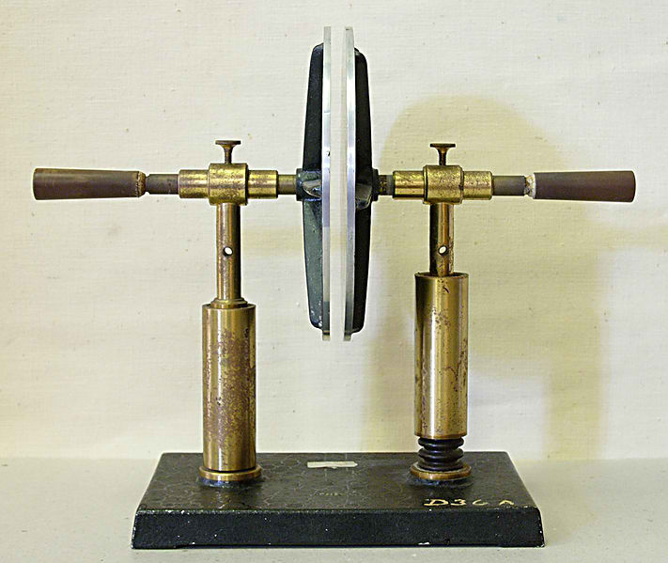
Capacitors
Store energy in an electric field T6A04
Capacitors oppose the change in voltage

Slide 24
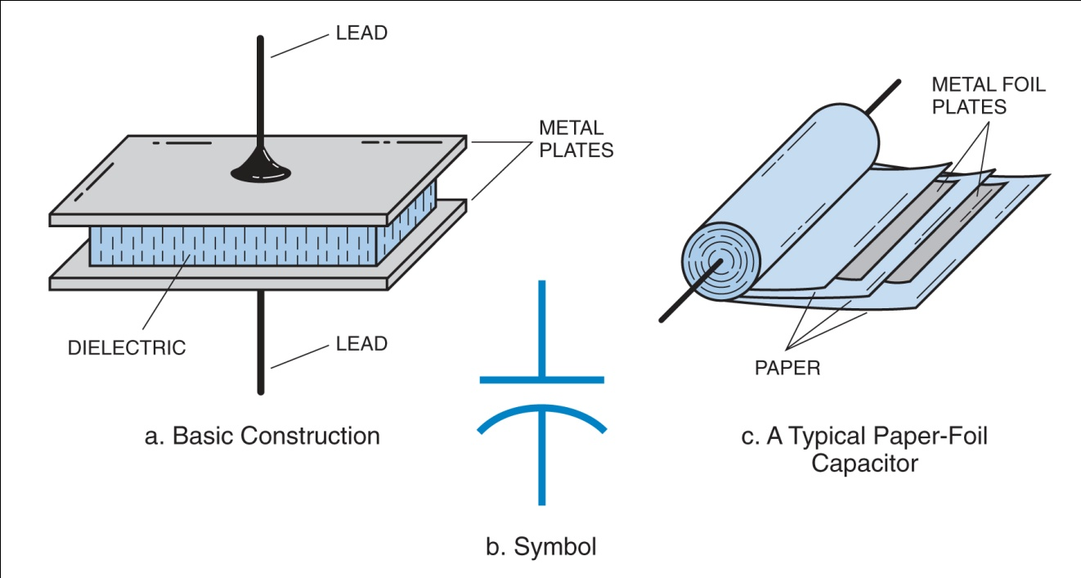
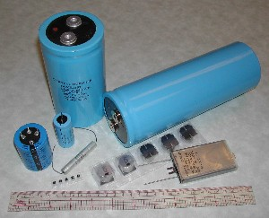
  T6A04 A capacitor is the electrical component that stores energy in an electric field.
Various fixed capacitors
Typical construction and schematic symbol for capacitors.
24

Slide 25
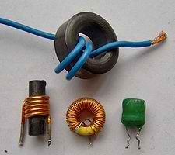
Inductors
Store energy in a magnetic field
T5C03 T6A06
Symbol L
Unit of measure is Henry
Abbreviated H
Schematic symbol for an inductor
Inductors oppose the change of current

Slide 26
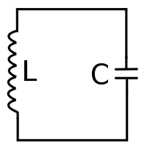
Resonant circuits
Circuits containing both capacitors and inductors
Will have at least one resonant frequency.
T6D08
Components that oppose AC voltage or current have reactance
Capacitive reactance
or
Inductive reactance
The combination of resistance and reactance is called impedance.
symbol Z

Slide 27
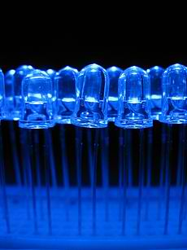
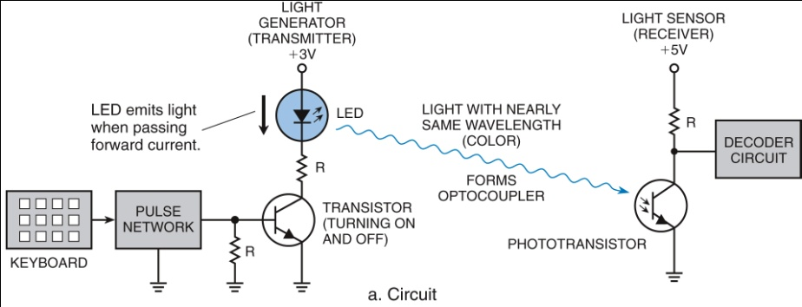
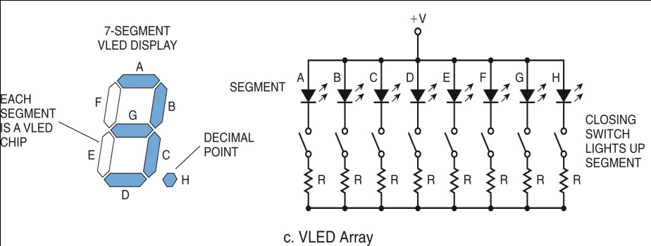
Diodes, Transistors, and Integrated Circuits
Semi Conductors
Primarily the active element is silicone.
Impurities are added to create special properties
Diode - A semiconductor that allows current to flow only in one direction. T6B02
A heavy duty diode is called a rectifier
Rectifiers are used to change AC into pulsating DC
A diode has two electrodes, anode and cathode
A special diode that gives off light is a LED (light emitting diode) T6B07 T6D07

Slide 28
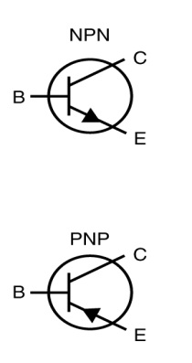
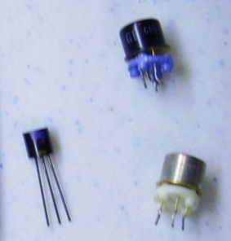
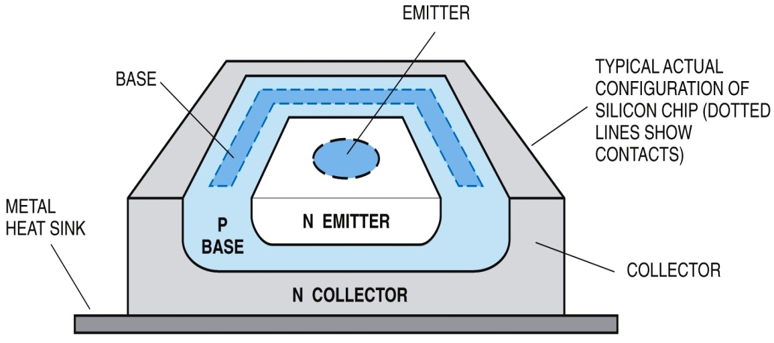
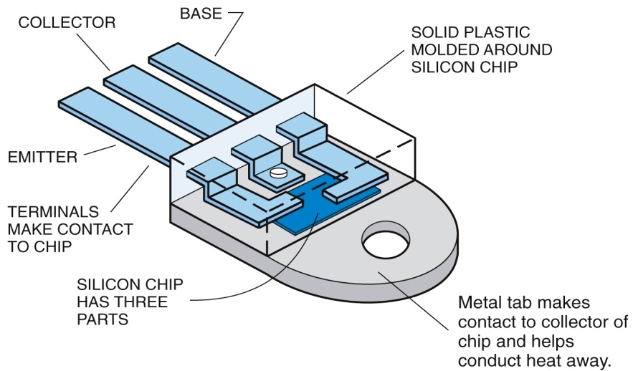
Transistors
  T6B03 A transistor is a component that can be used as an electronic switch or amplifier.
  T6B04 The bipolar junction transistor is a component that is made of three layers of semiconductor material.
Small Signal Transistors
Schematic Symbol

Slide 29
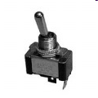


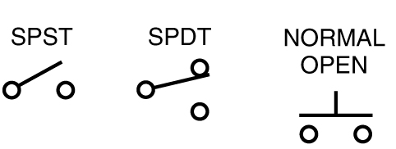
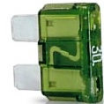


Gate Keepers
  T6A08 A switch is an electrical component that is used to connect or disconnect electrical circuits.
  T6A09 A fuse is an electrical component used to protect other circuit components from current overloads.
Schematic Symbol
Toggle Switch
Slide Switch
Rocker Switch
Slow Blow Fuse
Schematic Symbol
Automobile Fuse
29

Slide 30
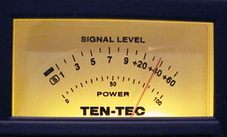
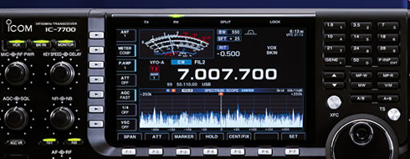
Display Components
  T6D04 A meter can be used to display signal strength on a numeric scale.
S-Meter
Icom 7700
30

Slide 31
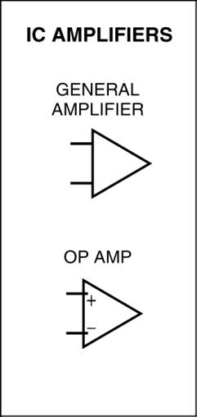
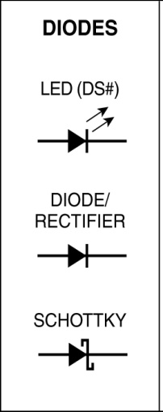
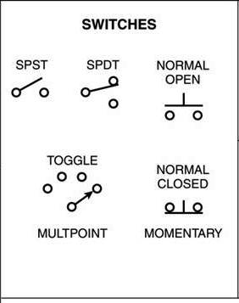
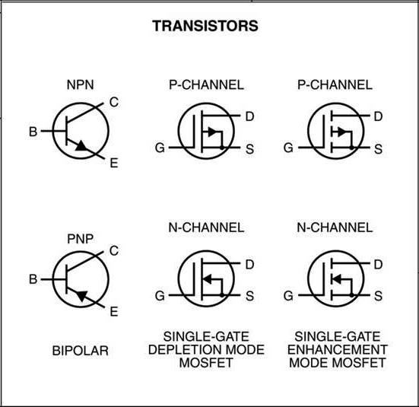
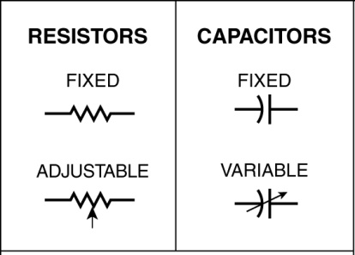
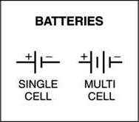
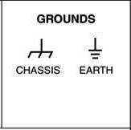
Schematic Symbols
  T6C01 Schematic symbols is the name for standardized representations of components in an electrical wiring diagram.
31

Slide 32
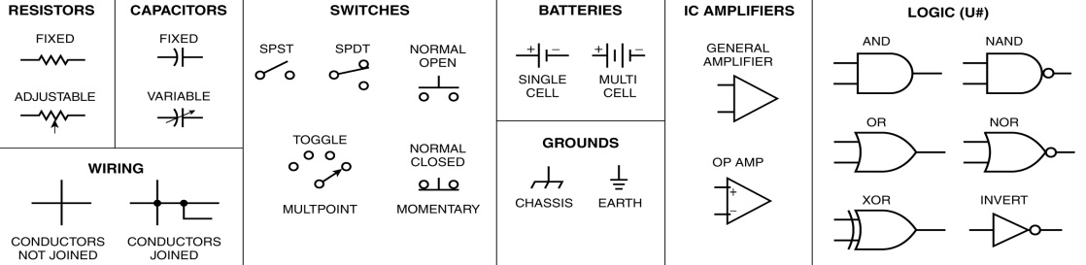
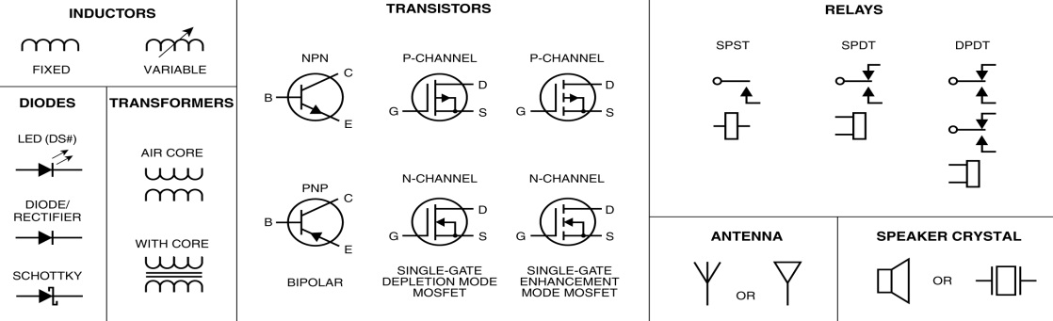
Schematic symbols
  T6C12 The symbols on an electrical circuit schematic diagram represent electrical components.

Slide 33
T6C: Circuit diagrams; schematic symbols
  T6C04 Component 1 in figure T1 is a
Component 2 in figure T1 is a
Component 3 in figure T1 is a
Lamp
Resistor
Transistor
Figure T1
33

Slide 34
T6C: Circuit diagrams; schematic symbols
  Component 6 in figure T2 is a
Component 3 in figure T2 is a
Component 8 in figure T2 is a
Component 9 in figure T2 is a
Component 4 in figure T2 is a
Variable resistor
STSP switch
Transformer
Capacitor
LED
Figure T2
34

Slide 35
T6C: Circuit diagrams; schematic symbols
  T6C11 Component 4 in figure T3 is an
Component 3 in figure T3 is a
Antenna
Variable inductor
Figure T3
35

Slide 36
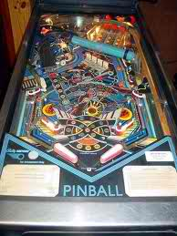
By controlling the movements of electrons
through our circuits. We can have circuits
do specific tasks.
Components throughout circuits are a lot
like the bumpers in a pin ball machine

Slide 37
For Next Week
Study flash cards www.hamexam.org
Radio
Fundamentals
Rules &
Regs.
Comm. w/
Others
Antennas
Propagation
Equipment
Electricity
Safety
Lesson 1
T1B
T3B
T8A
Lesson 2
T1A
T1C
TID
T1E
T1F
Lesson 3
T2A
T2B
T2C
T8B
T8C
Lesson 4
T3A
T3C
T9A
T9B
T7C
Lesson 5
T4A
T4B
T7A
T7B
T8D
Lesson 6
T5A
T5B
T5C
T5D
T6A
T6B
T6C
T6D
T7D
Lesson 7
T0A
T0B
T0C
73
Tom and Jack

Slide 38
To Bring
Ammeter
Multimeter
Electro magnetic
Conductor
Insulators
Resistor
Capacitor
Inductor
Circuit
Clear tube and marble
Shock absorber
Tuning fork
Ball magnet and al tube.

