Slide 1
Safety
Lesson 7

Slide 2
ZAP
T0A02 Current flowing through the body cause a health hazard:
By heating tissue;
It disrupts the electrical functions of cells;
It causes involuntary muscle contractions.

Slide 3
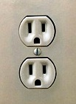
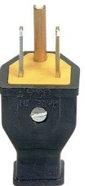
Green is Good
T0A06 A good way to guard against electrical shock at your station:
Use three-wire cords and plugs for all AC powered equipment;
T0A03 The green wire in a three-wire electrical AC plug is safety ground.
Hot (Live)
Neutral
Ground

Slide 4
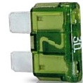
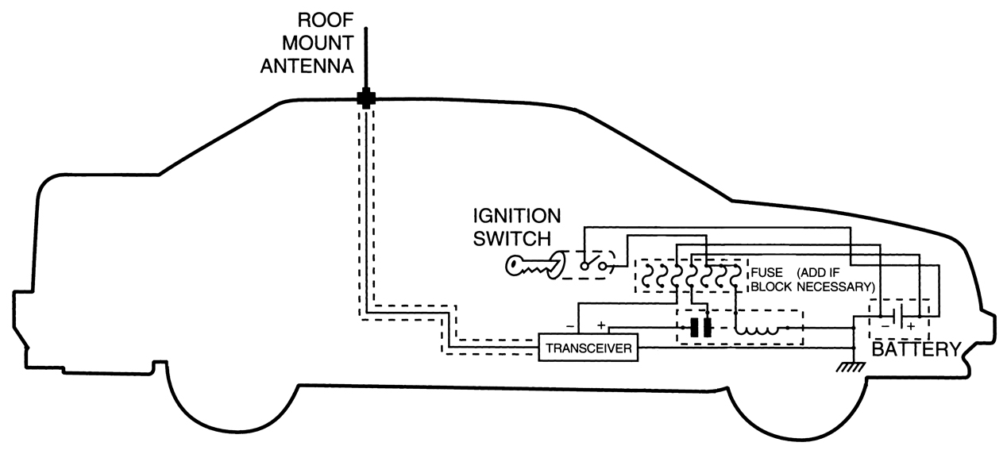
Fuse
T0A04 The purpose of a fuse in an electrical circuit is to interrupt power in case of overload.
T0A05 It is unwise to install a 20-ampere fuse in the place of a 5-ampere fuse because excessive current could cause a fire
Slow-Blow fuse
Automobile fuse
Fuses
Place the fuses as close to the battery as possible
4

Slide 5
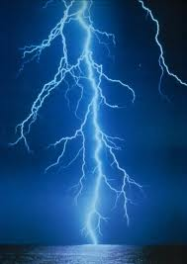
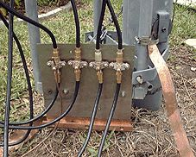
Lightning
T0A07
Ground all protectors to a common plate
Good for nearby lightning strikes
Direct hits, forget it, kiss everything goodbye
T0B10 Avoid sharp bends in your grounding conductors.

Slide 6
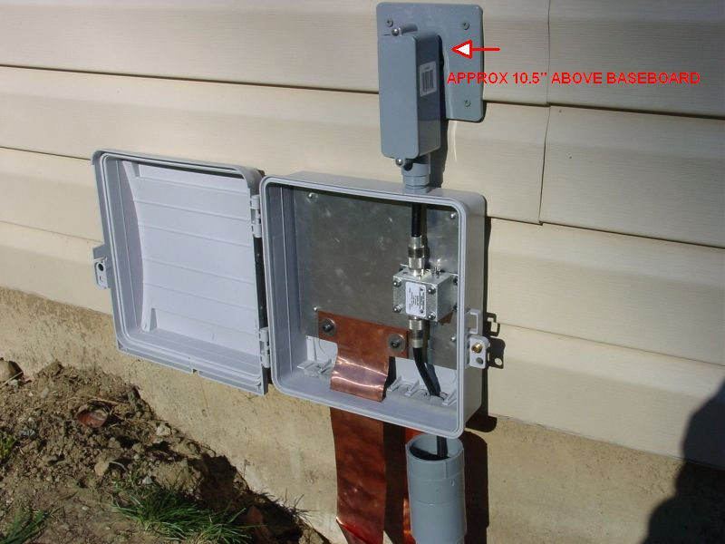

Slide 7
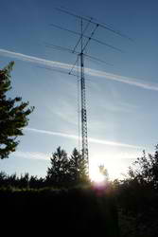
Tower Grounding
T0B08 Use eight-foot long ground rods for each tower leg, bonded to the tower and each other.
T0B12 Tower ground wires, Short and Direct
T0B11 Grounding requirements for an amateur radio tower or antenna are established by local electrical codes
Check local codes before putting up an antenna

Slide 8
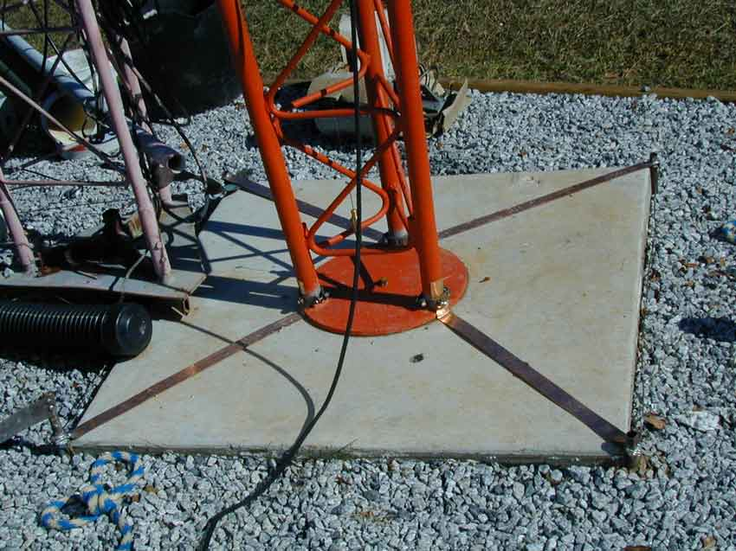
Tower Grounding

Slide 9
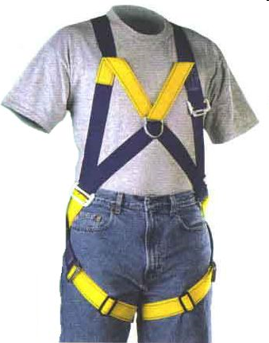
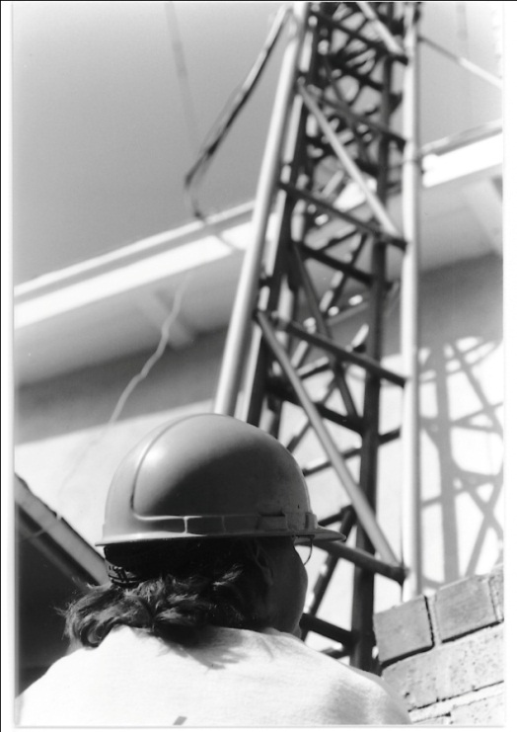
Overhead Tower Work
T0B01 Members of a tower work team should wear a hard hat and safety glasses at all times when any work is being done on the tower.
On ground or up the tower
Wear hard hat and safety glasses
T0B02 Putting on a climbing harness and safety glasses is a good precaution to observe before climbing an antenna tower.
Climbing Harness
Safety Glasses
And
Hard Hat
9

Slide 10
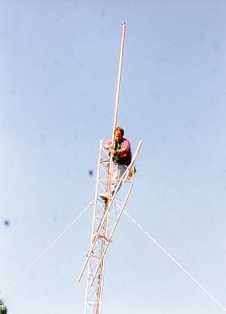
Tower Dogs
T0B03 It is never safe to climb a tower without a helper or observer.
T0B05 The purpose of a gin pole is to lift
tower sections or antennas.
T0B07 A crank-up tower must never be climbed unless it is in the fully retracted position.

Slide 11
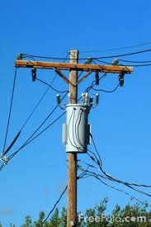
Department of Tower and Power
T0B09 You should avoid attaching an antenna to a utility pole as the antenna could contact high-voltage power wires.
And it may be illegal to do
T0B04 Looking for and staying clear of any overhead electrical wires.
T0B06 The minimum safe distance to allow from a power line when installing an antenna so that if the antenna falls unexpectedly, no part of it can come closer than
10 feet to the power wires.

Slide 12
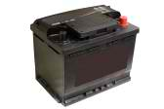
12 V. Storage Battery
T0A09 A hazard is presented by a conventional 12-volt storage battery with its explosive gas that can collect if not properly vented.
Dangerous acid could spill
Enough power to cause a fire
T0A10 If a lead-acid storage battery is charged or discharged too quickly it could overheat and give off flammable gas or explode.

Slide 13
Power Supplies
T0A11 May be a shock hazard from stored energy in capacitors.
T0A08 If we home build equipment, include a fuse or circuit breaker in the AC hot power line.

Slide 14
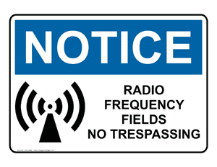
RF Hazards

Slide 15
Exposure limits
T0C05 Exposure limits vary with frequency because the human body absorbs more RF energy at some frequencies than at others.
T0C06 Acceptable methods to determine that your station complies with FCC RF exposure regulations:
By calculation based on FCC OET Bulletin 65
By calculation based on computer modeling
By measurement of field strength using calibrated equipment
Just remember all choices are correct

Slide 16
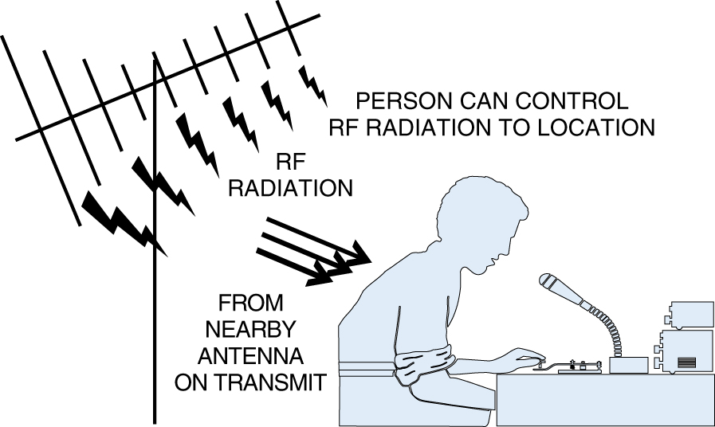
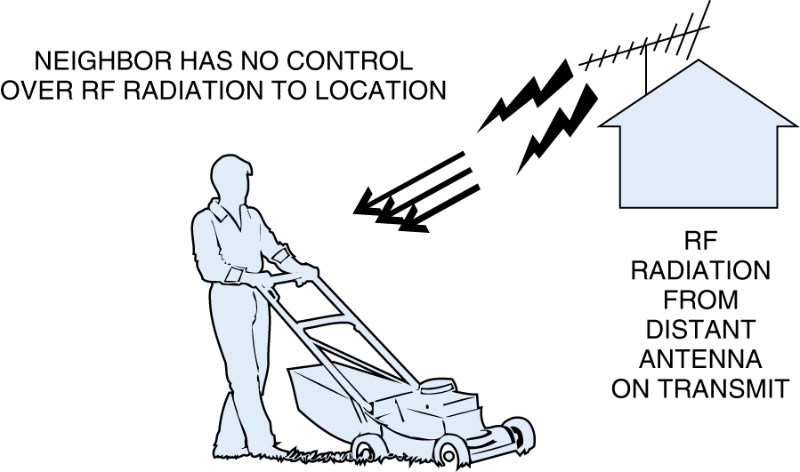
T0C04 Factors affecting the RF exposure of people near an amateur station antenna:
Frequency and power level of the RF field
Distance from the antenna to a person
Radiation pattern of the antenna
Just remember all choices are correct
Controlled
Uncontrolled
16

Slide 17
50 50 club
T0C01 VHF and UHF radio signals are non-ionizing radiation.
T0C12 Quite different from X-ray, gamma ray, and ultra violet radiation
T0C02 With 3.5 MHz, 50 MHz, 440 MHz, and 1296 MHz; a 50 MHz frequency has the lowest Maximum Permissible Exposure (MPE) limit.
T0C03 The maximum power level that an amateur radio station may use at VHF frequencies before an RF exposure evaluation is required is 50 watts PEP at the antenna.

Slide 18
Table 1 -- Power Thresholds for Routine Evaluation of Amateur Radio Stations
Band (Wavelength) Transmitter Power (W)
160 m 500
75 m 500
80 m 500
40 m 500
30 m 425
20 m 225
17 m 125
15 m 100
12 m 75
10 m 50
6 50
1.23 m 50
70 cm 70
33 cm 150
23 cm 200
13 cm and up 250

Slide 19
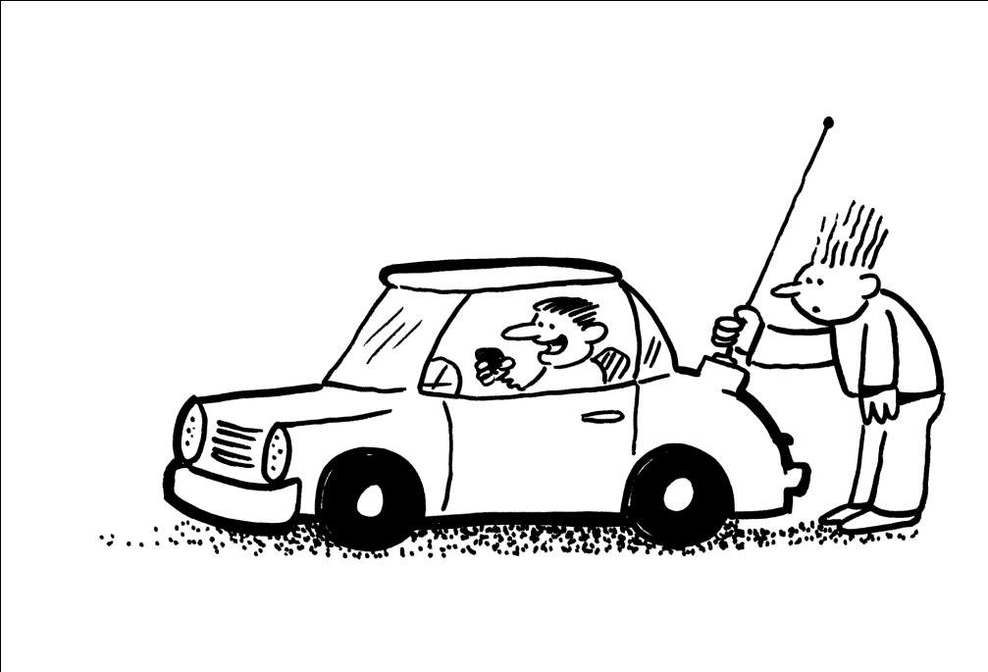
Ouch!
T0C07 If a person accidentally touched your antenna while you were transmitting they might receive a painful RF burn.
Be sure to place your antennas where no one can touch them. All antennas, not just the mobile ones.
Or
Don’t touch-a the antenna
19

Slide 20
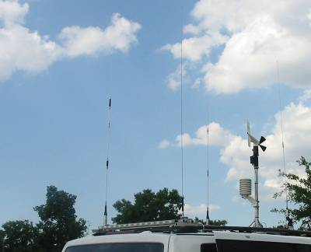
Exposure Prevention
T0C08 An action amateur operators might take to prevent exposure to RF radiation in excess of FCC-supplied limits is to relocate antennas.
T0C09 To make sure your station stays in compliance with RF safety regulations, re-evaluate the station whenever an item of equipment is changed.
The safest place to mount the mobile antenna for minimum RF exposure is on the metal roof as shown.

Slide 21
Duty Cycle
T0C10 Duty cycle is one of the factors used to determine safe RF radiation exposure levels because it affects the average exposure of people to radiation.
T0C11 When referring to RF exposure, "duty cycle" is the percentage of time the transmitter is transmitting.
T0C13 Permitted power density increases as duty cycle goes down.
21

Slide 22
Table 2
Operating Duty Factors by Mode
Mode Duty Factor Notes
Conversational SSB 20% Note 1
Conversational SSB 40% Note 2
Voice FM 100%
FSK/RTTY 100%
AFSK 100%
Conversational CW 40%
Carrier 100% Note 3
Note 1: Includes voice characteristics and syllabic duty factor. No speech processing.
Note 2: Moderate speech processing employed.
Note 3: A full carrier is commonly used for tune-up purposes.

Slide 23
Just remember the Cat
“Duty
Cycle”
You can only step on the tail so many times.
Be Safe

Slide 24
Element 2 Technician Class Question Pool T0 AC power circuits, antenna installation, RF hazards [3 Exam Questions – 3 Groups]
Valid July 1, 2010
Through
June 30, 2014

Slide 25
T0A02 How does current flowing through the body cause a health hazard?
By heating tissue
It disrupts the electrical functions of cells
It causes involuntary muscle contractions
All of these choices are correct

Slide 26
T0A03 What is connected to the green wire in a three-wire electrical AC plug?
Neutral
Hot
Safety ground
The white wire

Slide 27
T0A04 What is the purpose of a fuse in an electrical circuit?
To prevent power supply ripple from damaging a circuit
To interrupt power in case of overload
To limit current to prevent shocks
All of these choices are correct

Slide 28
T0A05 Why is it unwise to install a 20-ampere fuse in the place of a 5-ampere fuse?
The larger fuse would be likely to blow because it is rated for higher current
The power supply ripple would greatly increase
Excessive current could cause a fire
All of these choices are correct

Slide 29
T0A06 What is a good way to guard against electrical shock at your station?
Use three-wire cords and plugs for all AC powered equipment
Connect all AC powered station equipment to a common safety ground
Use a circuit protected by a ground-fault interrupter
All of these choices are correct

Slide 30
T0A07 Which of these precautions should be taken when installing devices for lightning protection in a coaxial cable feedline?
Include a parallel bypass switch for each protector so that it can be switched out of the circuit when running high power
Include a series switch in the ground line of each protector to prevent RF overload from inadvertently damaging the protector
Keep the ground wires from each protector separate and connected to station ground
Ground all of the protectors to a common plate which is in turn connected to an external ground

Slide 31
T0A09 What kind of hazard is presented by a conventional 12-volt storage battery?
It emits ozone which can be harmful to the atmosphere
Shock hazard due to high voltage
Explosive gas can collect if not properly vented
All of these choices are correct

Slide 32
T0A10 What can happen if a lead-acid storage battery is charged or discharged too quickly?
The battery could overheat and give off flammable gas or explode
The voltage can become reversed
The “memory effect” will reduce the capacity of the battery
All of these choices are correct

Slide 33
T0B07 Which of the following is an important safety rule to remember when using a crank-up tower?
This type of tower must never be painted
This type of tower must never be grounded
This type of tower must never be climbed unless it is in the fully retracted position
All of these choices are correct

Slide 34
T0B08 What is considered to be a proper grounding method for a tower?
A single four-foot ground rod, driven into the ground no more than 12 inches from the base
A ferrite-core RF choke connected between the tower and ground
Separate eight-foot long ground rods for each tower leg, bonded to the tower and each other
A connection between the tower base and a cold water pipe

Slide 35
T0B09 Why should you avoid attaching an antenna to a utility pole?
The antenna will not work properly because of induced voltages
The utility company will charge you an extra monthly fee
The antenna could contact high-voltage power wires
All of these choices are correct

Slide 36
T0B10 Which of the following is true concerning grounding conductors used for lightning protection?
Only non-insulated wire must be used
Wires must be carefully routed with precise right-angle bends
Sharp bends must be avoided
Common grounds must be avoided

Slide 37
T0B11 Which of the following establishes grounding requirements for an amateur radio tower or antenna?
FCC Part 97 Rules
Local electrical codes
FAA tower lighting regulations
Underwriters Laboratories' recommended practices

Slide 38
T0C01 What type of radiation are VHF and UHF radio signals?
Gamma radiation
Ionizing radiation
Alpha radiation
Non-ionizing radiation

Slide 39
T0C02 Which of the following frequencies has the lowest Maximum Permissible Exposure limit?
3.5 MHz
50 MHz
440 MHz
1296 MHz

Slide 40
T0C03 What is the maximum power level that an amateur radio station may use at VHF frequencies before an RF exposure evaluation is required?
1500 watts PEP transmitter output
1 watt forward power
50 watts PEP at the antenna
50 watts PEP reflected power

Slide 41
T0C04 What factors affect the RF exposure of people near an amateur station antenna?
Frequency and power level of the RF field
Distance from the antenna to a person
Radiation pattern of the antenna
All of these choices are correct

Slide 42
T0C05 Why do exposure limits vary with frequency?
Lower frequency RF fields have more energy than higher frequency fields
Lower frequency RF fields do not penetrate the human body
Higher frequency RF fields are transient in nature
The human body absorbs more RF energy at some frequencies than at others

Slide 43
T0C06 Which of the following is an acceptable method to determine that your station complies with FCC RF exposure regulations?
By calculation based on FCC OET Bulletin 65
By calculation based on computer modeling
By measurement of field strength using calibrated equipment
All of these choices are correct

Slide 44
T0C07 What could happen if a person accidentally touched your antenna while you were transmitting?
Touching the antenna could cause television interference
They might receive a painful RF burn
They might develop radiation poisoning
All of these choices are correct

Slide 45
T0C08 Which of the following actions might amateur operators take to prevent exposure to RF radiation in excess of FCC-supplied limits?
Relocate antennas
Relocate the transmitter
Increase the duty cycle
All of these choices are correct

Slide 46
T0C09 How can you make sure your station stays in compliance with RF safety regulations?
By informing the FCC of any changes made in your station
By re-evaluating the station whenever an item of equipment is changed
By making sure your antennas have low SWR
All of these choices are correct

Slide 47
T0C10 Why is duty cycle one of the factors used to determine safe RF radiation exposure levels?
It affects the average exposure of people to radiation
It affects the peak exposure of people to radiation
It takes into account the antenna feedline loss
It takes into account the thermal effects of the final amplifier

Slide 48
T0C10 Why is duty cycle one of the factors used to determine safe RF radiation exposure levels?
The difference between the lowest power output and the highest power output of a transmitter
The difference between the PEP and average power output of a transmitter
The percentage of time that a transmitter is transmitting
The percentage of time that a transmitter is not transmitting

Slide 49
T0C11 What is the definition of duty cycle during the averaging time for RF exposure?
C.
A. The difference between the lowest power output and the highest power output of a transmitter
B. The difference between the PEP and average power output of a transmitter
C. The percentage of time that a transmitter is transmitting
C.
C.
D. The percentage of time that a transmitter is not transmitting

Slide 50
For Next Week
Study flash cards www.hamexam.org
Chapters listed using Ham Radio School .Com by Stu Turner
Ch.
1, 3 & 11
Ch. 5 & 7
Ch.
6.1, 6.2, 10, 12
Ch. 8 & 9
Ch.13
Ch. 4, 3 & 6.3
Ch. 2
Radio
Fundamentals
Rules &
Regs.
Comm. w/
Others
Antennas
Propagation
Equipment
Electricity
Safety
Lesson 1
T1B
T3B
T8A
Lesson 2
T1A
T1C
TID
T1E
T1F
Lesson 3
T2A
T2B
T2C
T8B
T8C
Lesson 4
T3A
T3C
T9A
T9B
T7C
Lesson 5
T4A
T4B
T7A
T7B
T8D
Lesson 6
T5A
T5B
T5C
T5D
T6A
T6B
T6C
T6D
T7D
Lesson 7
T0A
T0B
T0C
73
Tom and Jack

